Slide 1
Biodiversity-ABGQI Classification
By: Kathy Y, Justin B, Darien L

Slide 2
Introduction: Background
BioSoundSCape: Connecting acoustics and remote sensing to study habitat-animal diversity across environmental gradients.
Using soundscape classification with convolutional neural networks (CNN) reveals temporal and geographic patterns in eco-acoustic data.
Previous renditions of this project created a CNN to detect components in wav files collected all over Sonoma County.
Notes:
Scientific Paper of Sonoma County CNN Project: https://www.sciencedirect.com/science/article/pii/S1470160X22003028

Slide 3
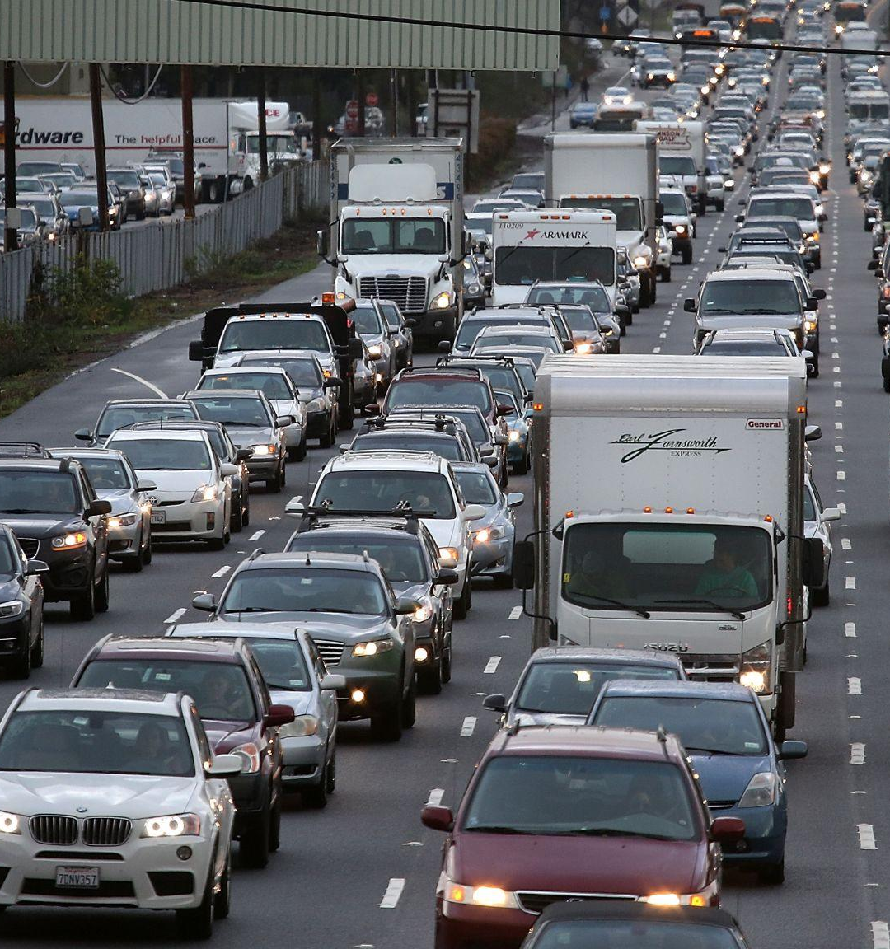
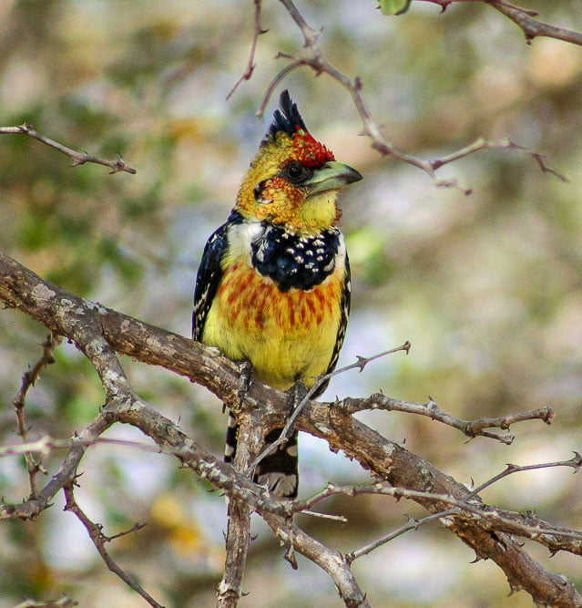
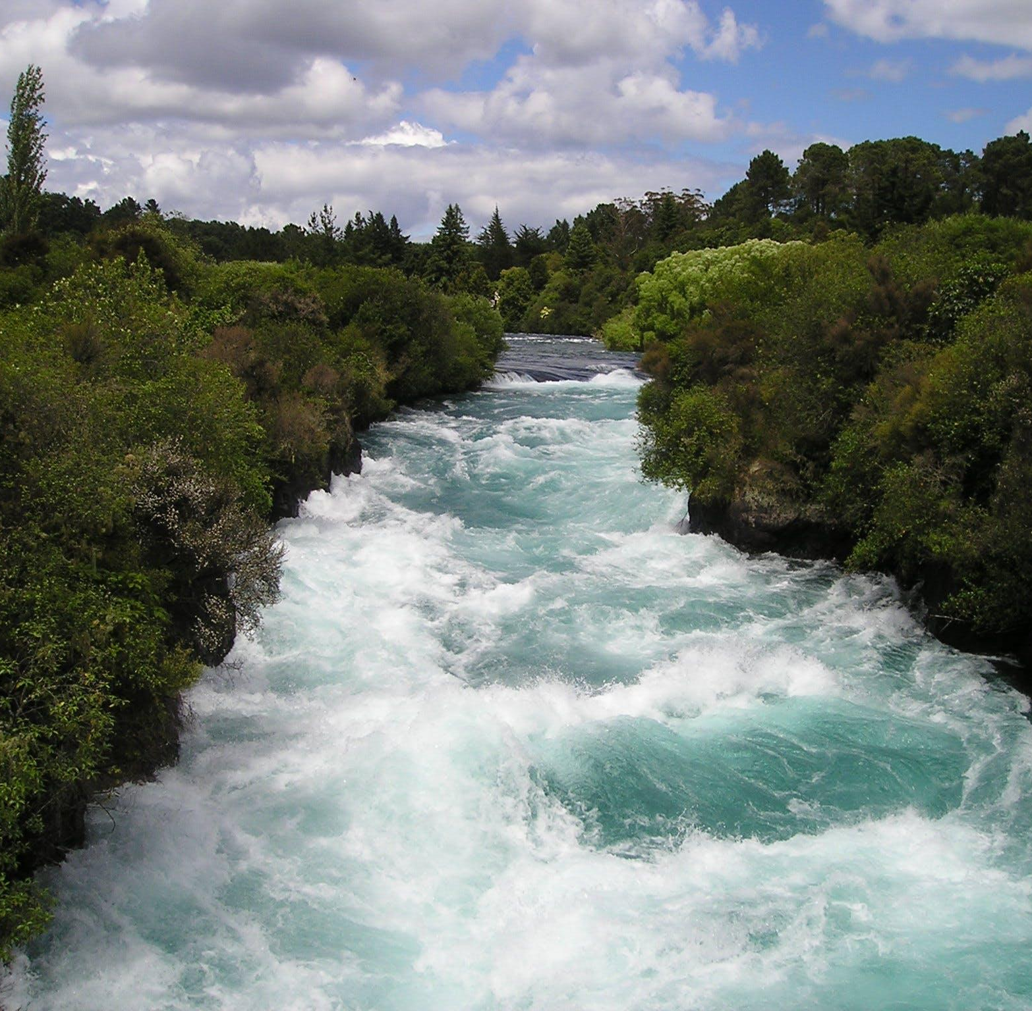
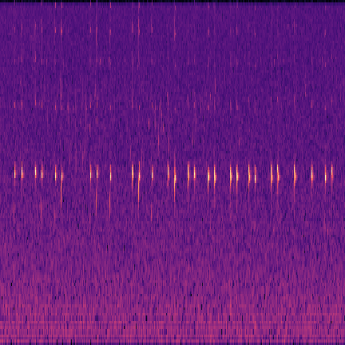
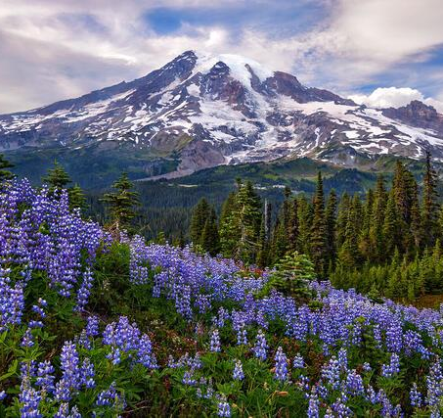
Introduction: Background (cont.)
The categories being classified by the CNN are:
Anthropophony
Cars, airplanes, human voices, etc.
Biophony
Birds, insects, mammals, amphibians, etc.
Geophony
Wind, rain, water in streams, etc.
Interference
Error in recording
Quiet
Absence of Sound

Slide 4
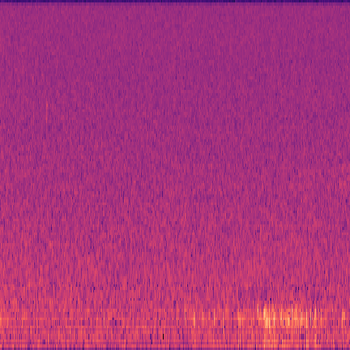
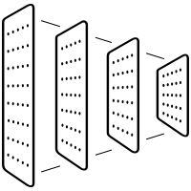
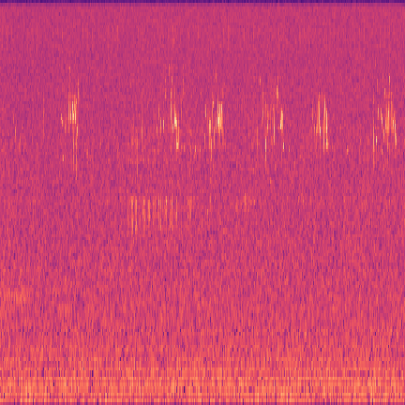
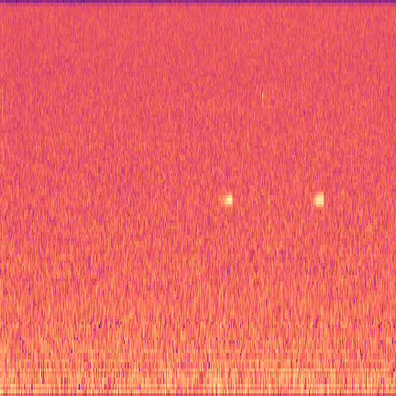
Introduction: Our Problem
We have a CNN trained and tested on old Sonoma County data
Now with new data from South Africa, is our CNN still effective?
Can we make improvements?
What kind of analysis can we use to compare the old model to a new and improved model?
Input: Spectrogram images from wav files
CNN(Old Model)
MobileNetV2
% of Anthropophony
% of Biophony
% of Geophony
% of Interference
% of Quiet
Classification
Notes:
In this section, you need to give a brief overview and your understanding of the problem. Summarize in your own words what you were trying to achieve with your project. What was the scope of your tasks? What was the dataset employed? What were the results obtained? Often, this is the most important section that gets the attention of the reader and encourages them to dive further into the report. Figures come very handy to convey ideas - so use them liberally and refer to them in text. In other words, if there is a figure in your report but it is not referenced anywhere, the reader has no idea of its context.

Slide 5
Introduction: Our Problem (cont.)
The old model utilizes labeled data at a 2 second level
Each piece of data is a separate 1 min. wav file, and these wav files are broken down into 2 second intervals
The old data used to train the old model was labeled at a 2 second level
The new data is not labeled at a 2 second level
The only labels we have are at a 1 min. level, which means we can’t fine tune the old model on the new data.
This means we need to get creative in order to improve classification on the new data without the ability to relying on using that new data.

Slide 6
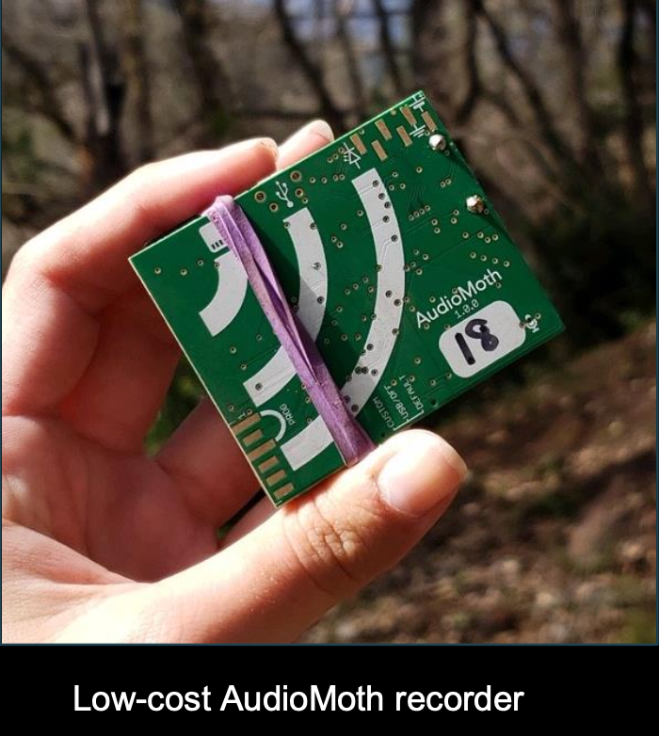
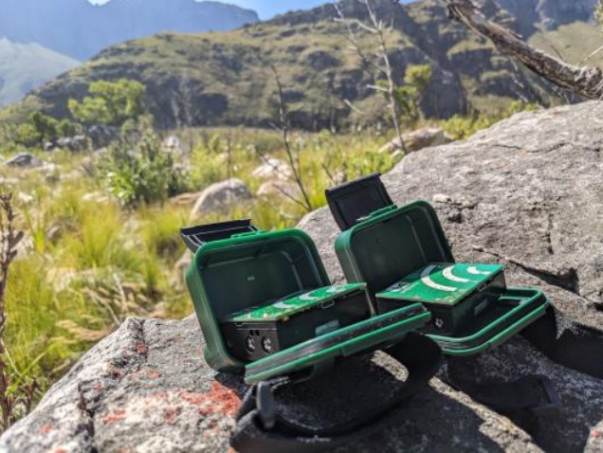
Introduction: Data Collection
Old Data:
Came from Sonoma County
Old model was trained on labeled wav files that were broken down into 2 second intervals.
New Data:
Came from South Africa
The old model was not trained on any of this new data
New dataset recorded differently
Problem: Only 1 min labeled data and no labeled data on the Quiet class

Slide 7
Introduction: Results of Old Model w/New Data
New 1 min WAV files from South Africa were ran through the old model
30 2 sec melspecs were generated for each WAV file
A respective CSV was generated with predictions for each melspec
Predictions were accurate for some, but not all categories

Slide 8
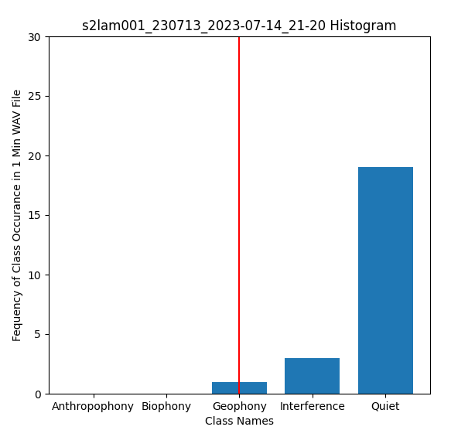
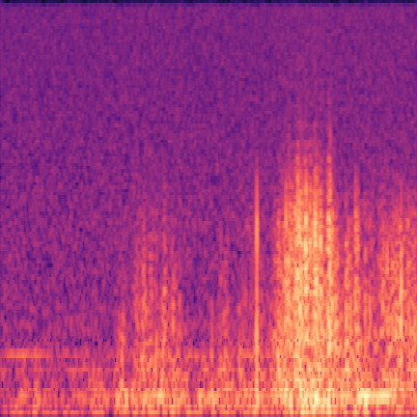
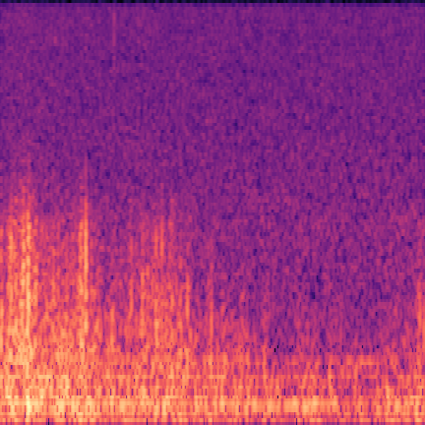
Introduction: Results of Old Model w/New Data (cont.)
Wind was accurately predicted in the last 4 seconds

Slide 9
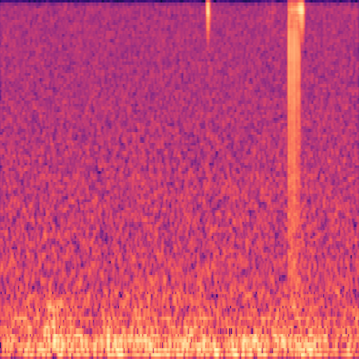
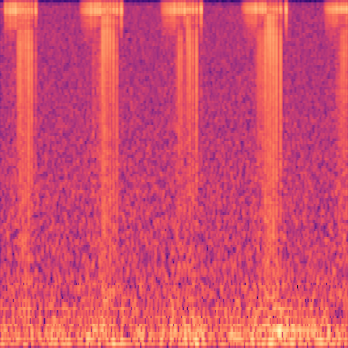
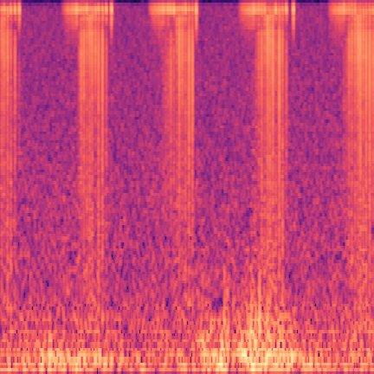
Introduction: Results of Old Model w/New Data (cont.)
We think there was interference starting at 0:25, but it was not labeled
The old model was able to predict in 24.png, but once it started repeating, the model was unsure of what it was predicting until 32.png

Slide 10
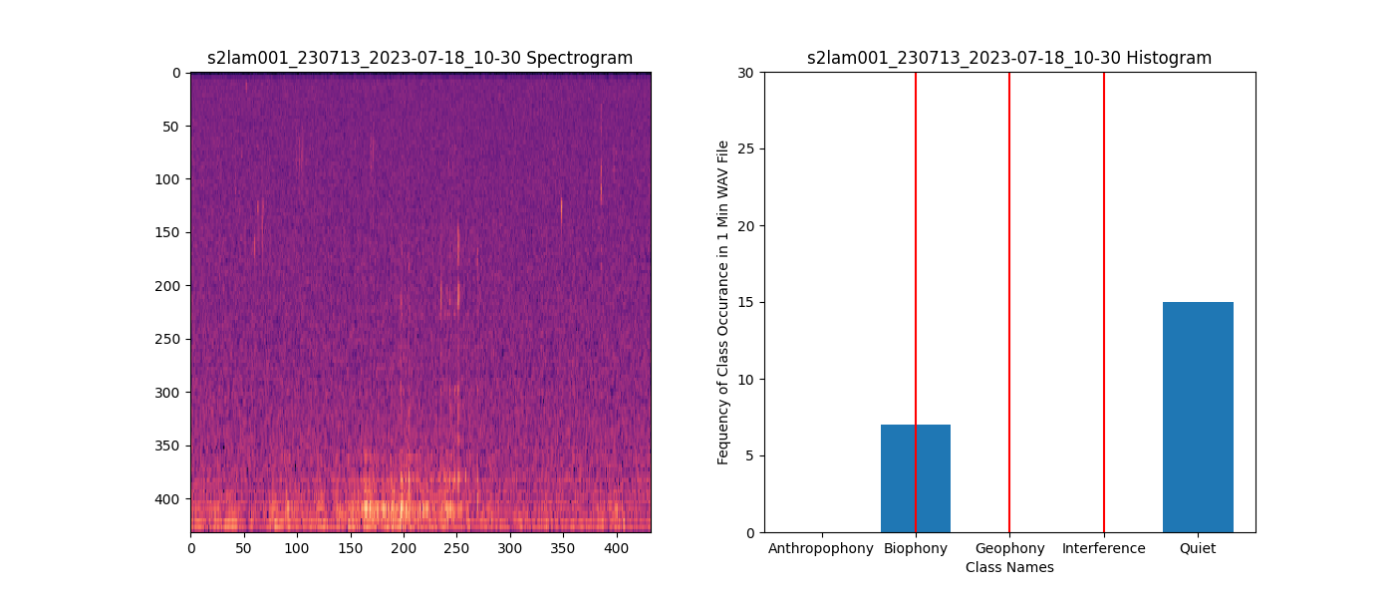
Introduction: Results of Old Model w/New Data (cont.)
Biophony was accurately detected, but geophony (rain) and interference was not detected all

Slide 11
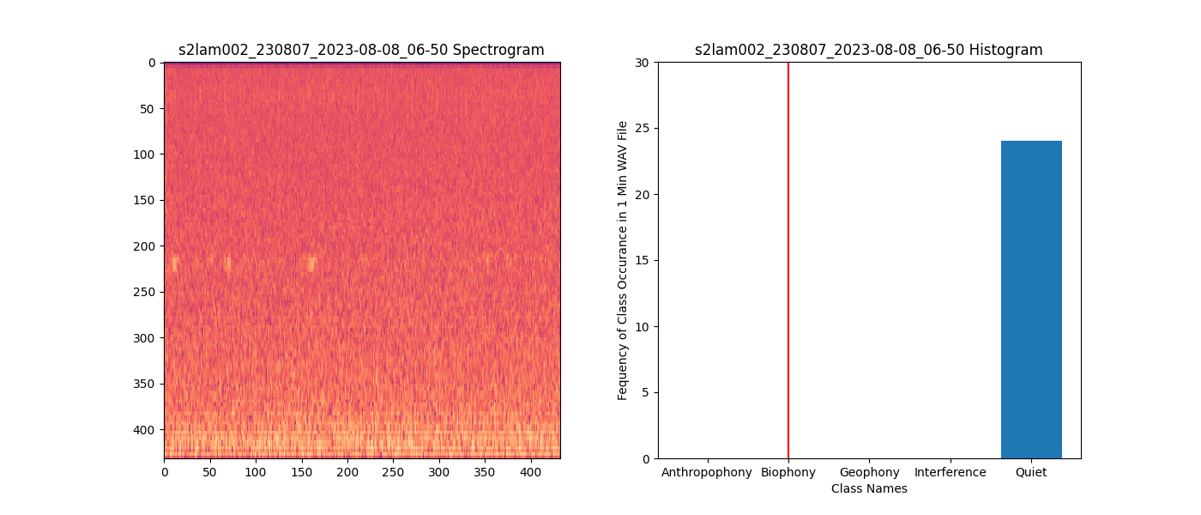
Introduction: Results of Old Model w/New Data (cont.)
This WAV file contains amphibians, but the old model is not trained to detect it

Slide 12
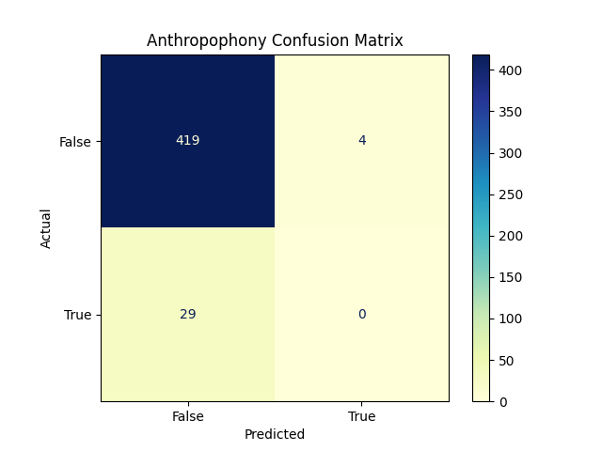
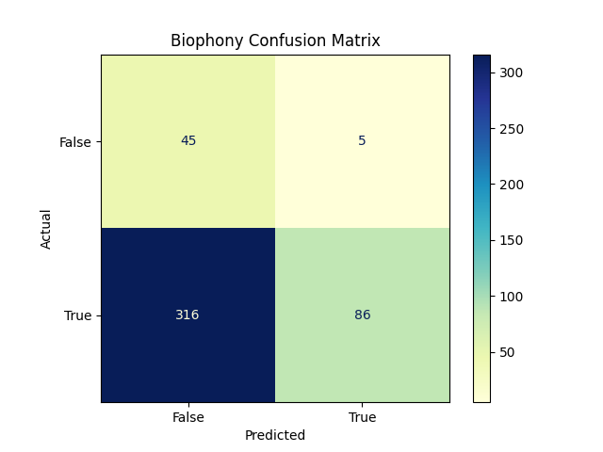
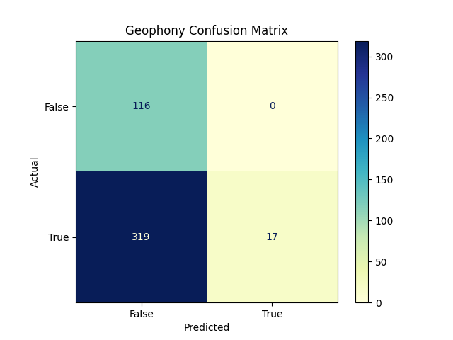
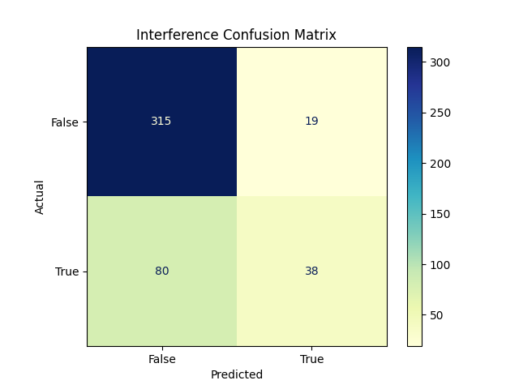
Introduction: Results of Old Model w/New Data (cont.)
As seen below, the old model definitely needs to be improved
Using class specific thresholds:
Anthropophony = 0.74
Biophony = 0.4
Geophony = 0.83
Interference = 0.17
Quiet = 0.83

Slide 13
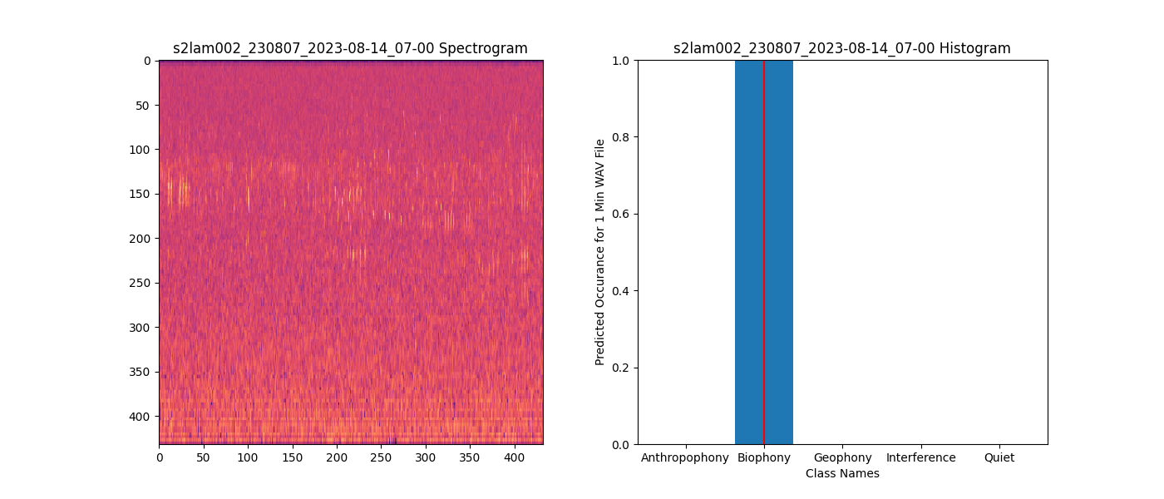
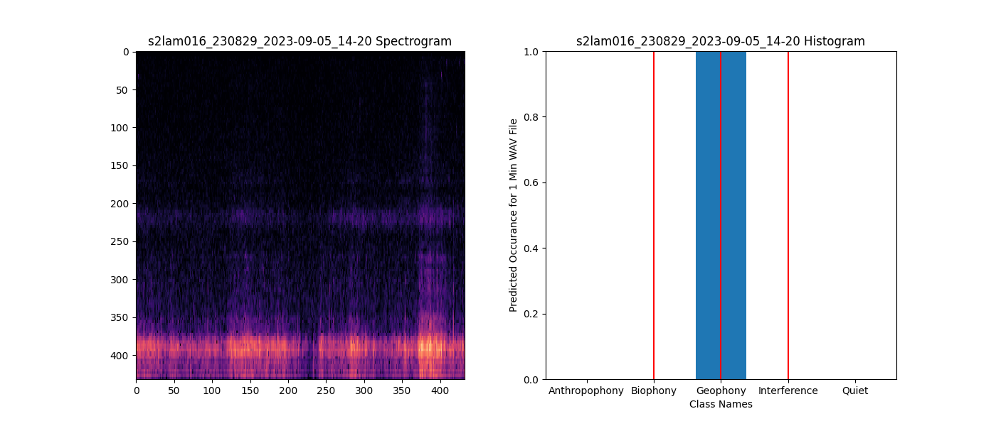
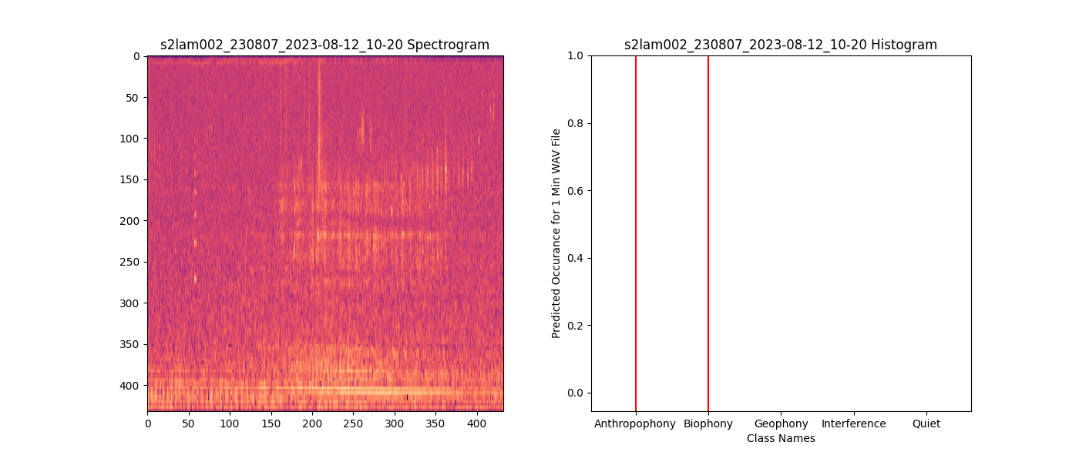
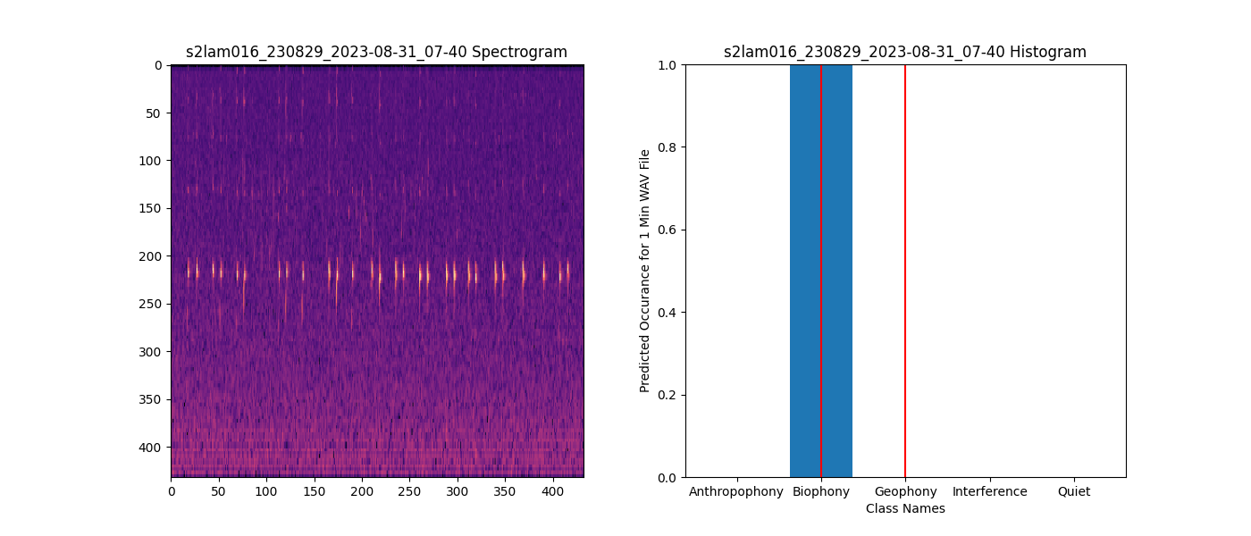
Introduction: Results of Old Model w/New Data (cont.)
Examples of Histograms for individual data samples (1 min. wav files)

Slide 14
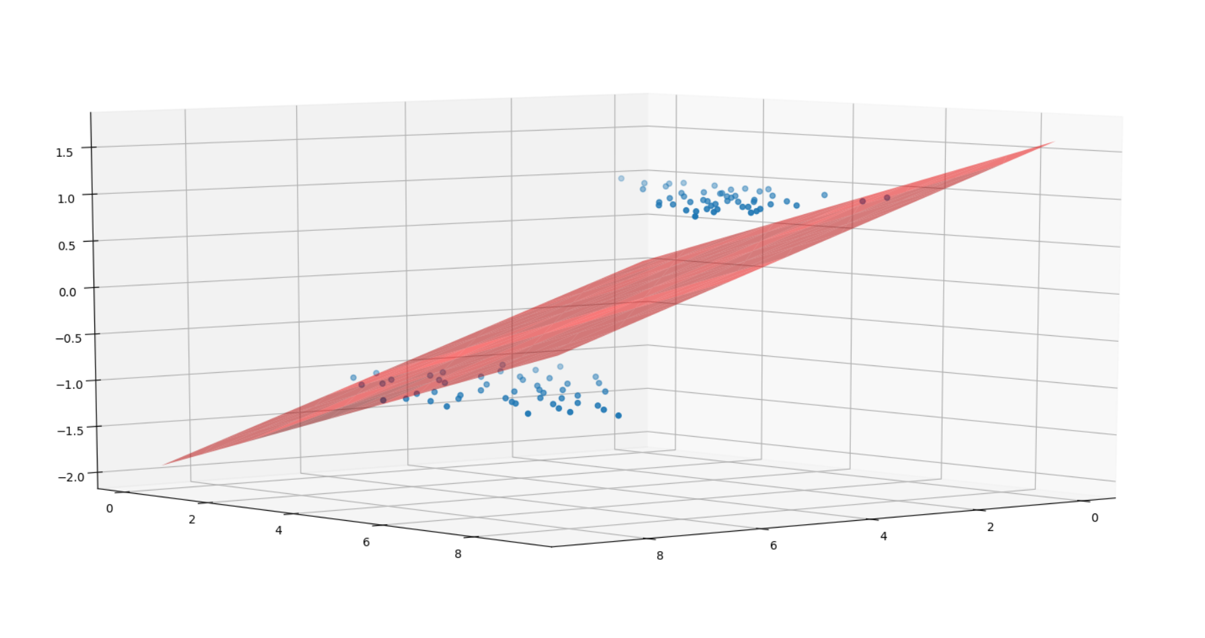
Approach/Algorithm: New Model, with SVMs
Without a lot of training data, we needed to find a better way to improve the old model.
So, instead we tried to use the old CNN as a feature extractor, and then we used an SVM classifier to hopefully improve our results with the new data.
Input: Spectrogram images from wav files
CNN(Old Model)
MobileNetV2
SVM Classifier
Feature Extraction
% of Anthropophony
% of Biophony
% of Geophony
% of Interference
Classification
Notes:
In this section, give a brief description of the algorithm that you implemented. Instead of simply copying from the original paper/web links/videos, you need to describe your understanding of the algorithm in your own words. I encourage you to employ intermediate results obtained by your implementation to convey the different steps of the algorithm. This is also the place to present the design decisions you had to make ( How did you set any parameters used in the code? Did you make any extension to the original algorithm? etc.).

Slide 15
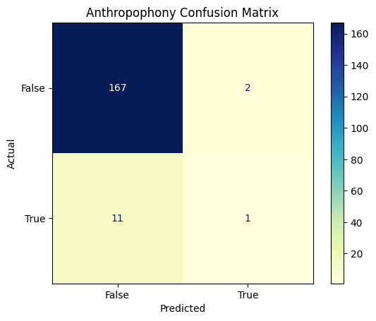
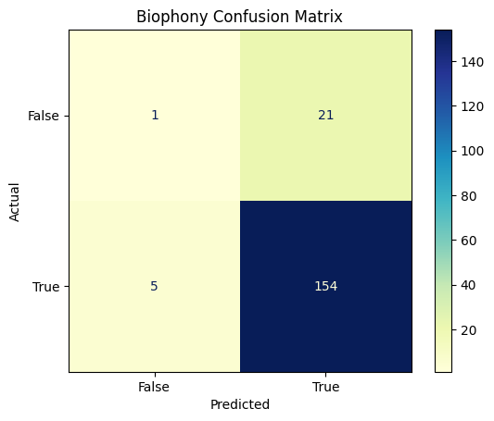
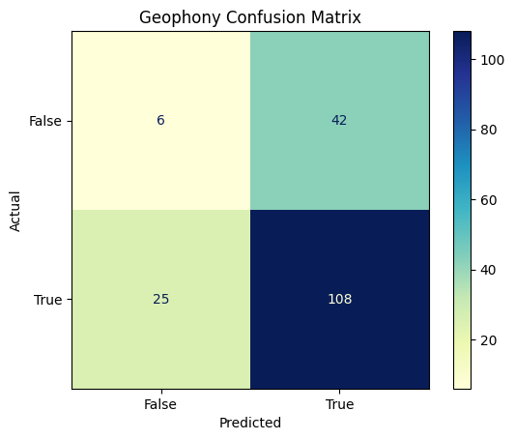
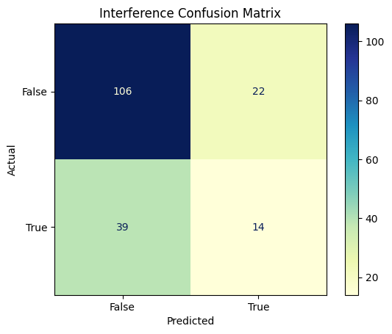
Results: Old Model w/SVMs
Needed multi-labeled wav files, so we created a different SVM for each label
Total class accuracies:
Anthropophony: ~94.48%
Biophony: ~87.29%
Geophony: ~63.54%
Interference: ~68.51%
Notes:
Use this section to give both quantitative and qualitative results of your approach. For qualitative results, please pick some images and show your results on them. It is encouraged to give insights about why your method does well on some images, but poorly on other images. Show pictures of intermediate and final results that convince me (and you) that the program does what you intended it to do. For quantitative results, you need to generate numbers (accuracy, confusion matrix, etc.) and curves (ROC/RPC) that evaluate the performance of your implementation. You can vary some of the parameters or change some components of your method and compare the performance of different settings.

Slide 16
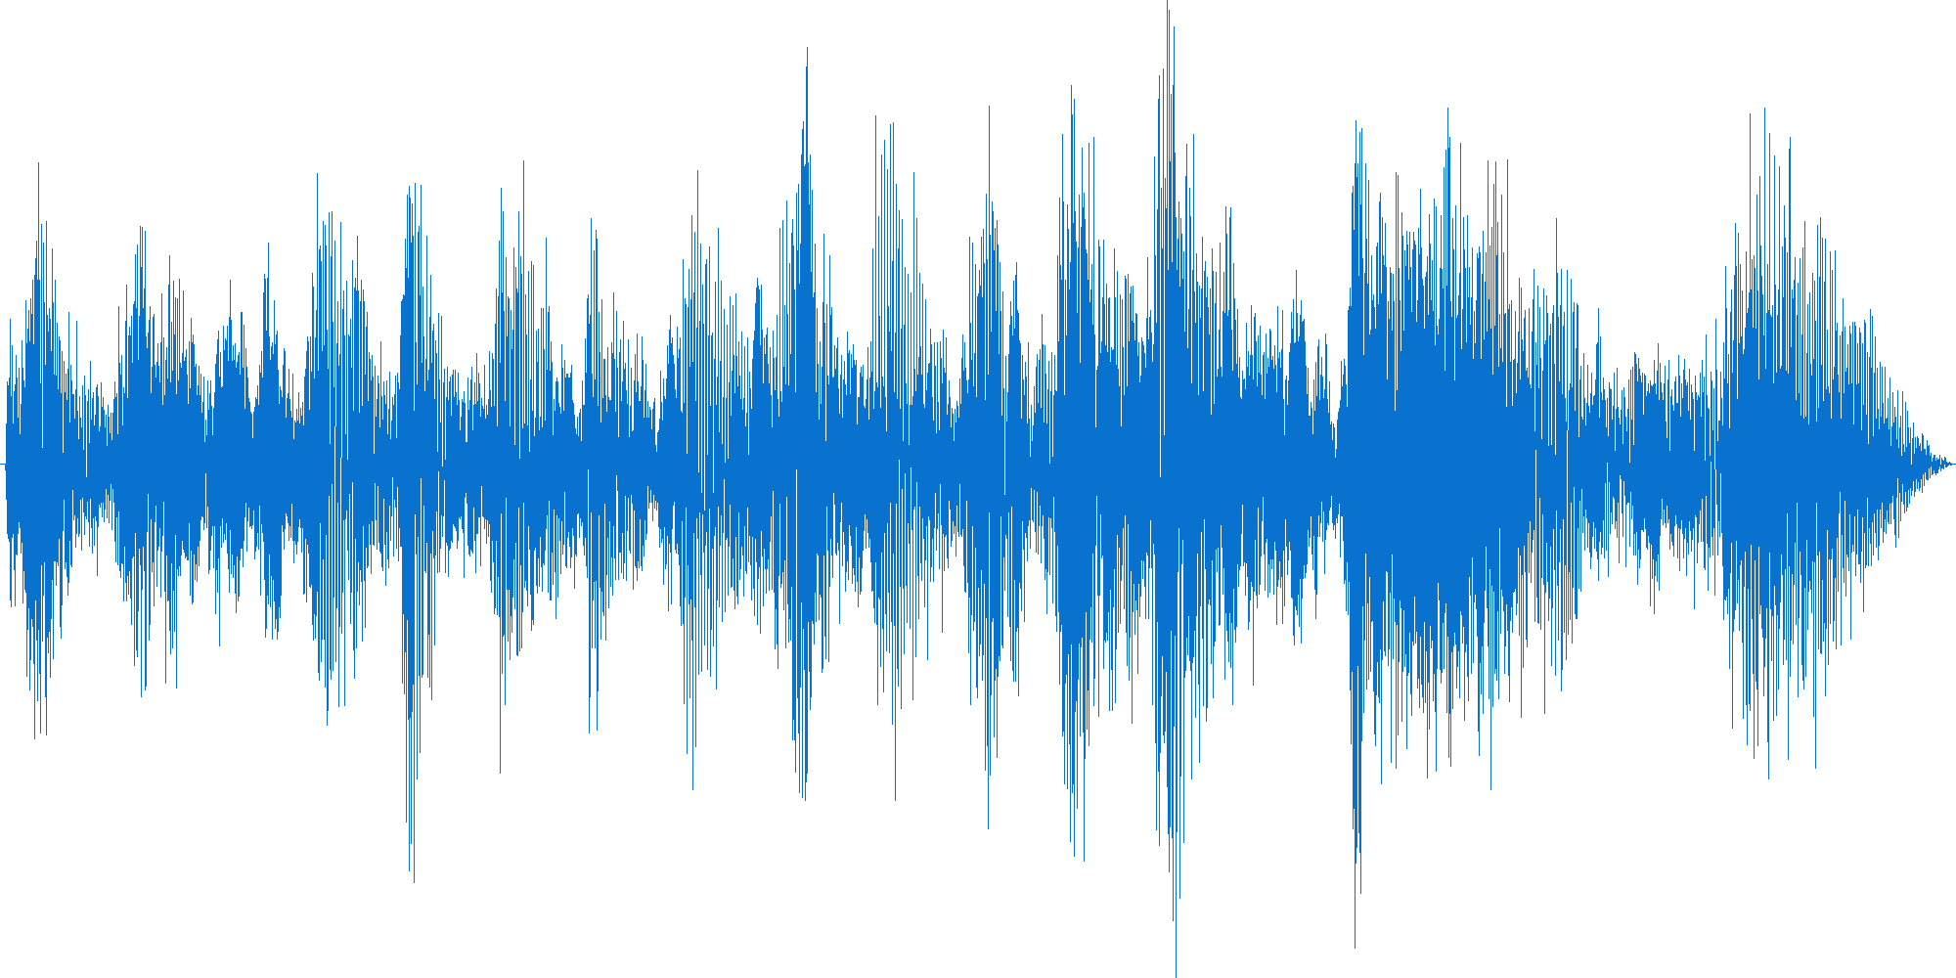
Approach/Algorithm: YAMNet Model
We could also try with a new model, pre-trained on other data, and see how well we could do there.
The YAMNet model is a deep net that predicts 521 audio event classes from the AudioSet-YouTube corpus. It employs the Mobilenet_v1 depthwise-separable convolution architecture.
The goal is to see if we can still achieve high accuracy without the need to train - using our limited data.
Input: 1 min wav files
CNN
YAMNet Model
Our Output Layer
With 4 classes
% of Anthropophony
% of Biophony
% of Geophony
% of Interference
Classification
Notes:
YAMNet Model TF: https://www.tensorflow.org/hub/tutorials/yamnet

Slide 17
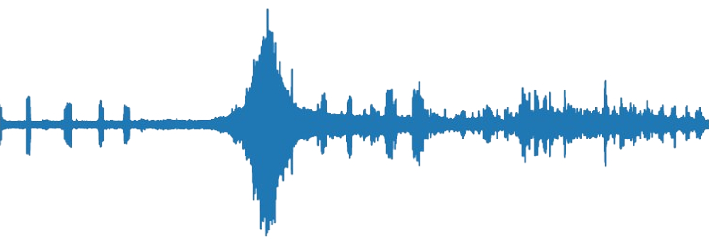
Results: YAMNet - Single File Predictions
1 minute wav file as input
1 classification per 0.5 seconds

Slide 18
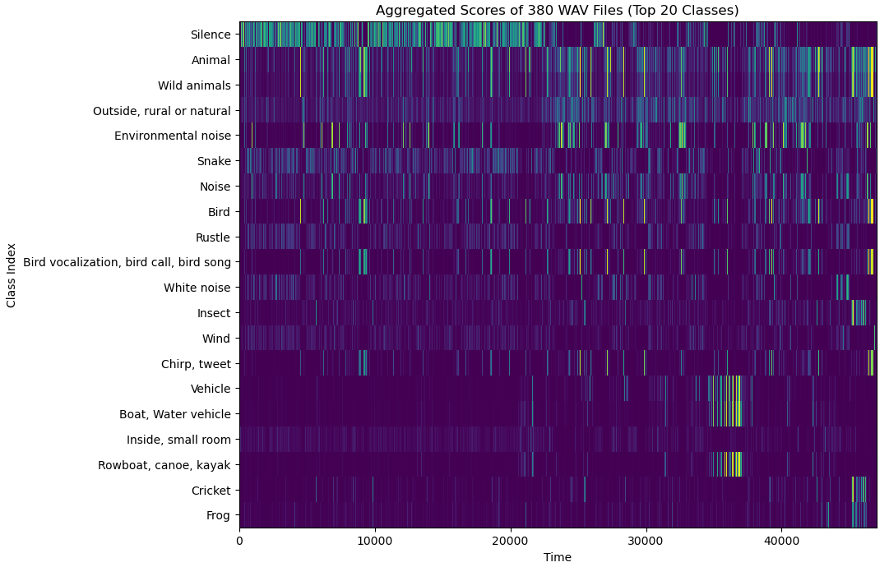
Results: YAMNet - 380 File Predictions
Without Noise Reduction

Slide 19
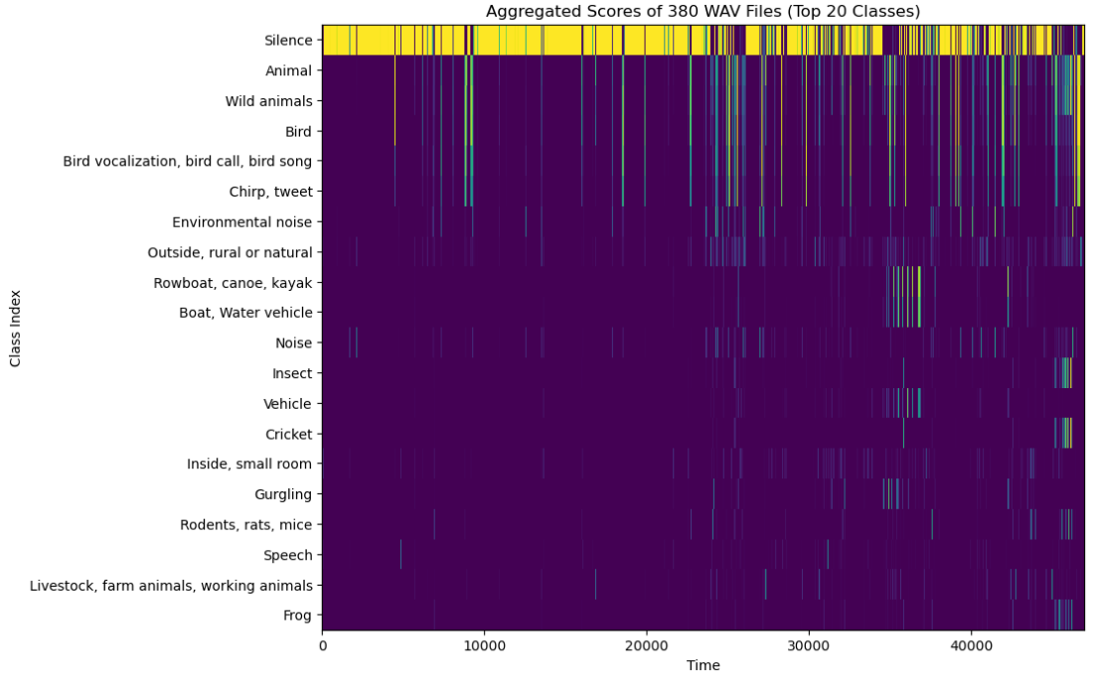
Results: YAMNet - 380 File Predictions
With Noise Reduction

Slide 20
Discussion and Conclusion
Old Model:
Worked well with Sonoma County data but, not with the new data.
Old model with SVM classifier:
Even with a lack of data to train our SVM classifier, the results were surprisingly promising. The overall accuracies for the main 4 classes, even at a 1 minute level, were much higher than the original model.
YAMNet model:
The pre-trained model gave promising results. These results can likely be improved by fine-tuning the model and training it on custom data.
Notes:
In this section, you provide any concluding remarks. Reflect if, in hindsight, your approach to the problem was successful? Were there some problem areas that arose which would lead you to make different design choices if you had to do this all over again from scratch?

Slide 21
Our Code:
Main code of interest:
Old model as Feature extractor with added SVM classifiers
CNN_inference_with_SVM_Classifier.ipynb
YAMNet Model
YAMNet-TL-NR.ipynb
Python script for creating histograms and confusion matrices for model comparison
Histogram_With_Confusion_Matrix_Creation.ipynb

Slide 22
References
API Reference — Matplotlib 3.8.2 documentation. (n.d.). Matplotlib — Visualization with Python.
https://matplotlib.org/stable/api/index.html
API reference — pandas 2.1.4 documentation. (n.d.). pandas - Python Data Analysis Library.
https://pandas.pydata.org/docs/reference/index.html
Arbimon - Projects. (n.d.). Arbimon - Projects. https://arbimon.rfcx.org/
Build your First Multi-Label Image Classification Model in Python. (n.d.). Analytics Vidhya.
https://www.analyticsvidhya.com/blog/2019/04/build-first-multi-label-image-classification-model-python/
Python Machine Learning - Confusion Matrix. (n.d.). W3Schools Online Web Tutorials.
https://www.w3schools.com/python/python_ml_confusion_matrix.asp
Quinn, C. A., Burns, P., Gill, G., Baligar, S., Snyder, R. L., Salas, L., Goetz, S. J., & Clark, M. L. (2022). Soundscape
classification with convolutional neural networks reveals temporal and geographic patterns in eco-acoustic data. Ecological Indicators, 138, 108831. https://doi.org/10.1016/j.ecolind.2022.108831
Sound classification with YAMNet | TensorFlow Hub. (n.d.). TensorFlow.
https://www.tensorflow.org/hub/tutorials/yamnet
WeiXiong. (2019, June 20). Feature extraction (ResNet50) + SVM. Kaggle: Your Machine Learning and Data
Science Community. https://www.kaggle.com/code/winnie19900705/feature-extraction-resnet50-svm

