Slide 1
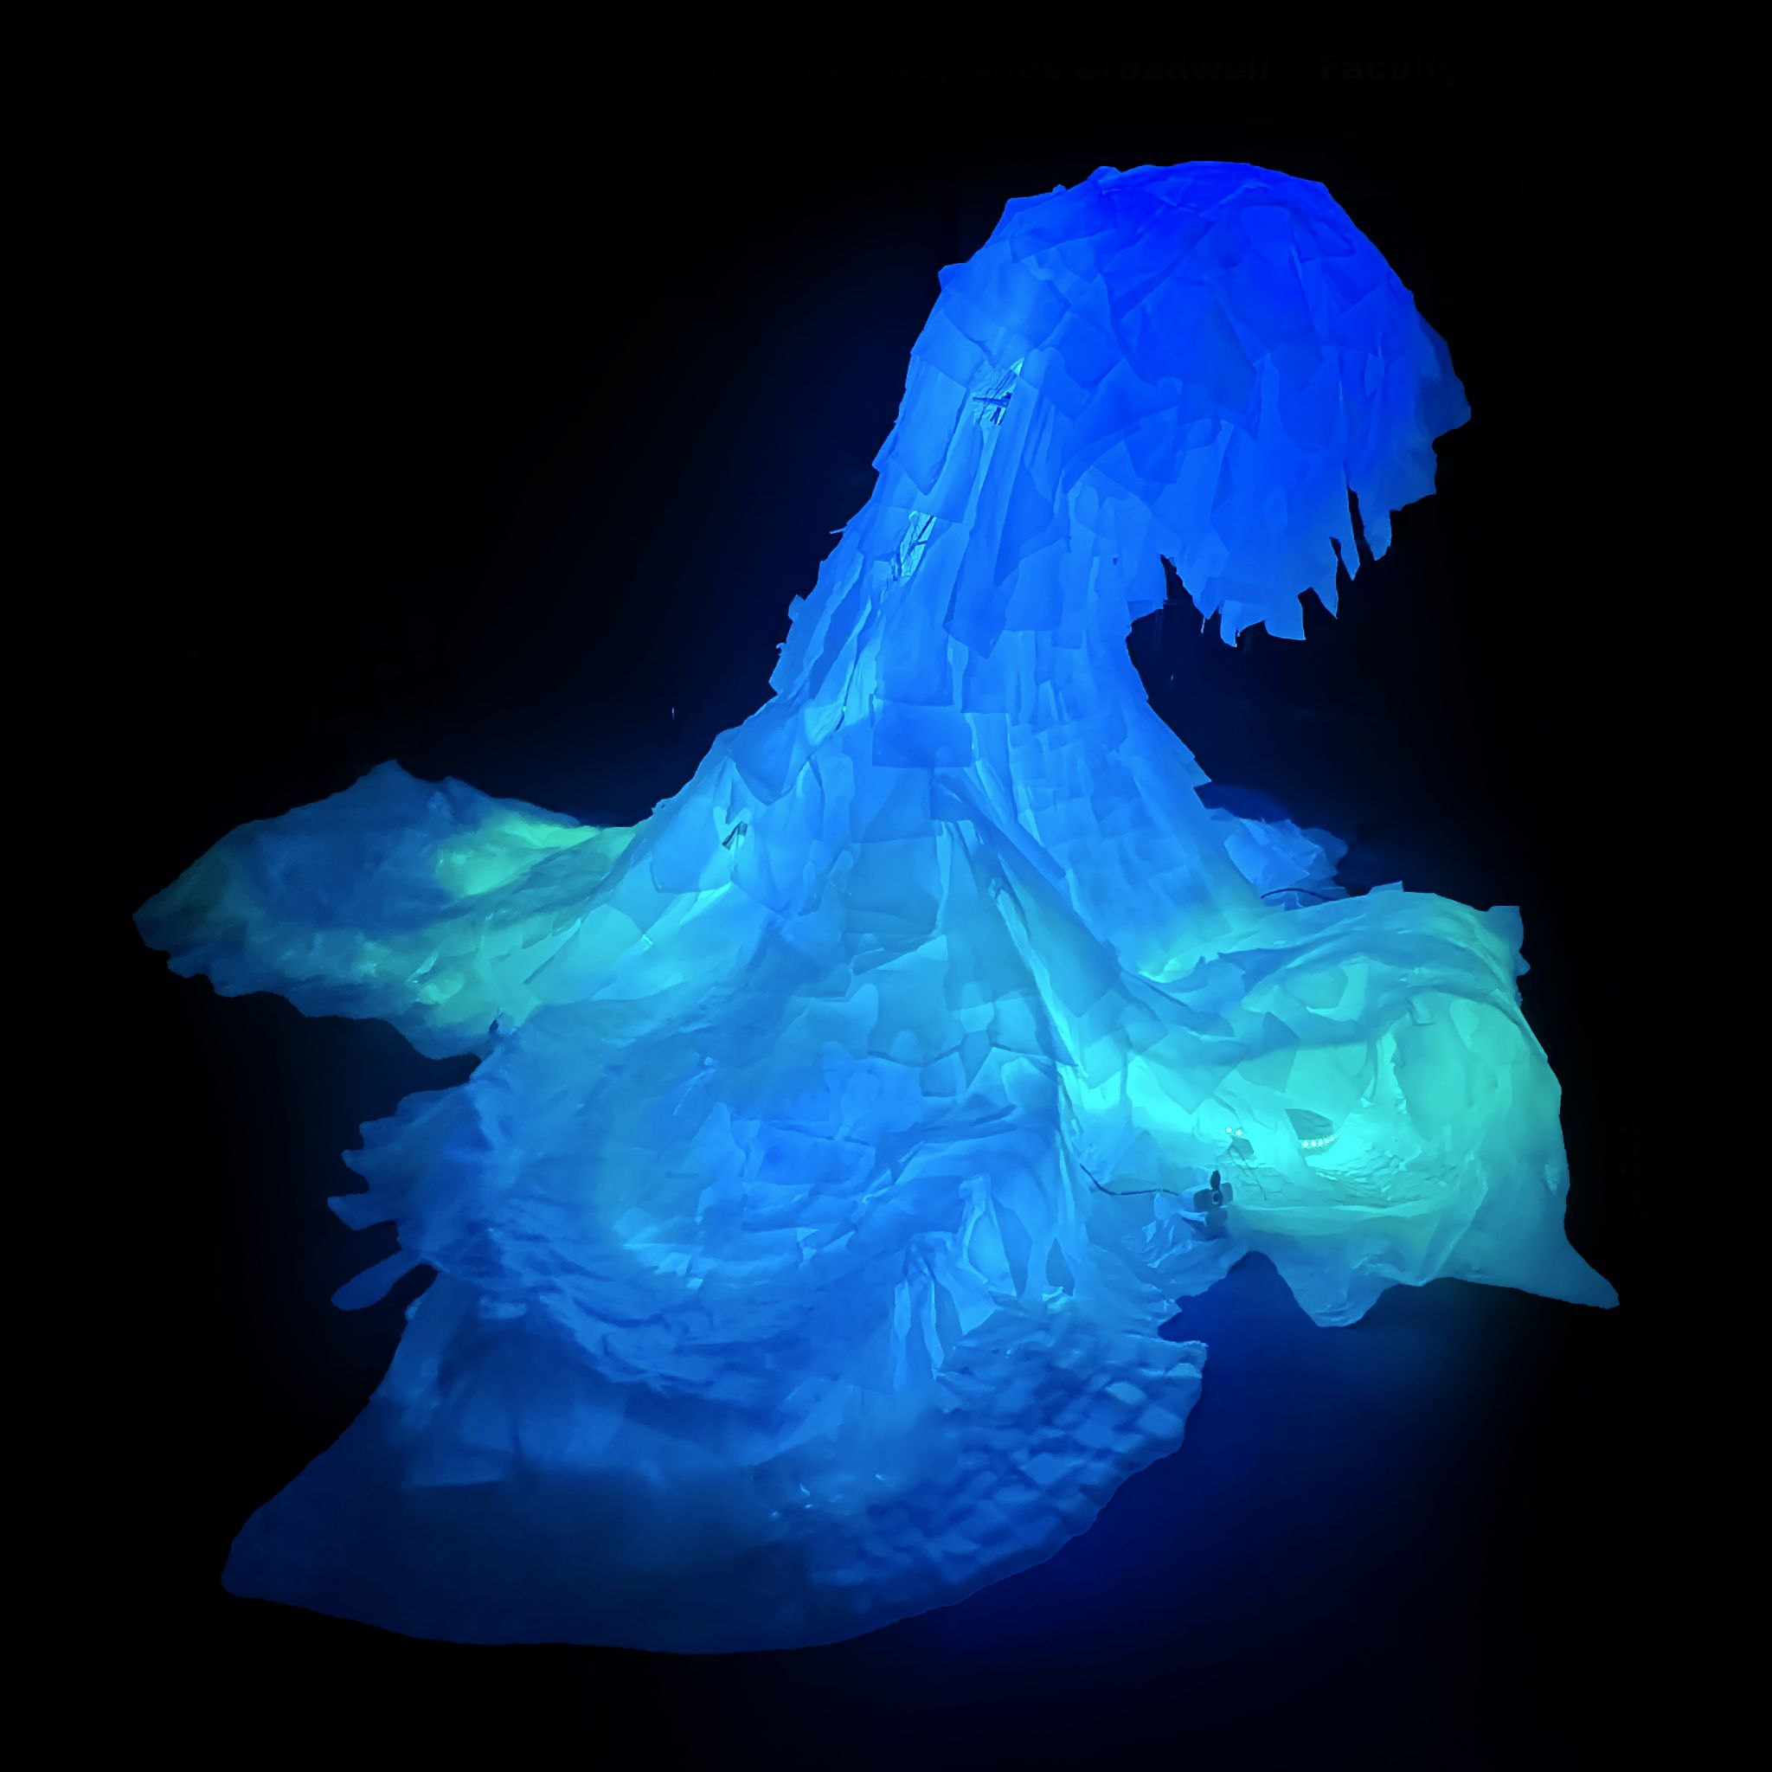
“Plasticola”
(Part 2)
Eduardo Camacho

Slide 2
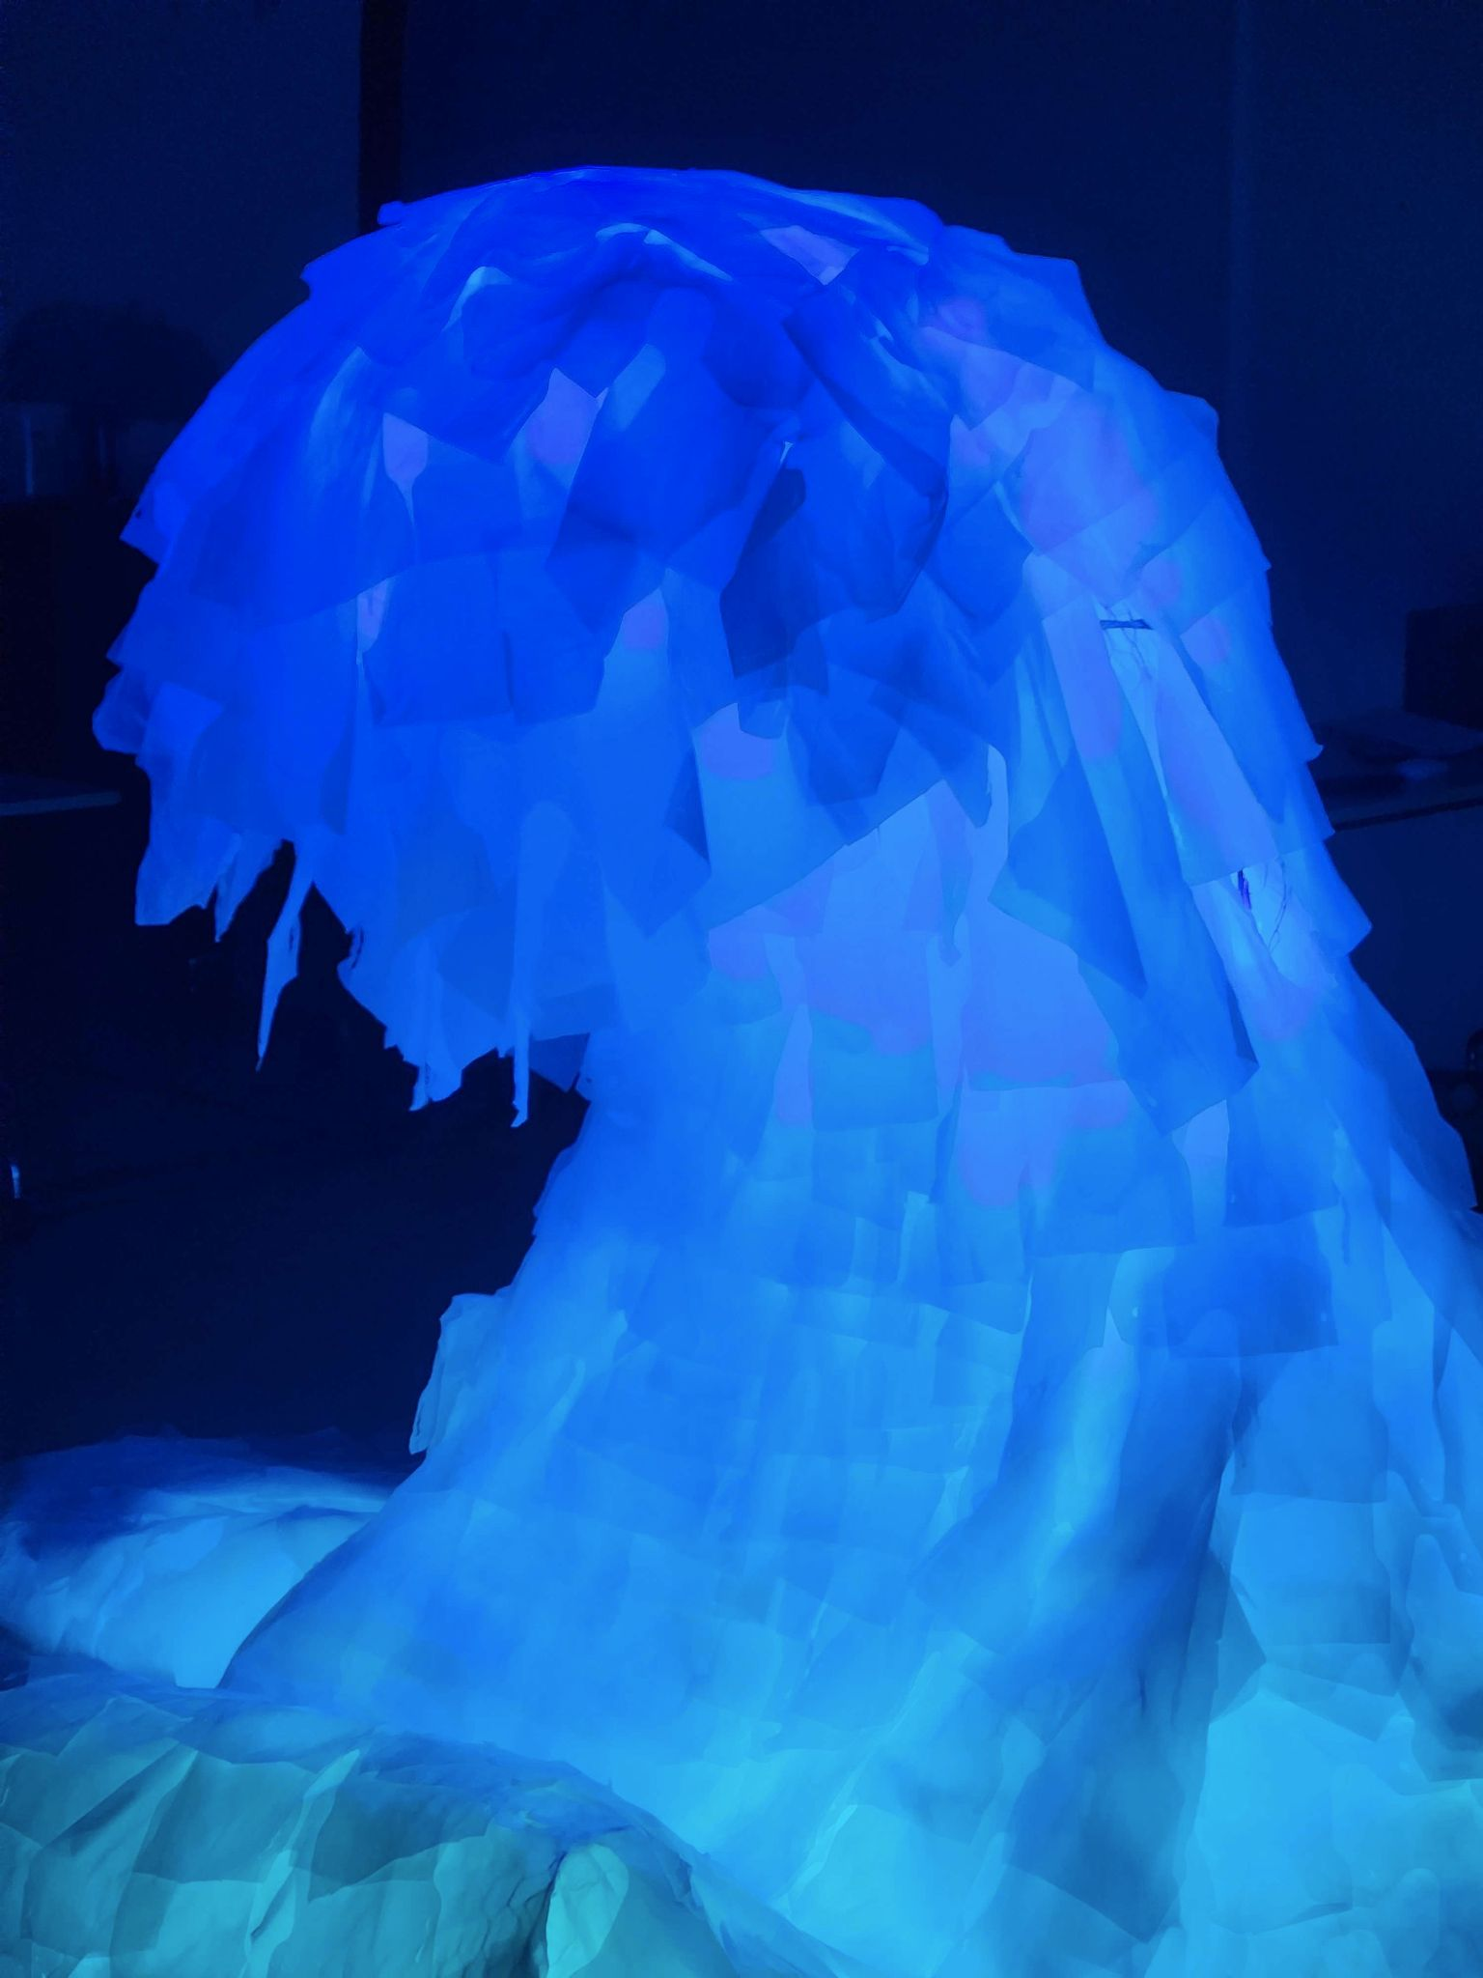
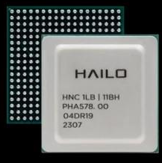
Last time we Presented:
Upgraded Cameras
→ →
Add “AI HAT (Hailo-8 Accelerator)”
+ =
Larger FOV)
Better edge clarity at night
Higher resolution
Enables better inference speeds and performance (better models)
More responsive detections

Slide 3
What’s New (or different!):
Changed Cameras Again! (IMX462 → IMX708)
→
Added Plastic (3 layers)
New Multiplexer (HAT on top) Doesn’t support IMX462
Large lens rubs up against the plastic

Slide 4
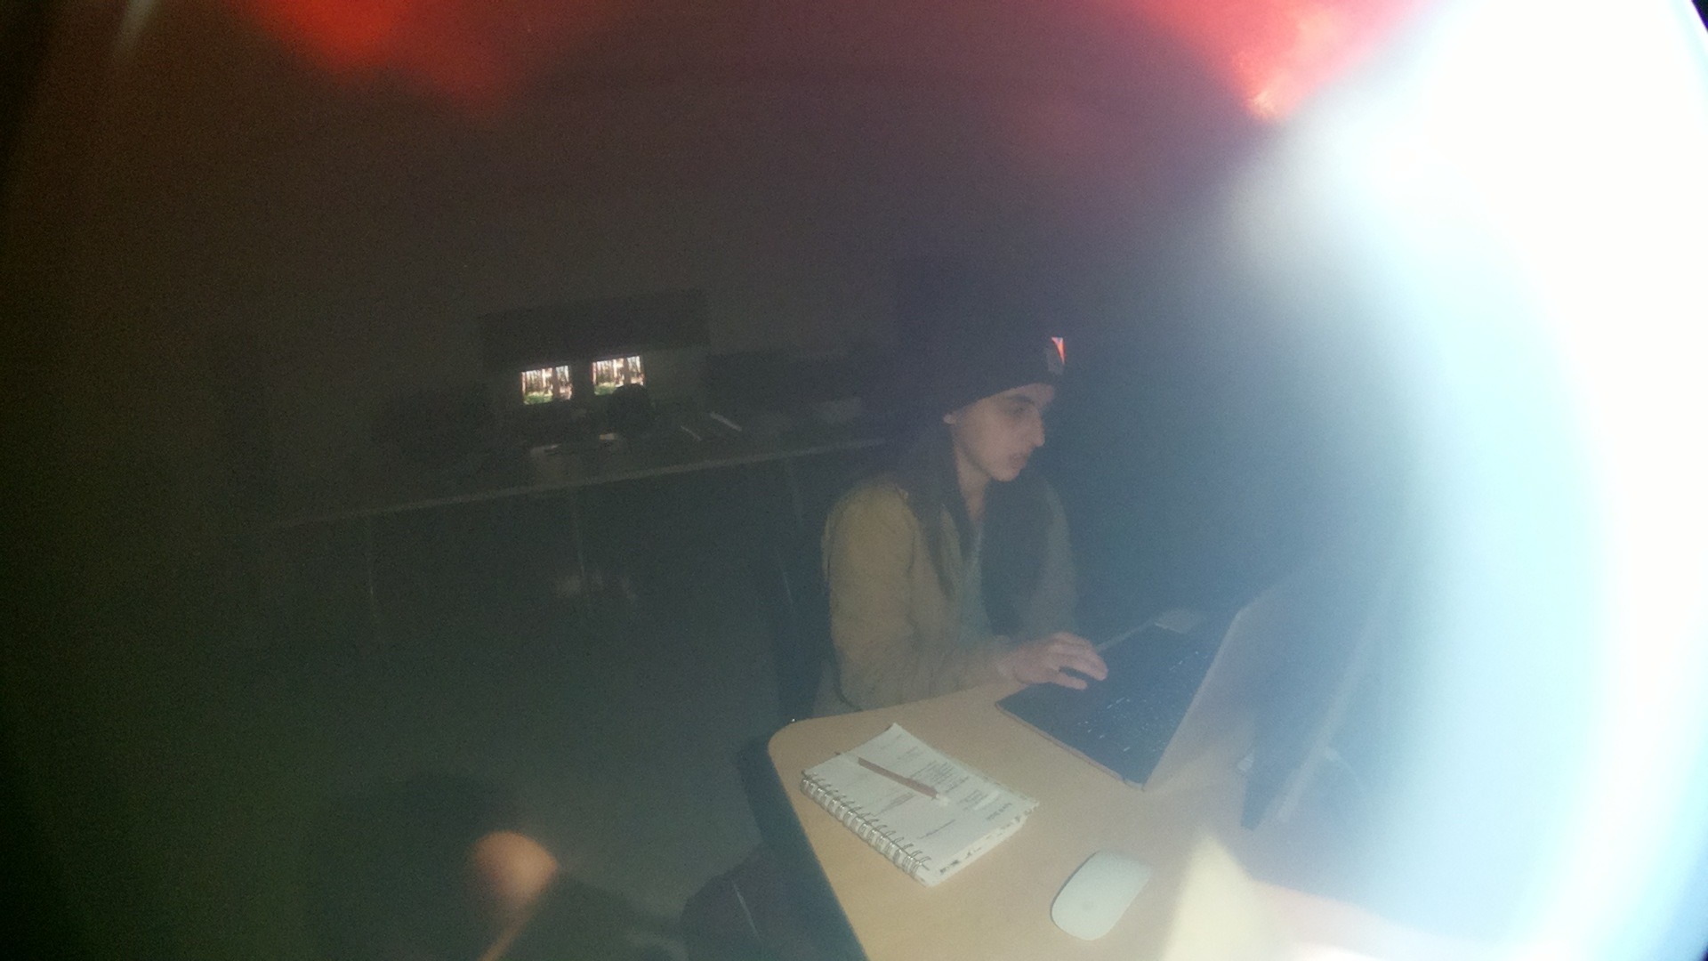
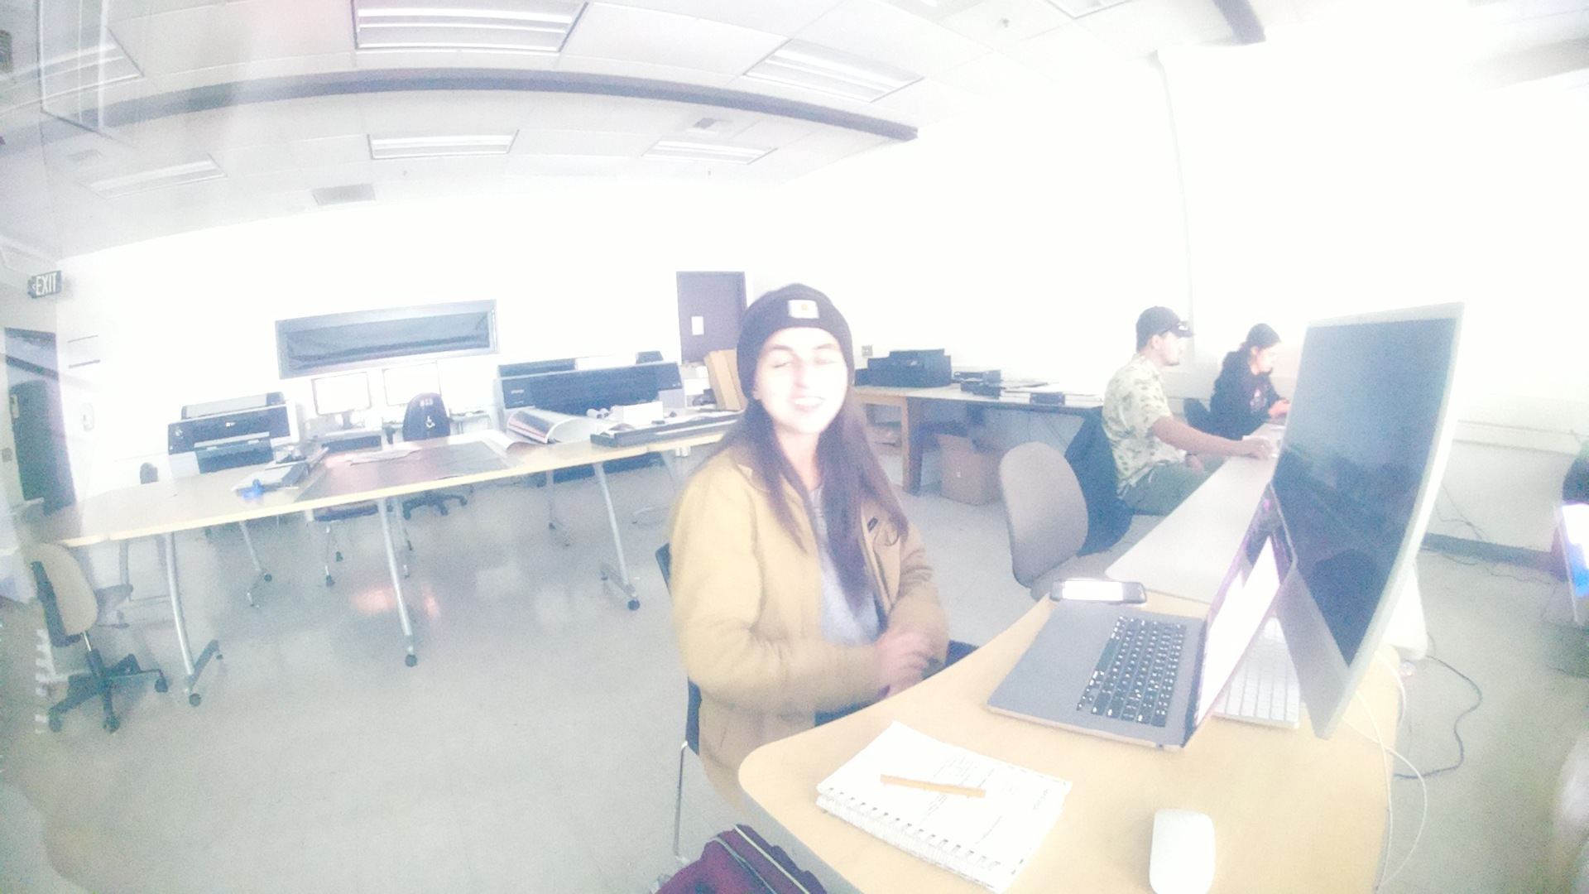
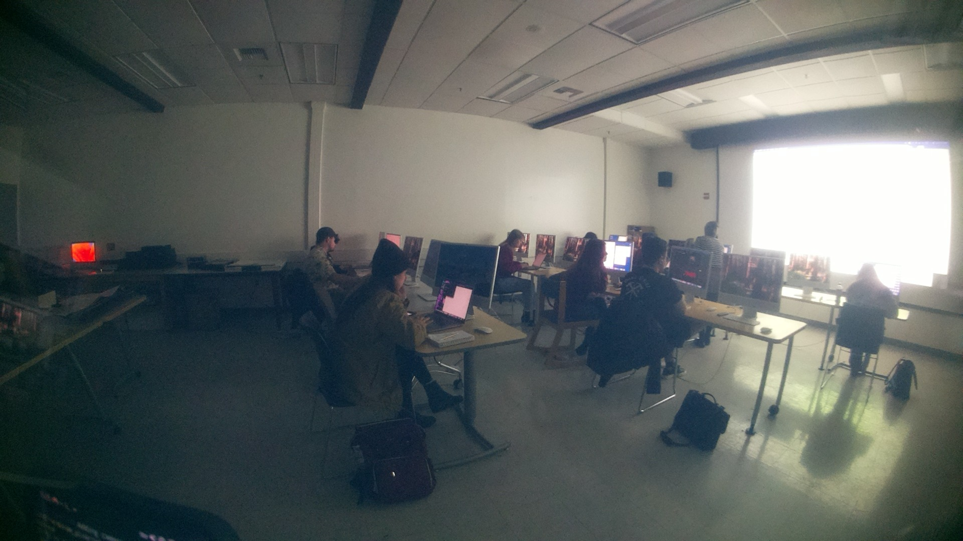
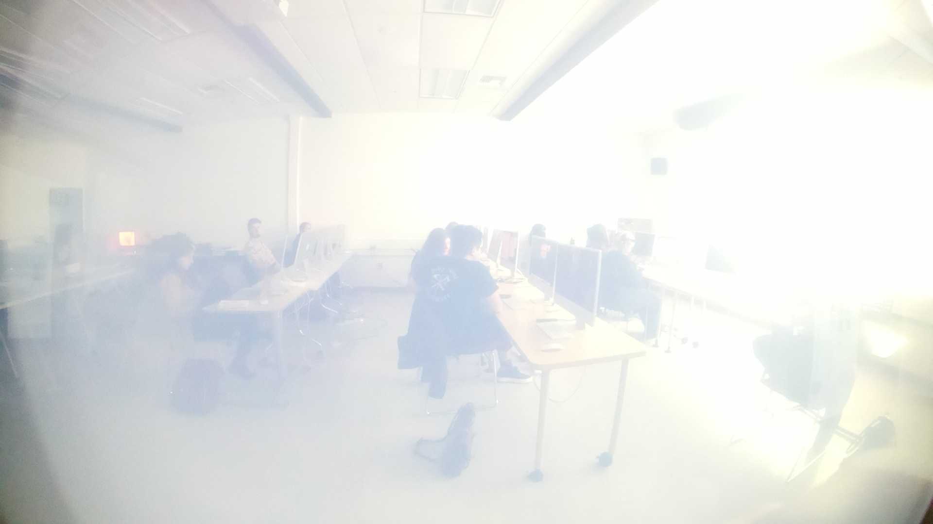
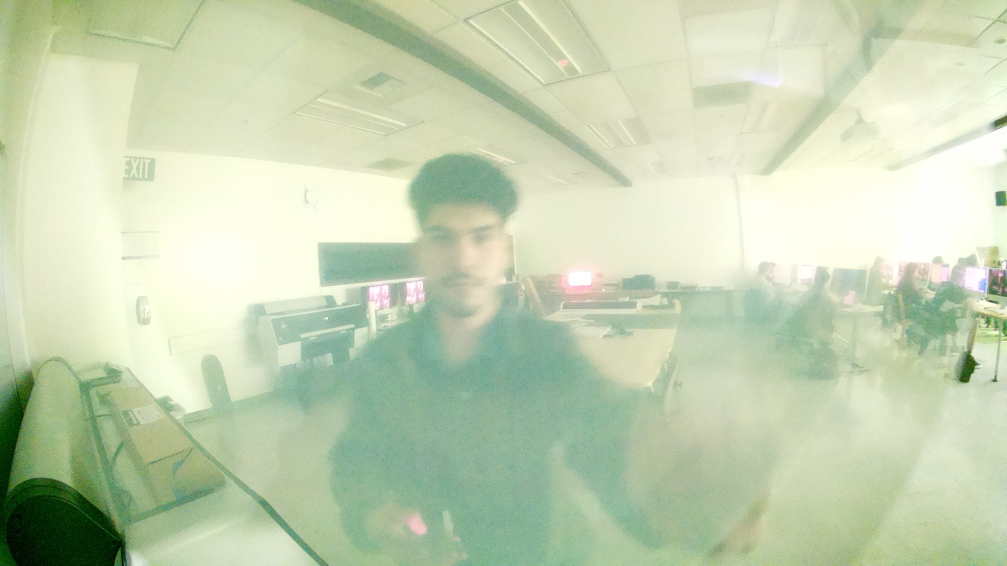
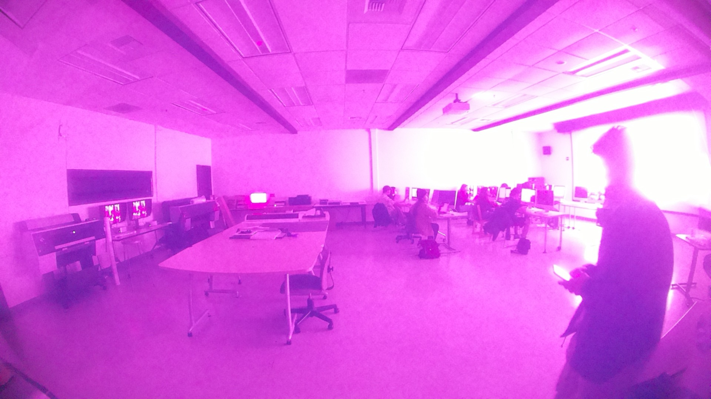
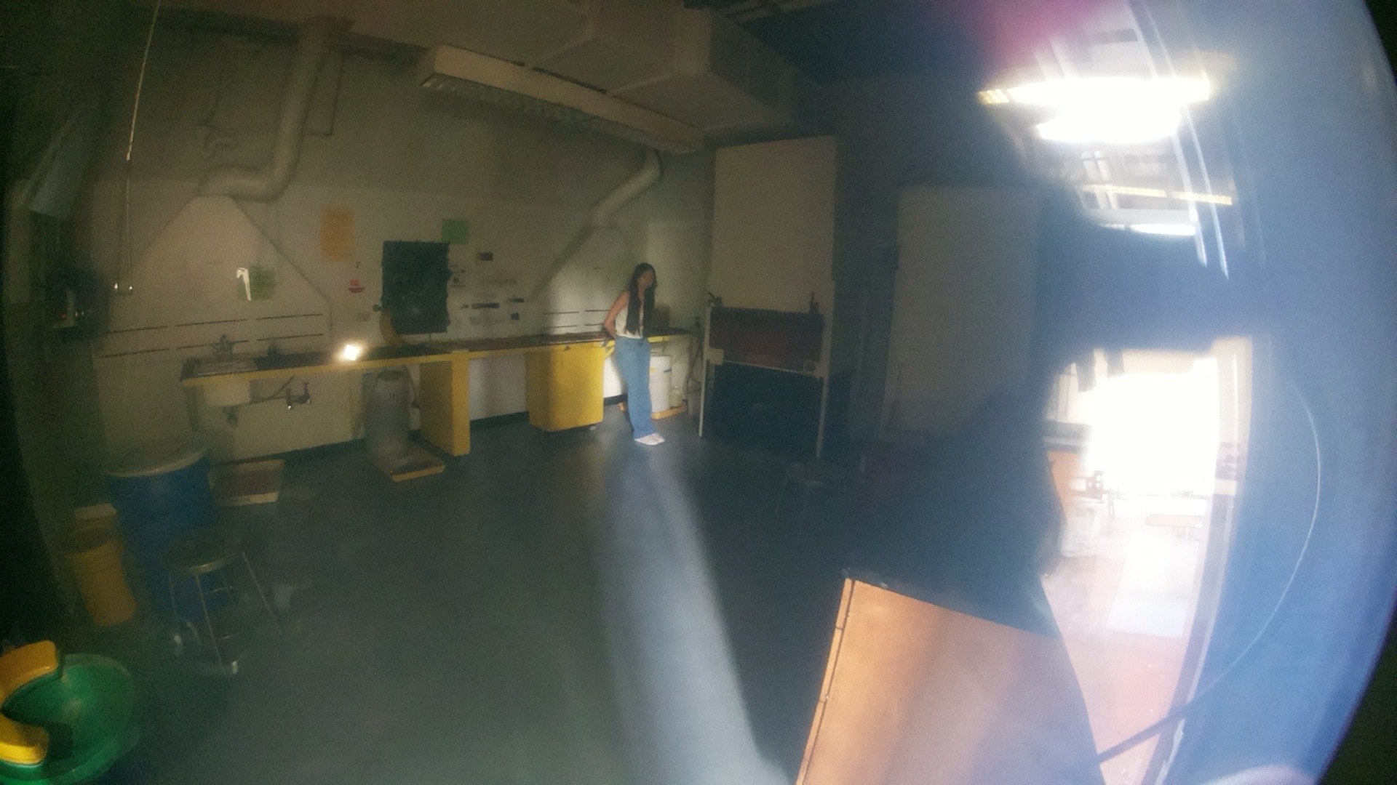
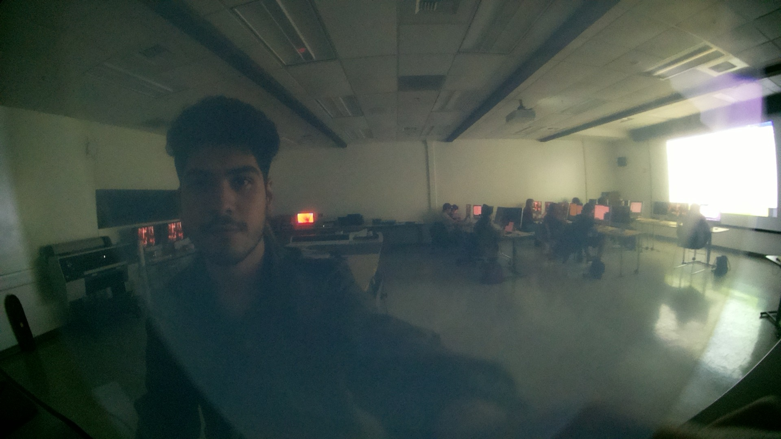
Remember This?:
Over 300 Images taken
(Angled Diffusion Issue) →

Slide 5
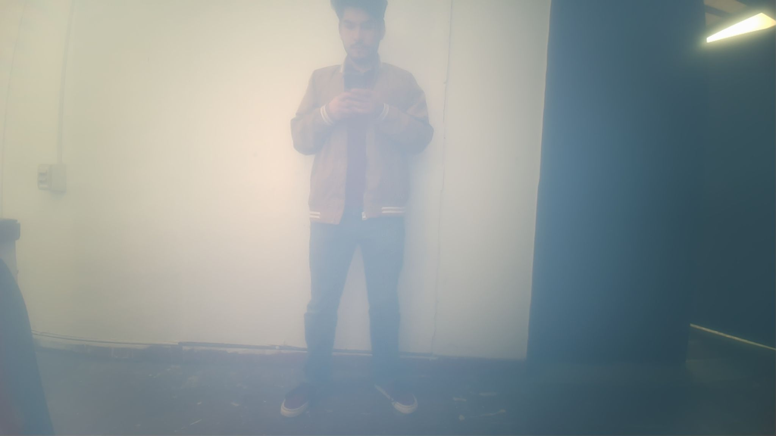
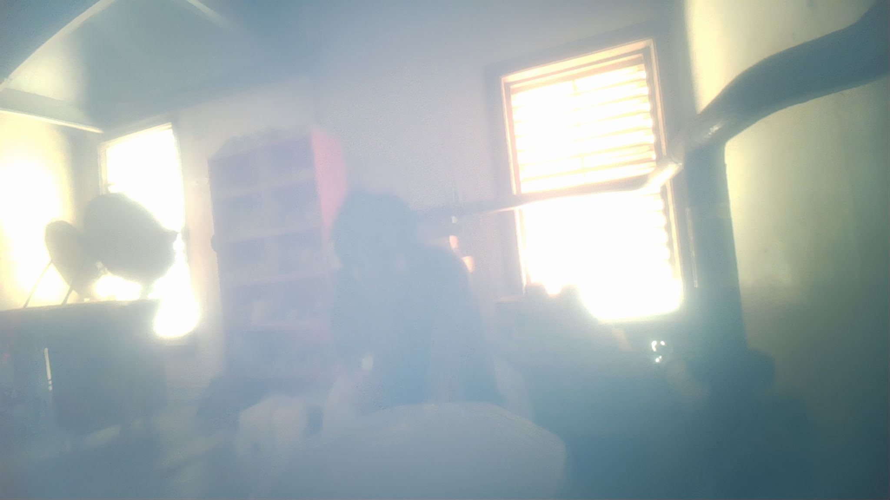
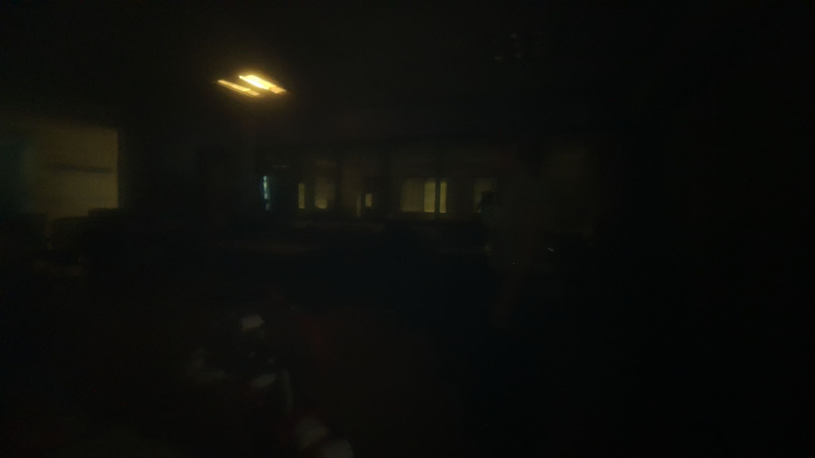
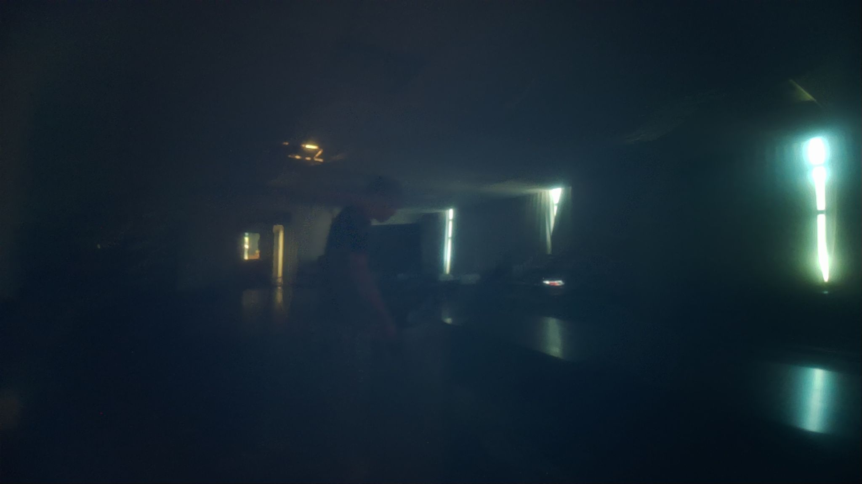
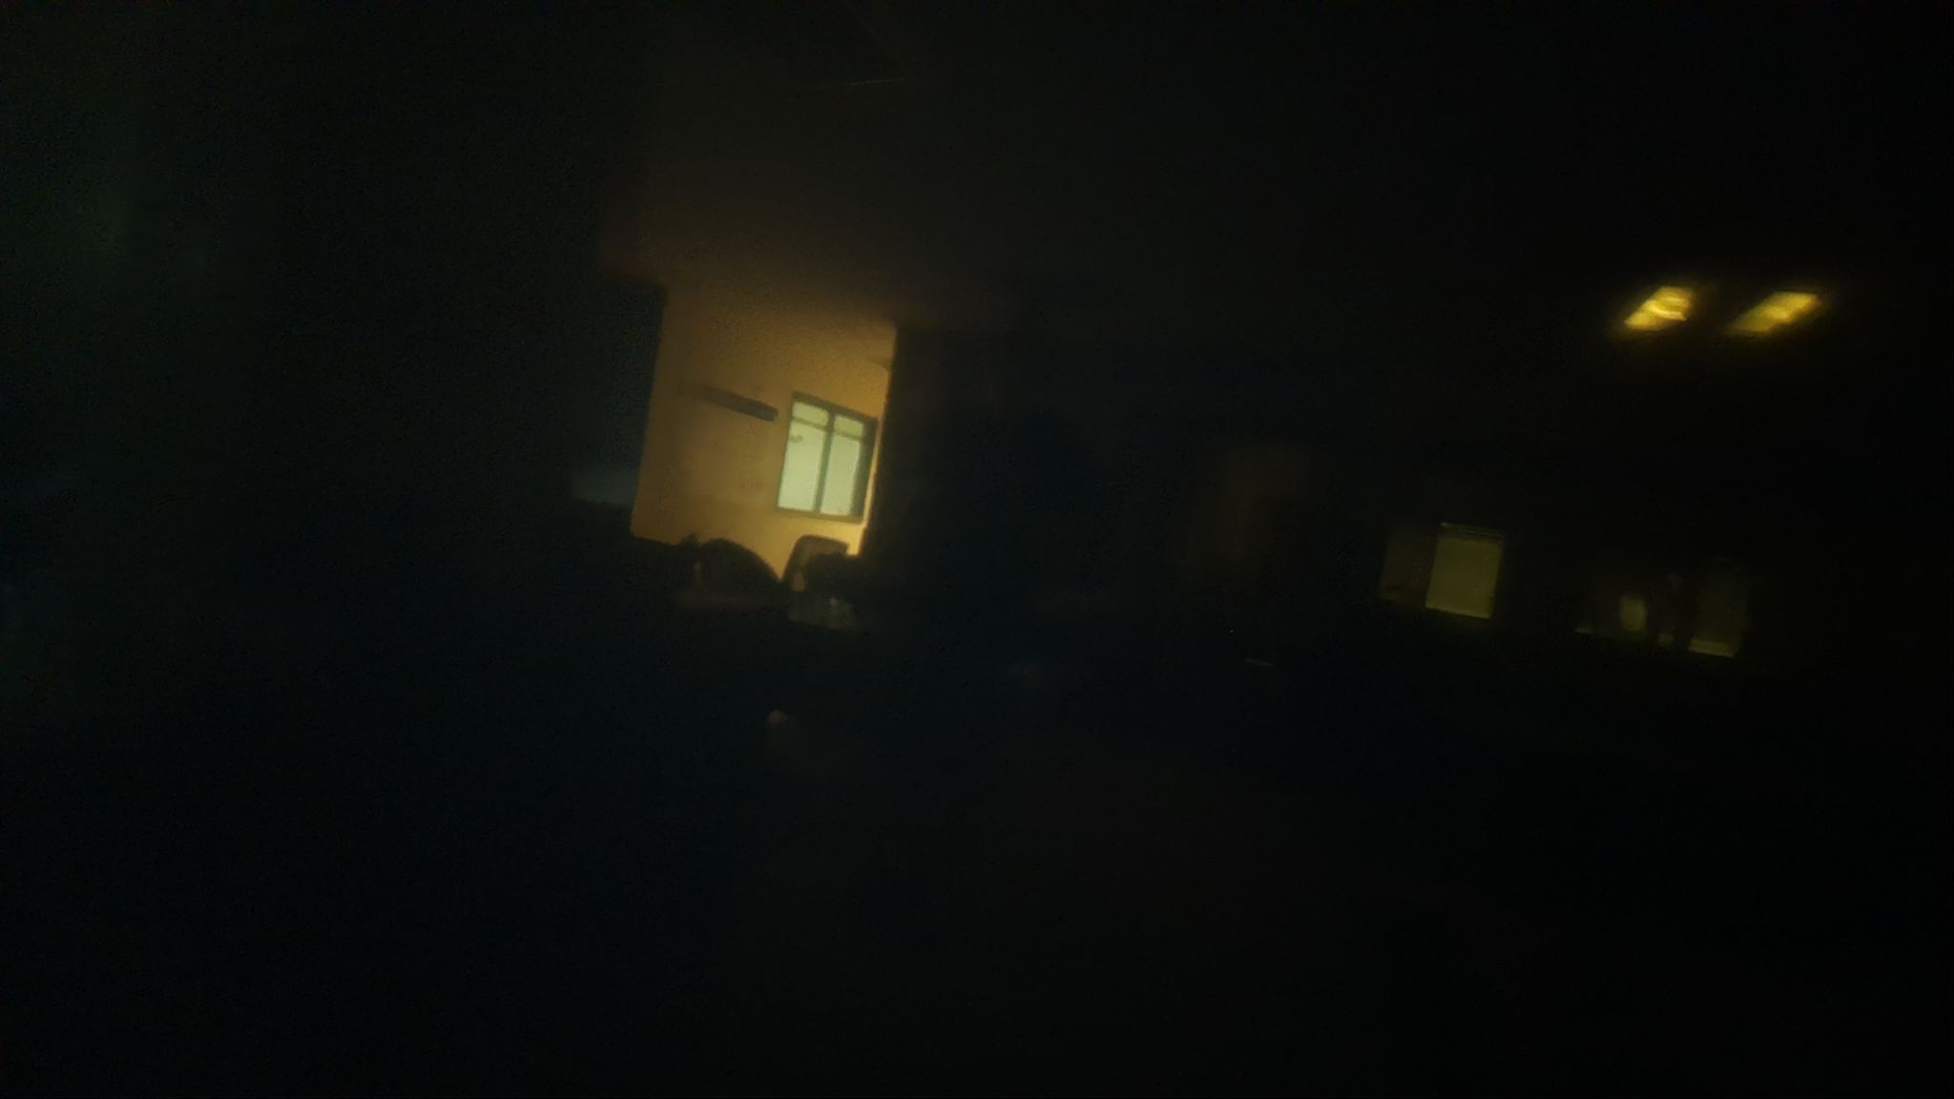
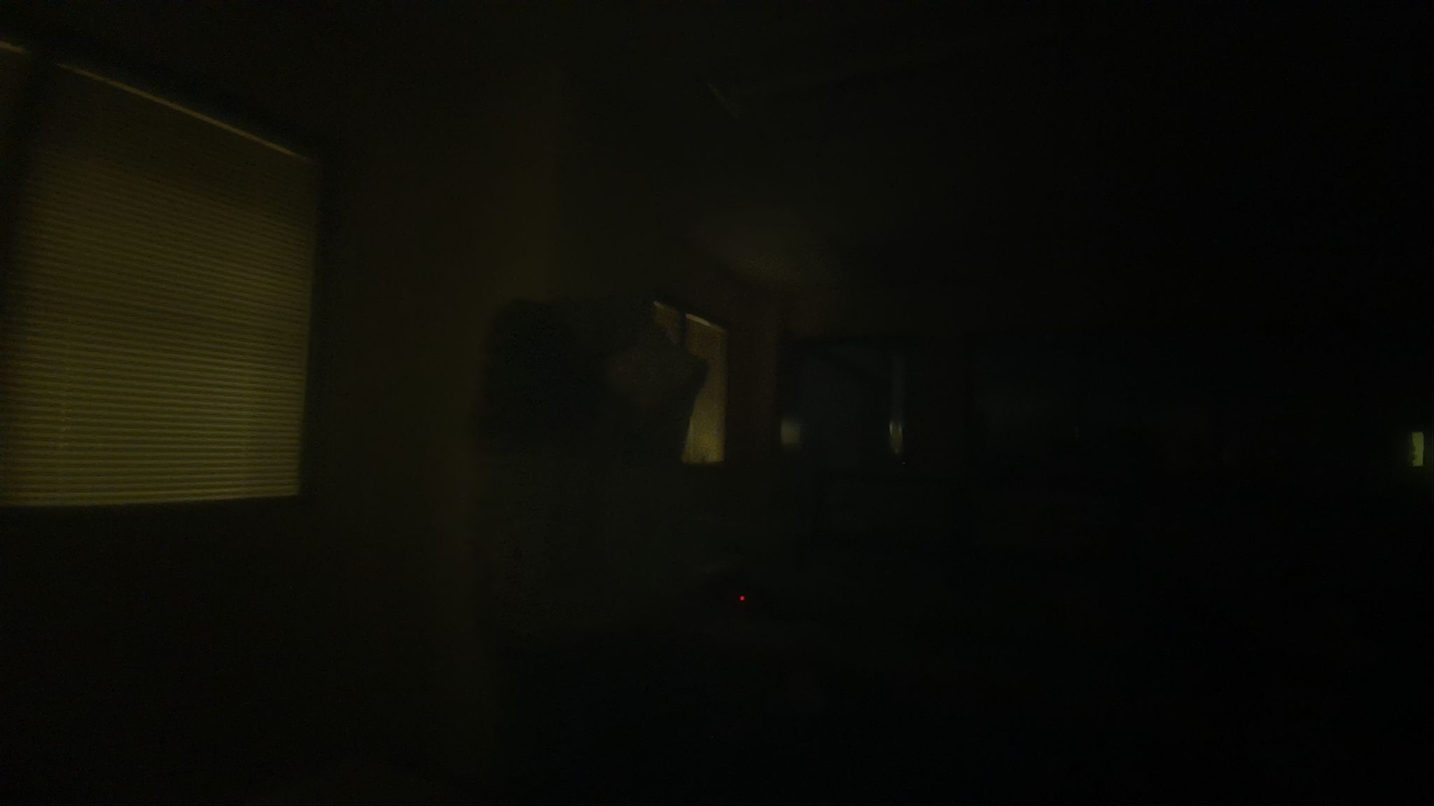
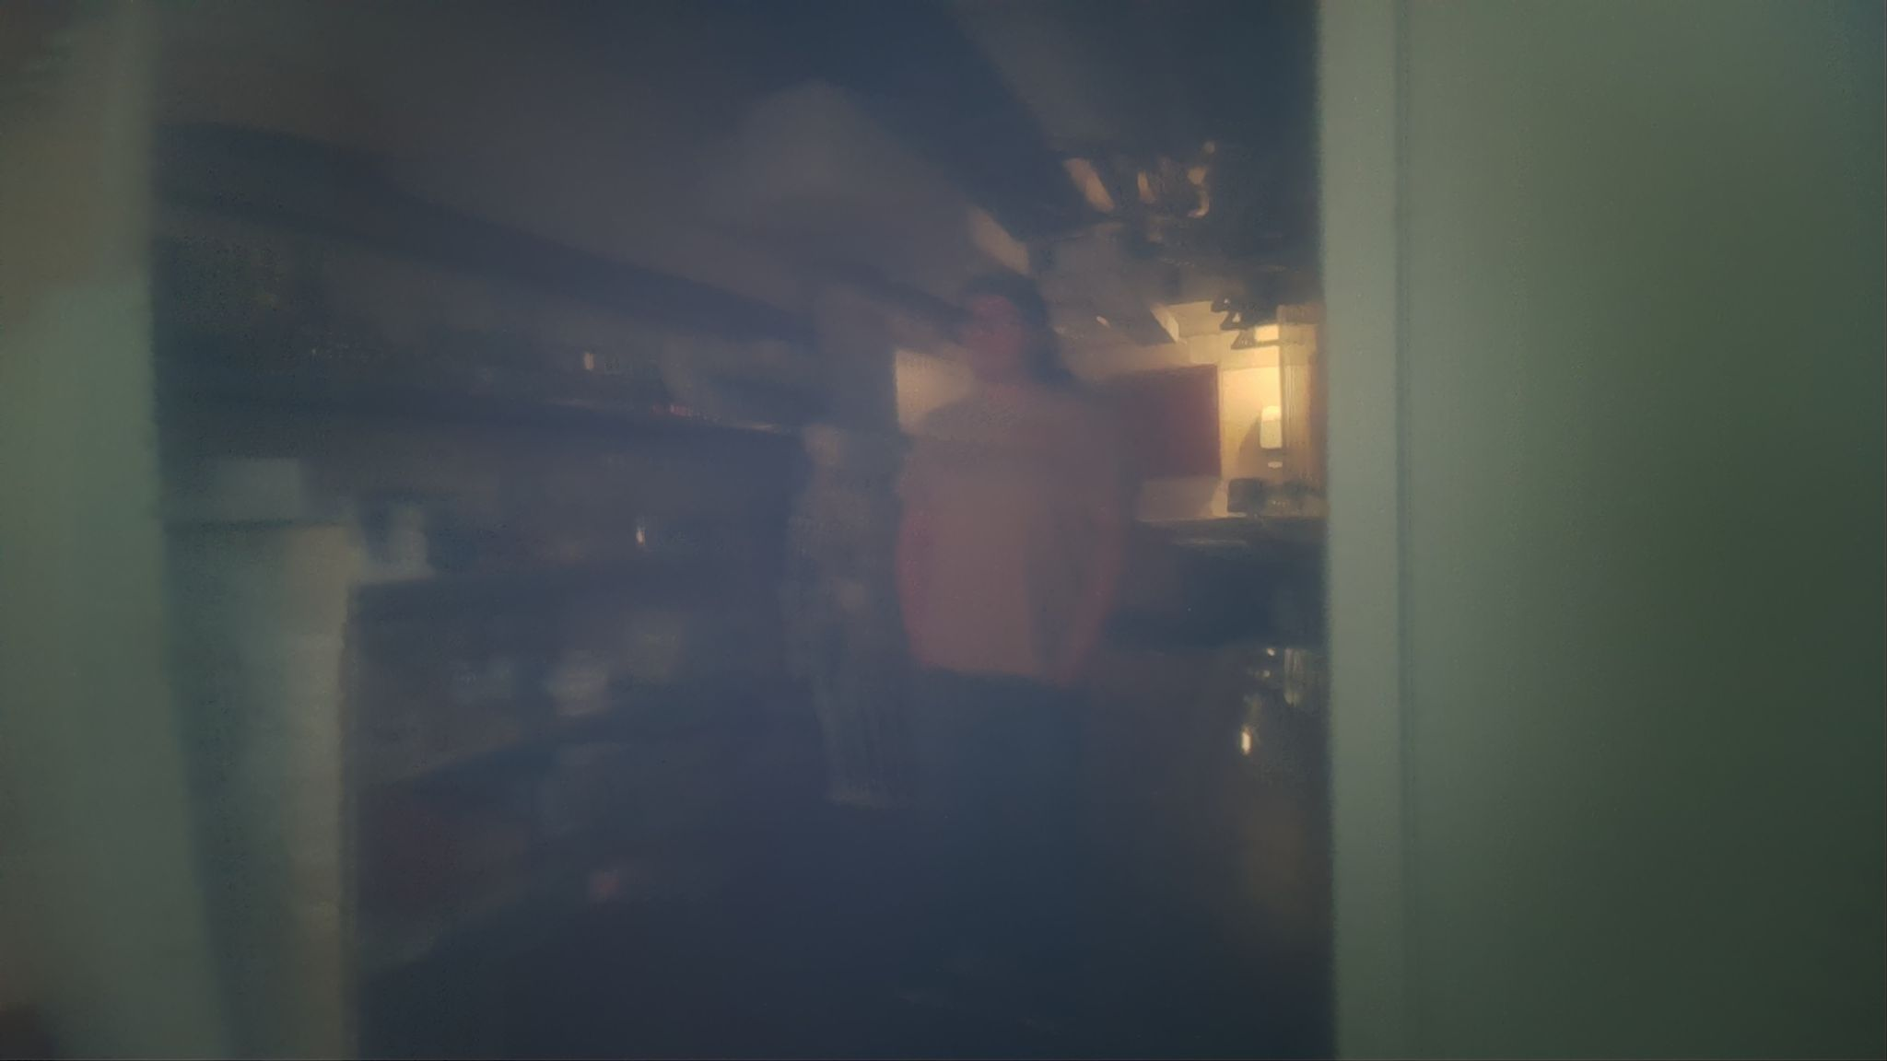
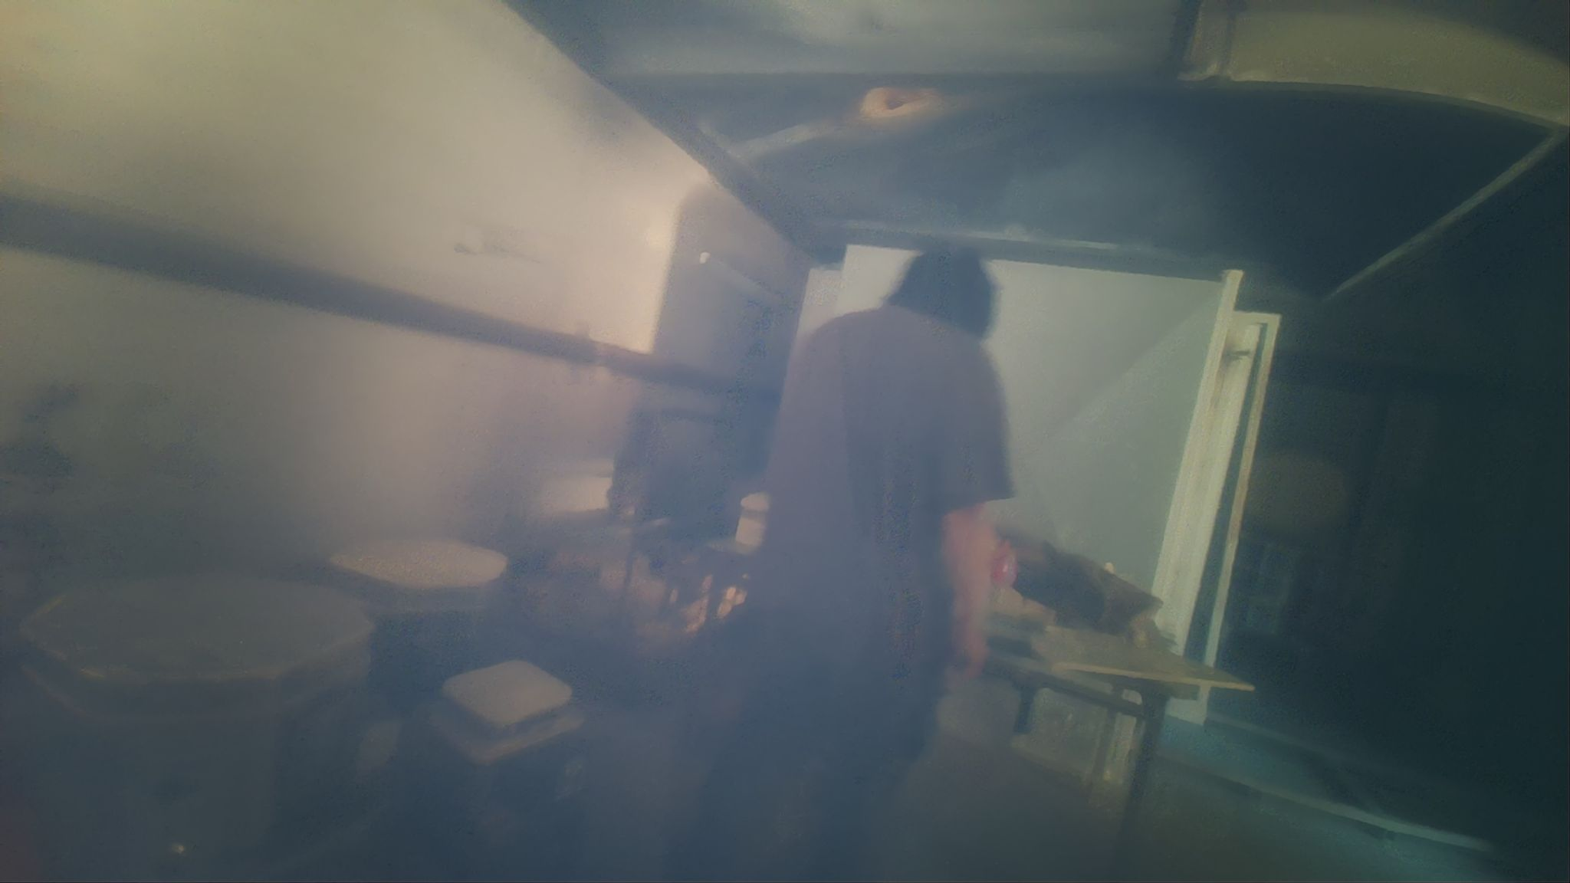
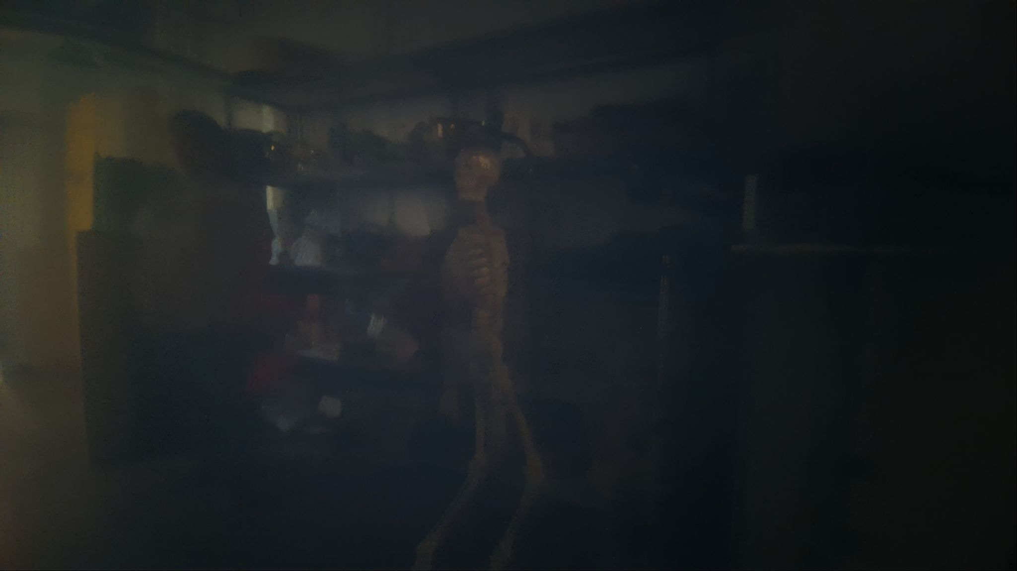
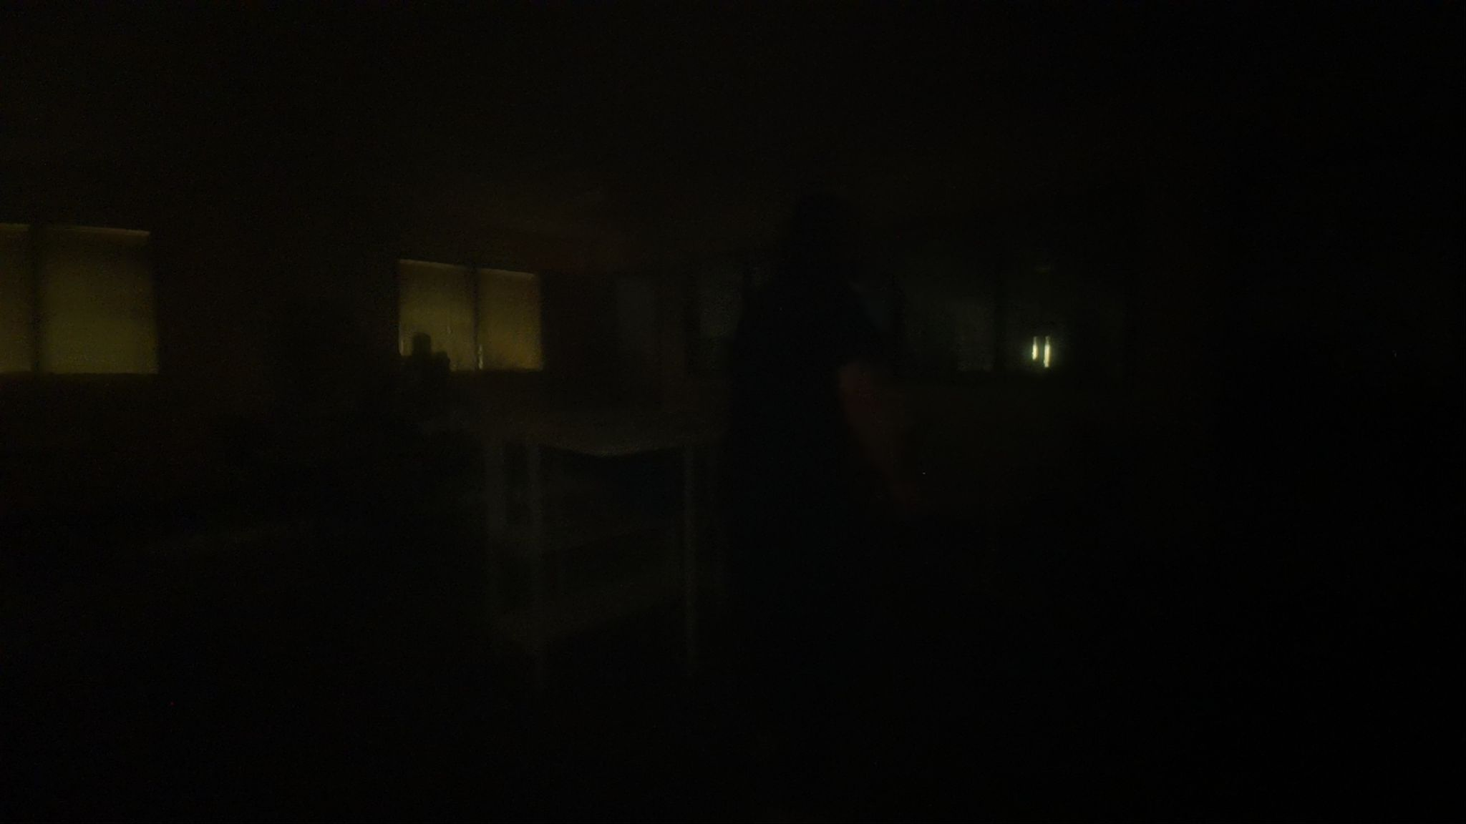
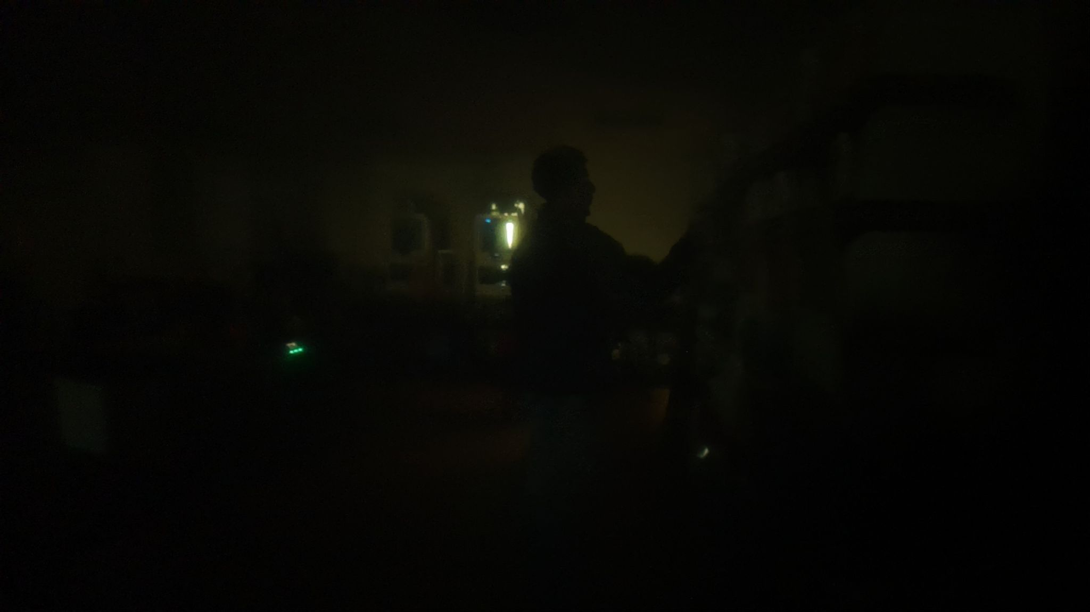
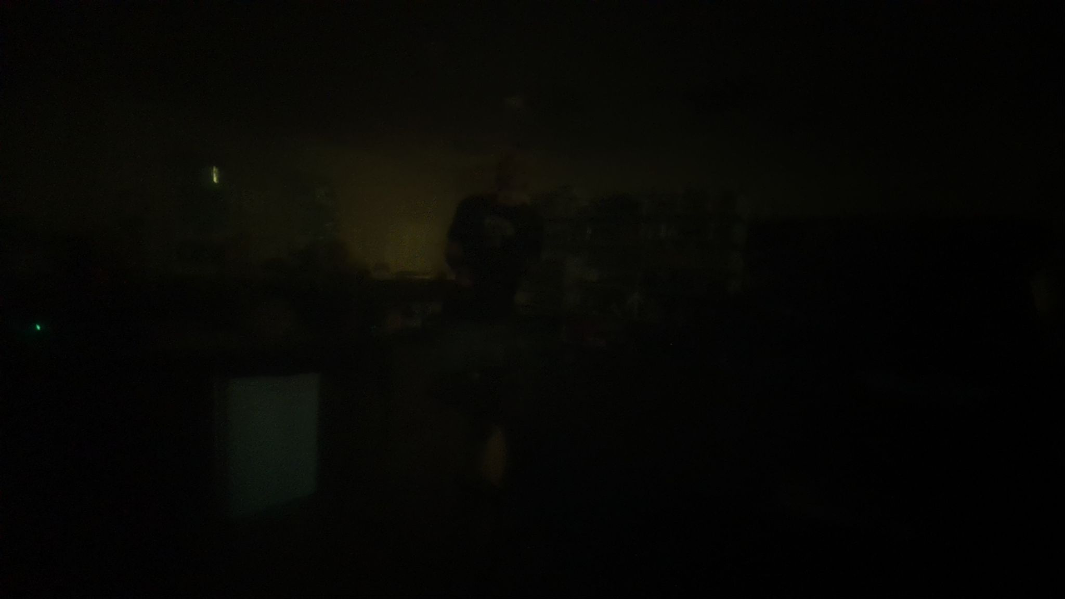
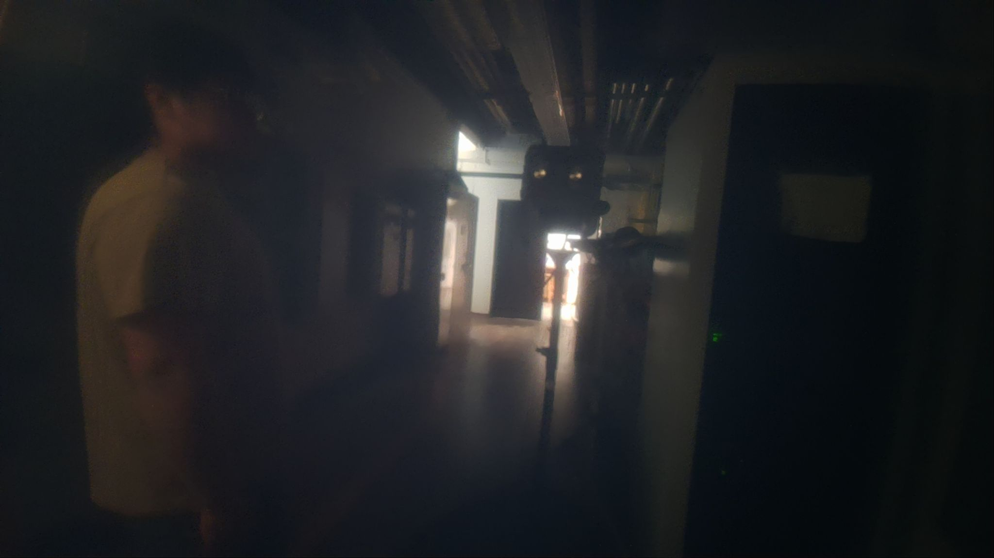
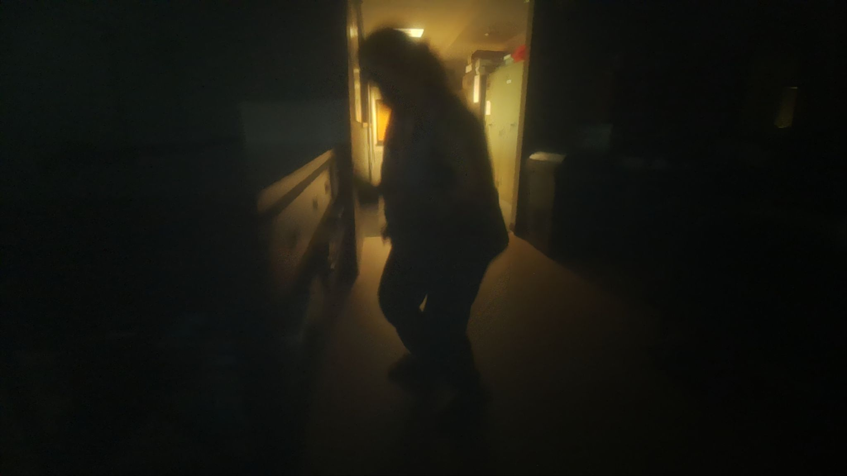
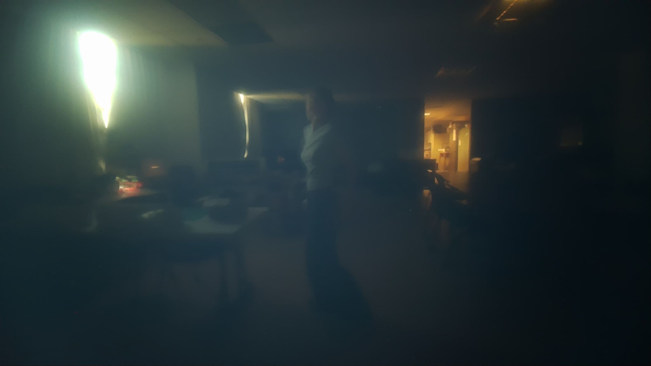
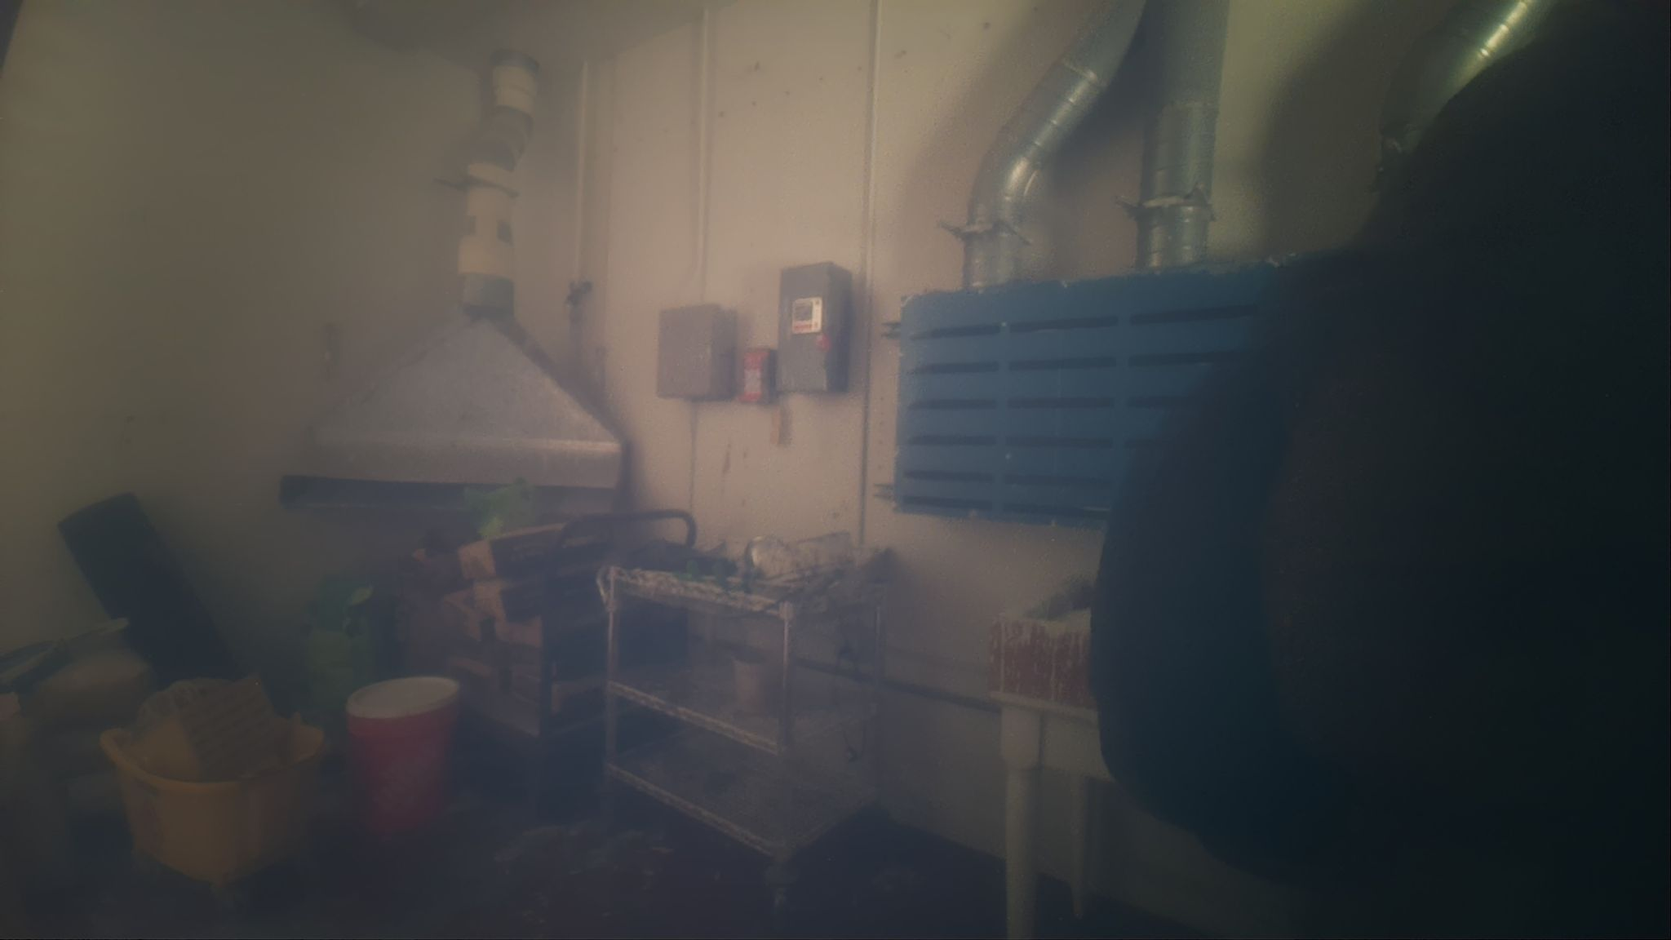
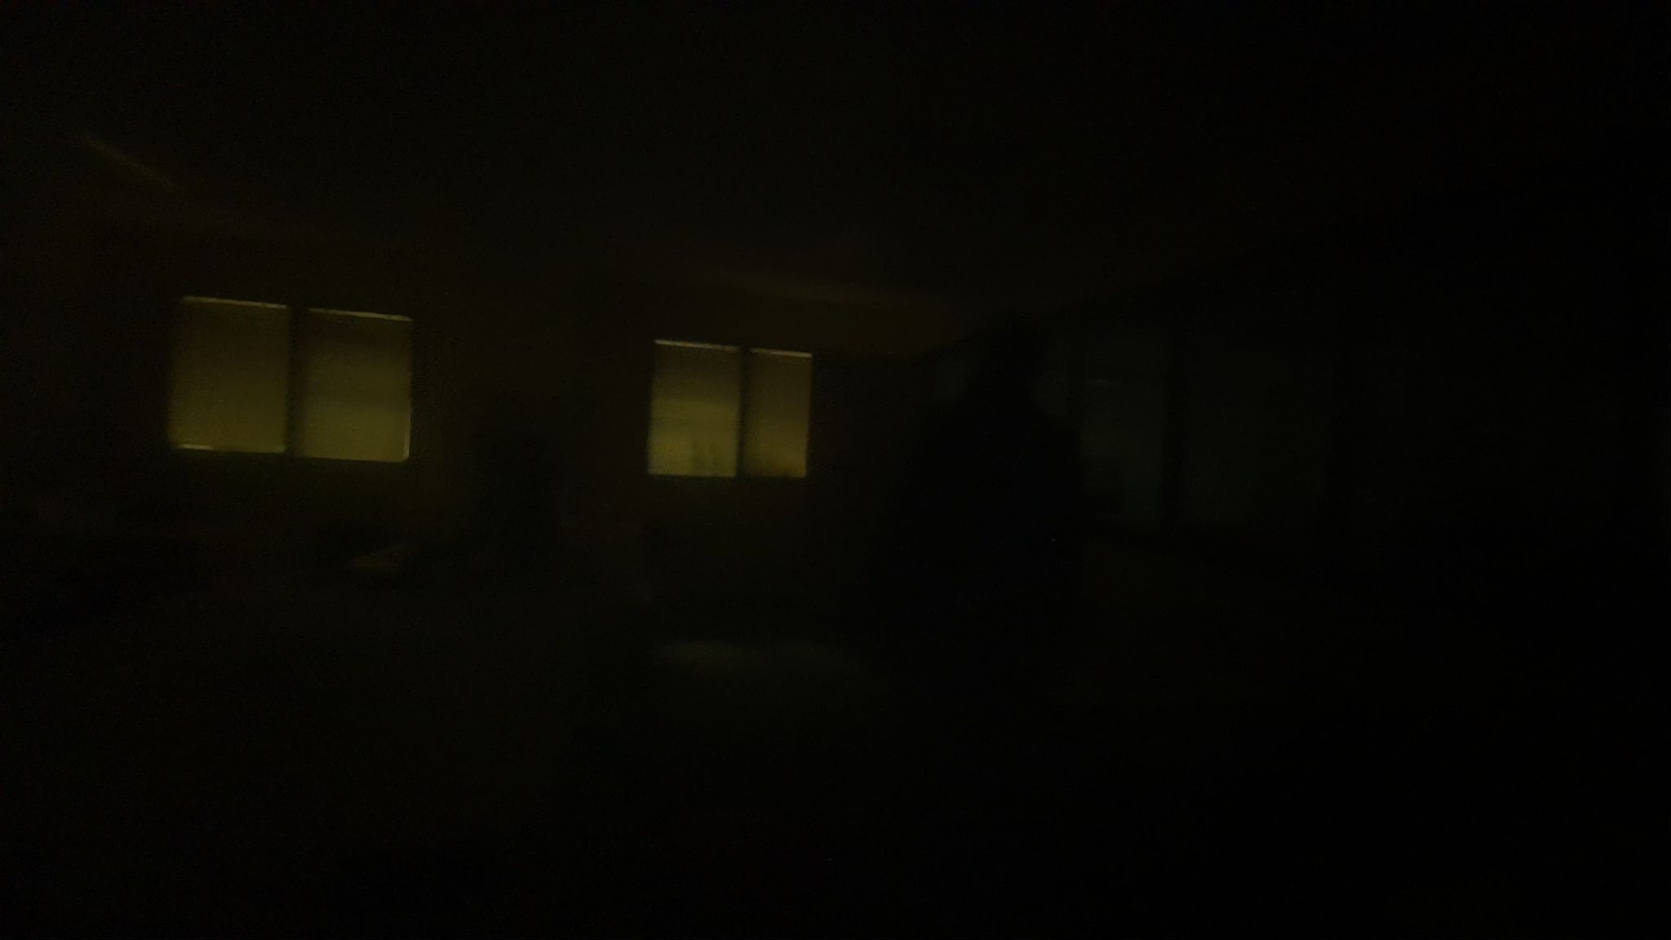
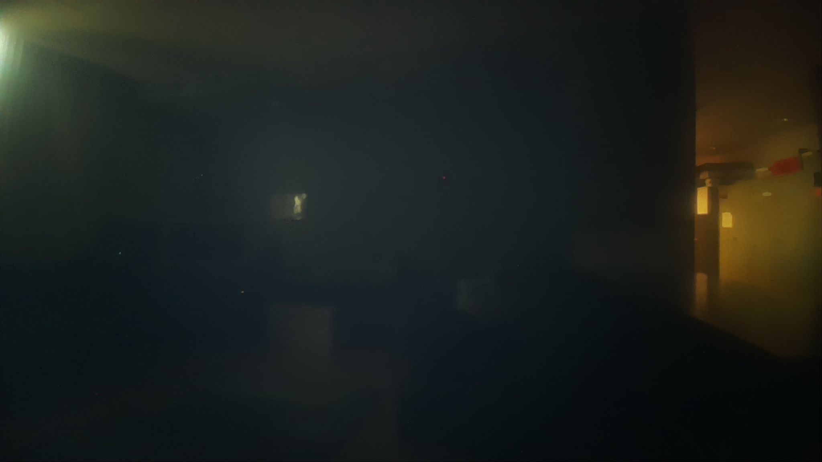
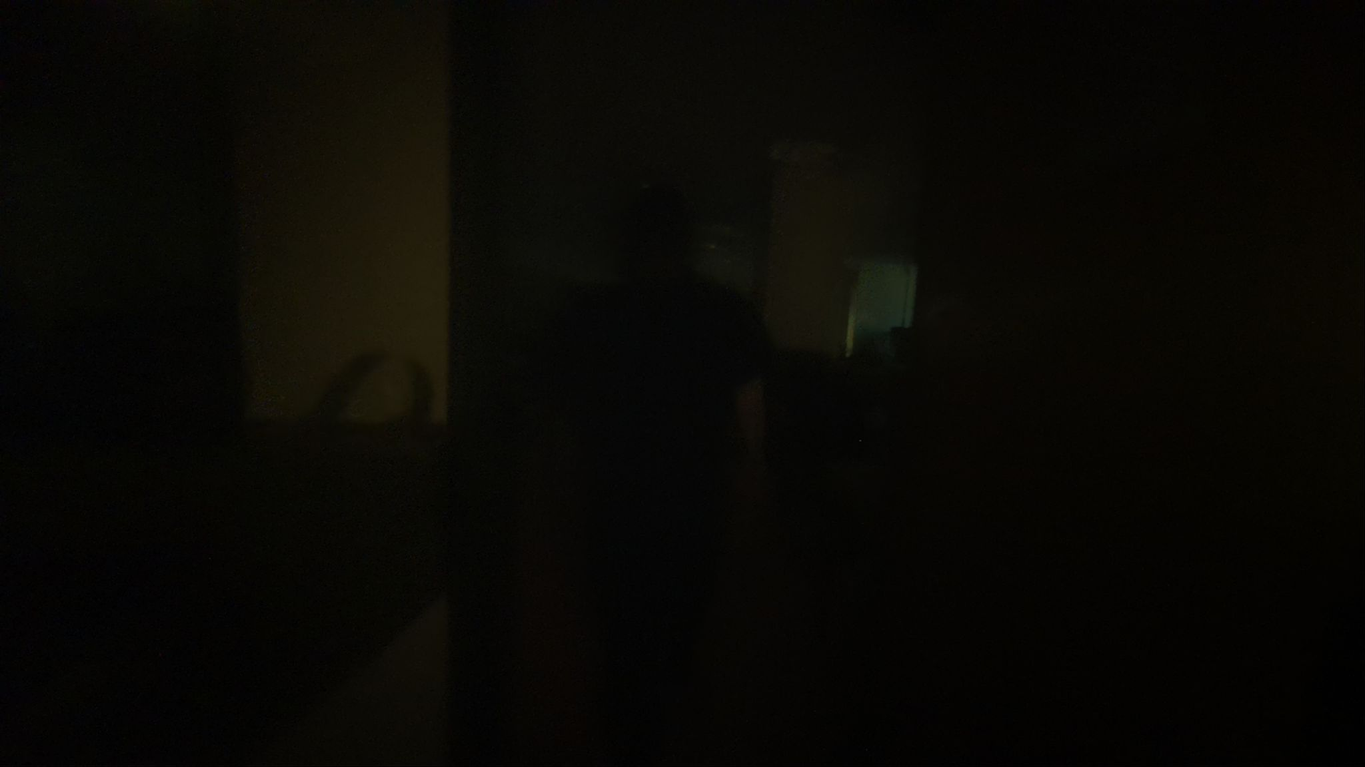
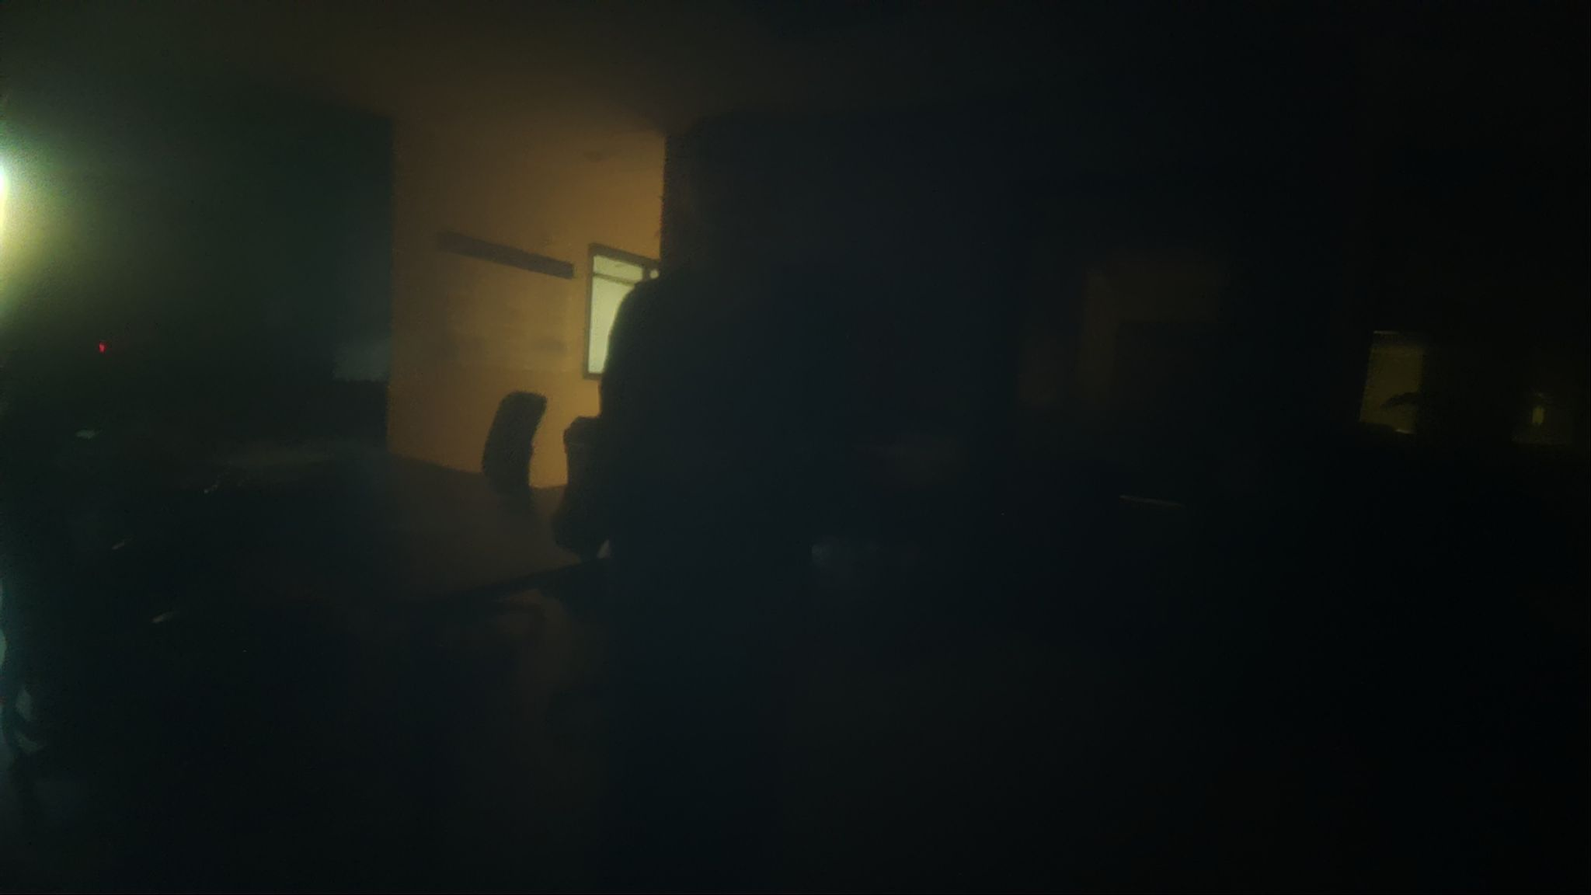
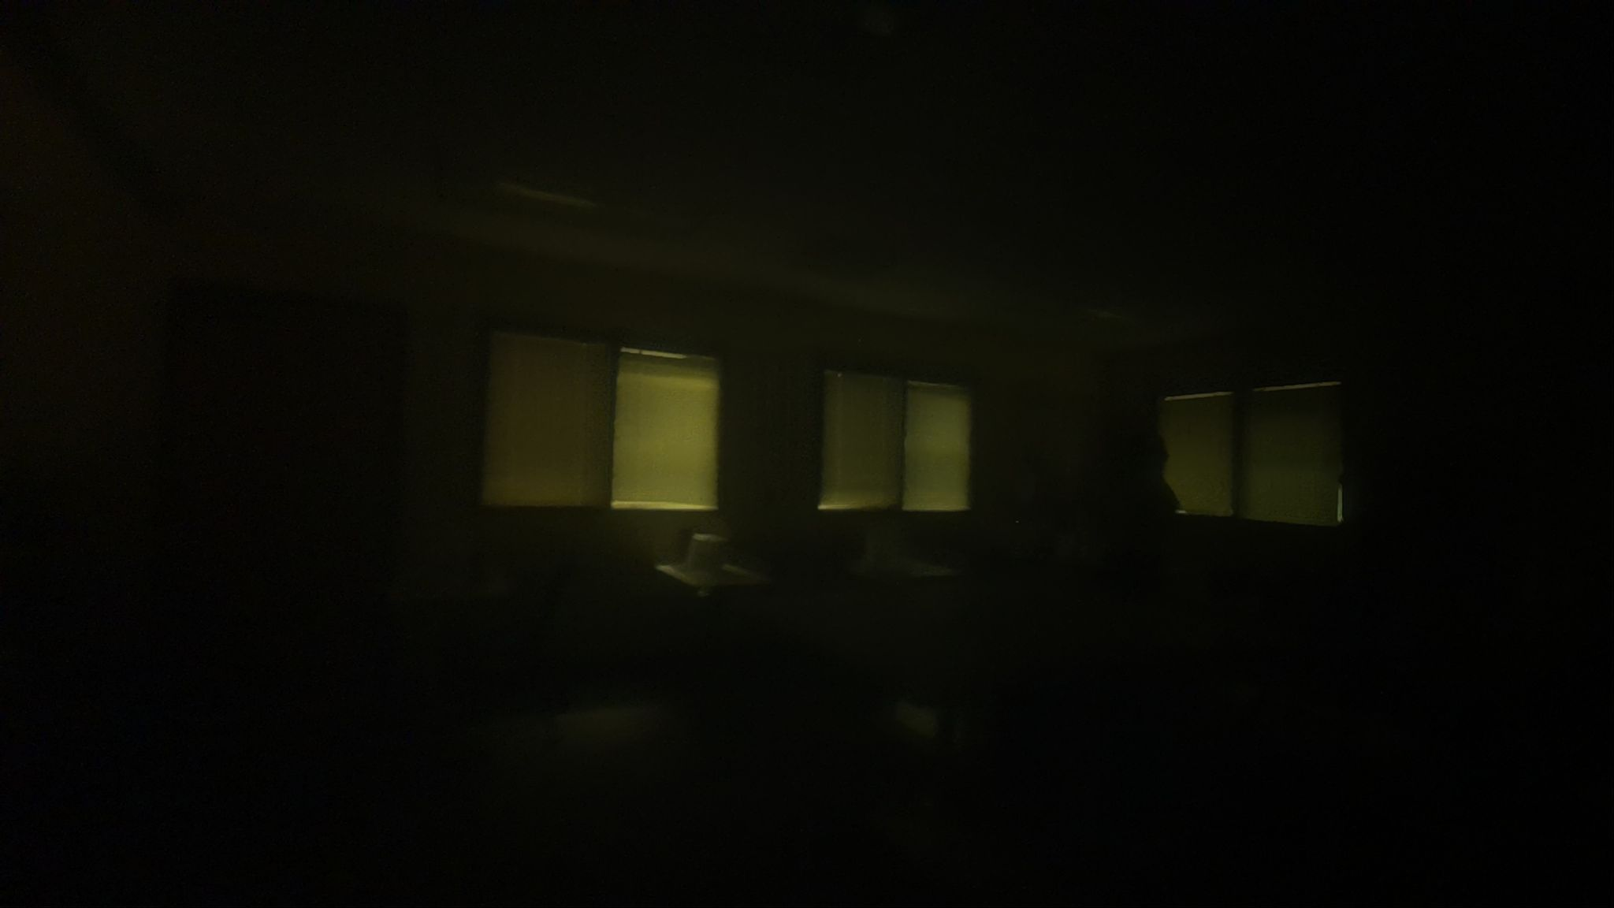
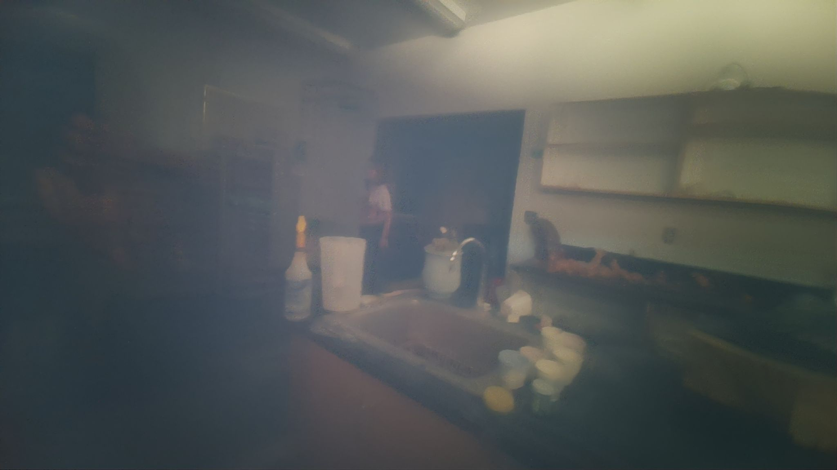
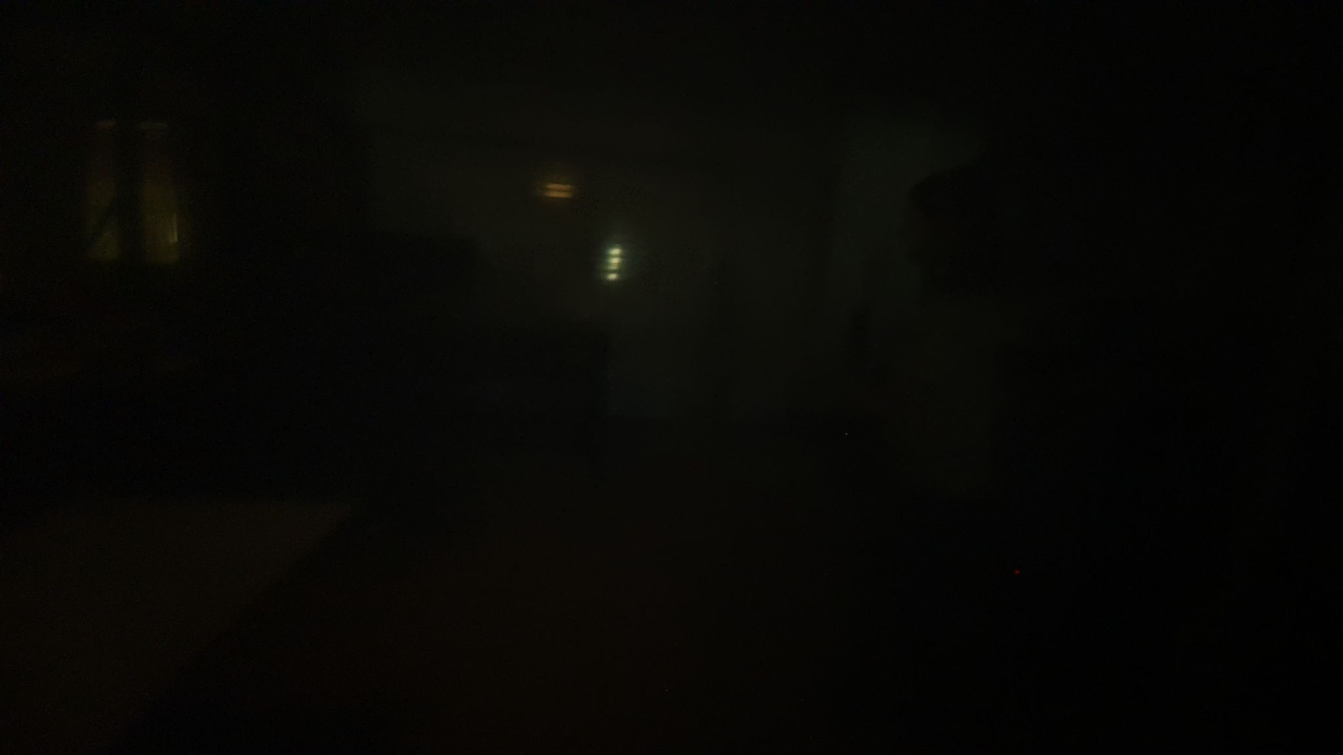
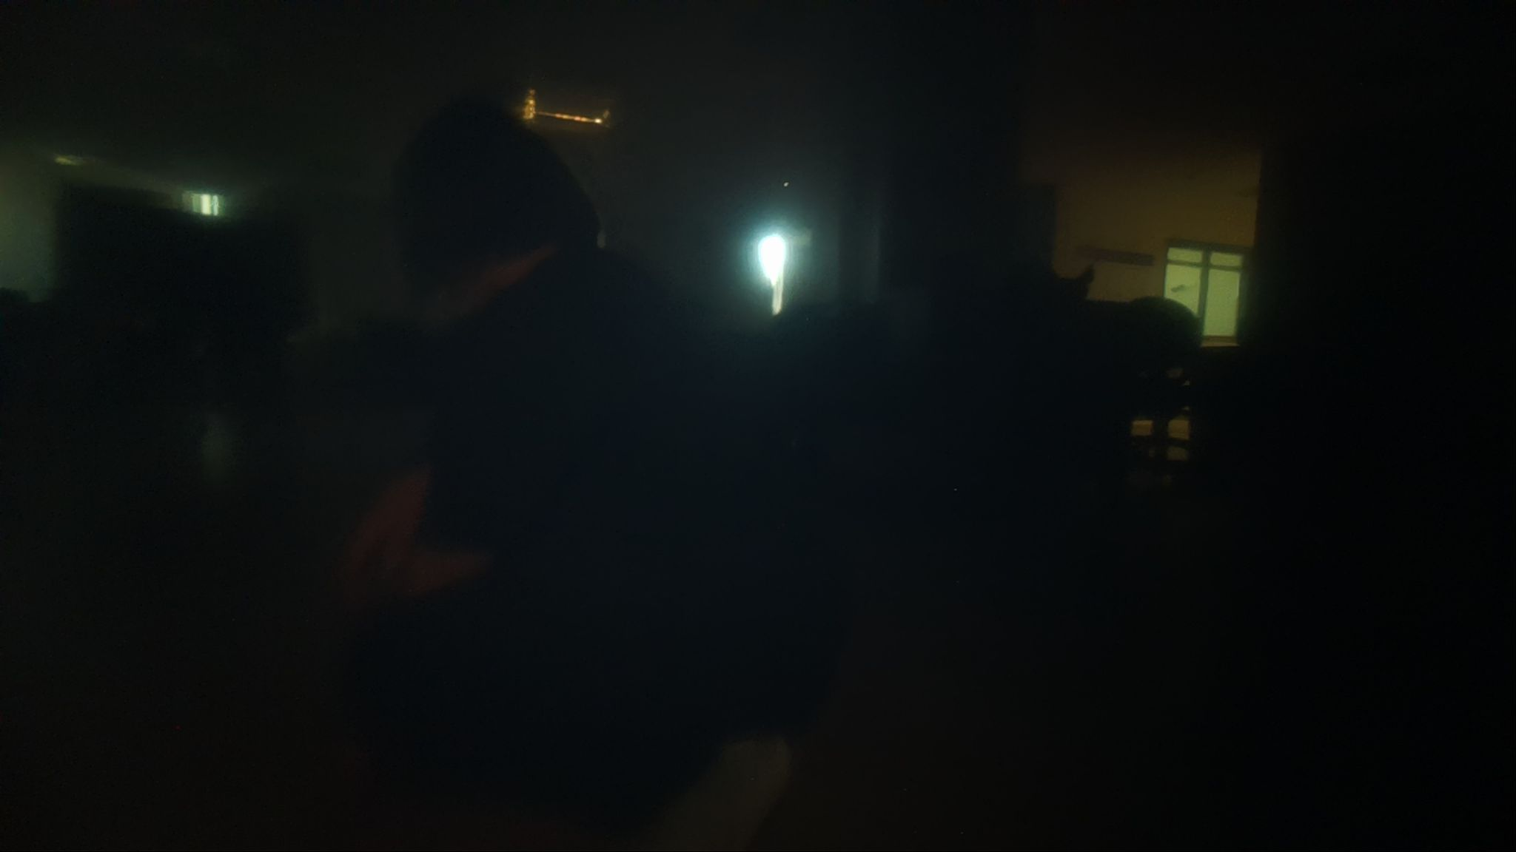
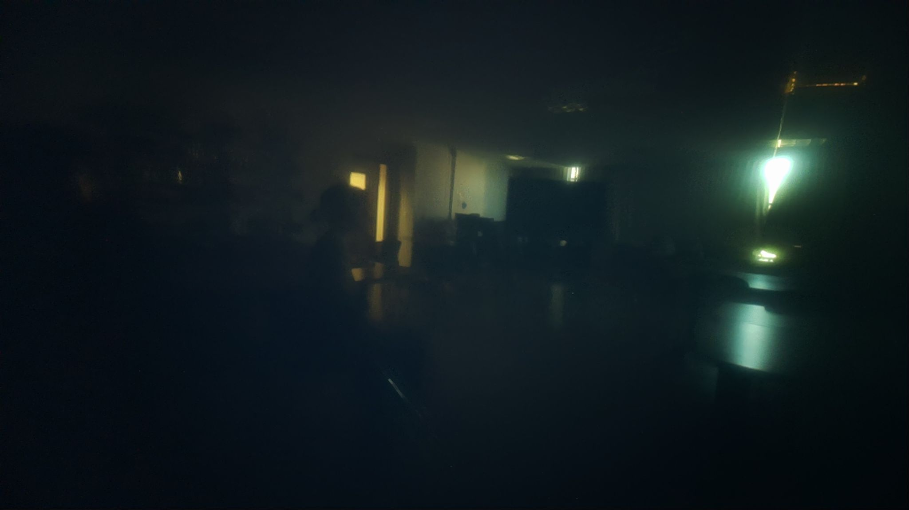
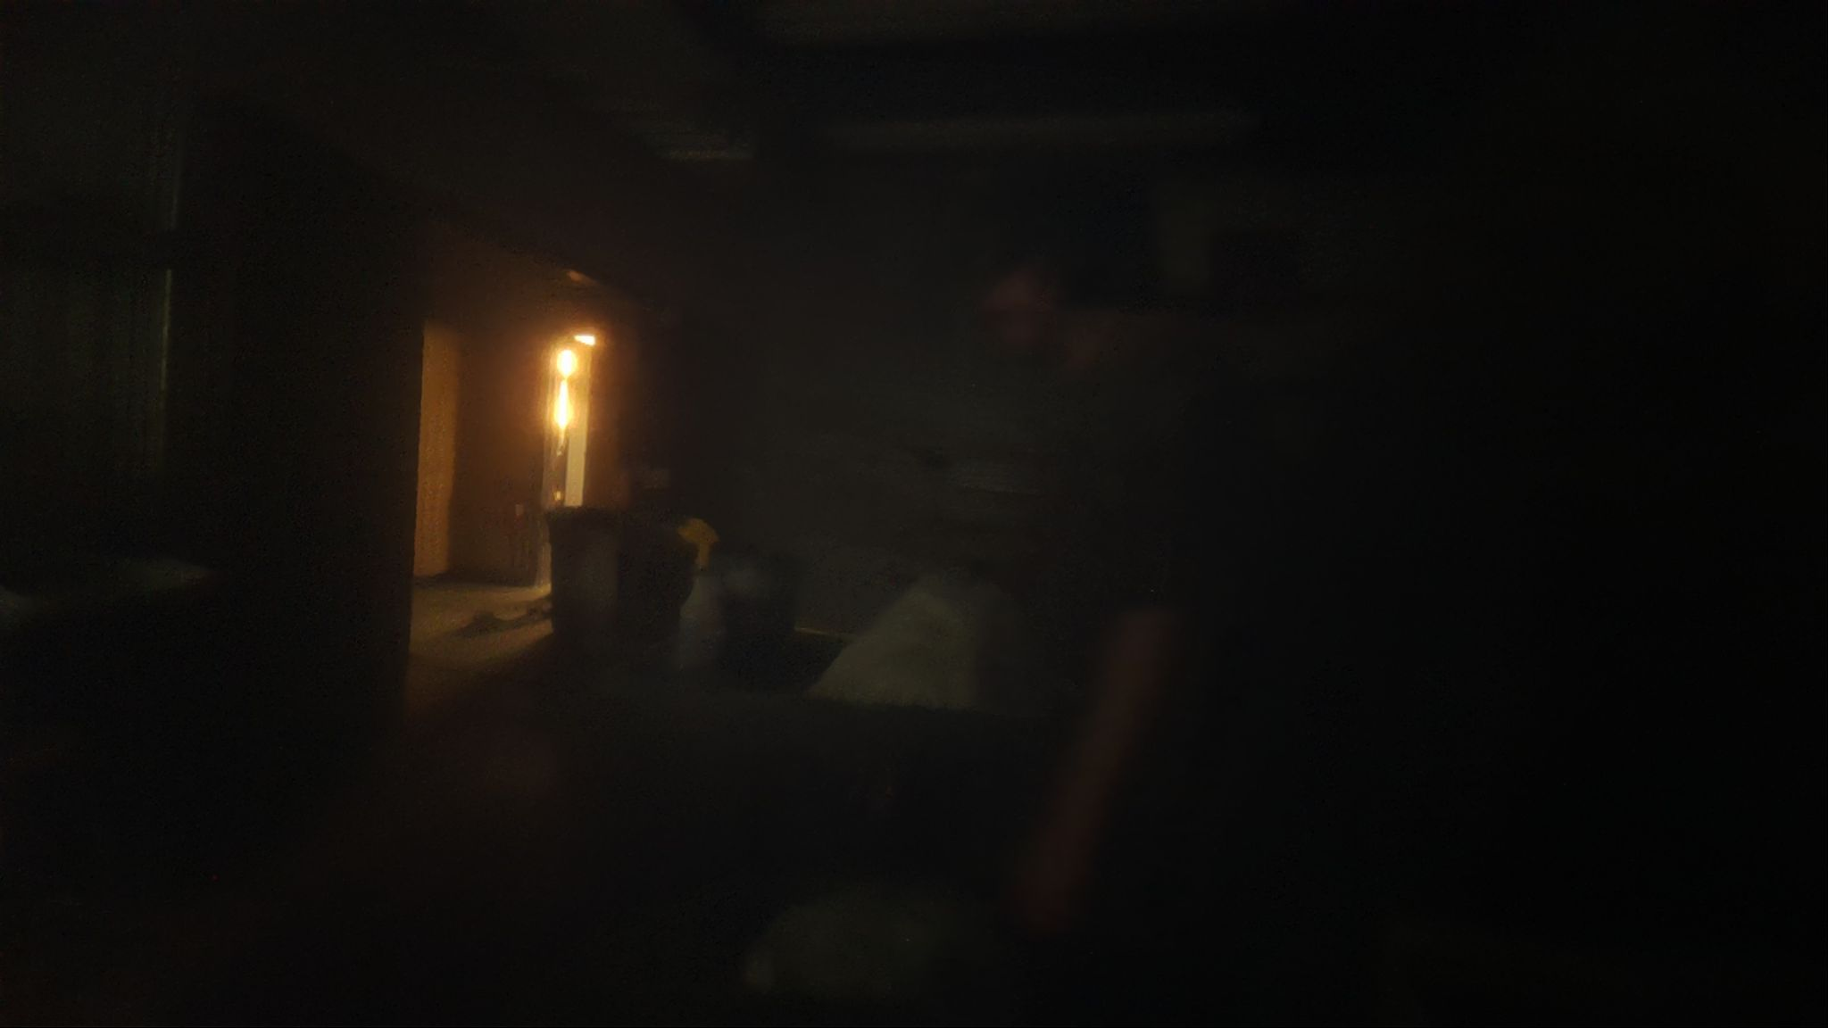
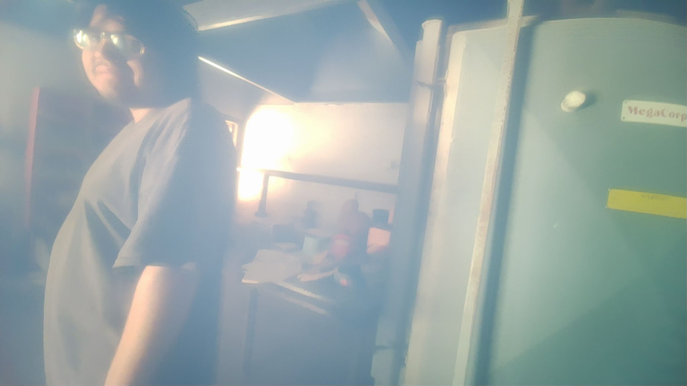
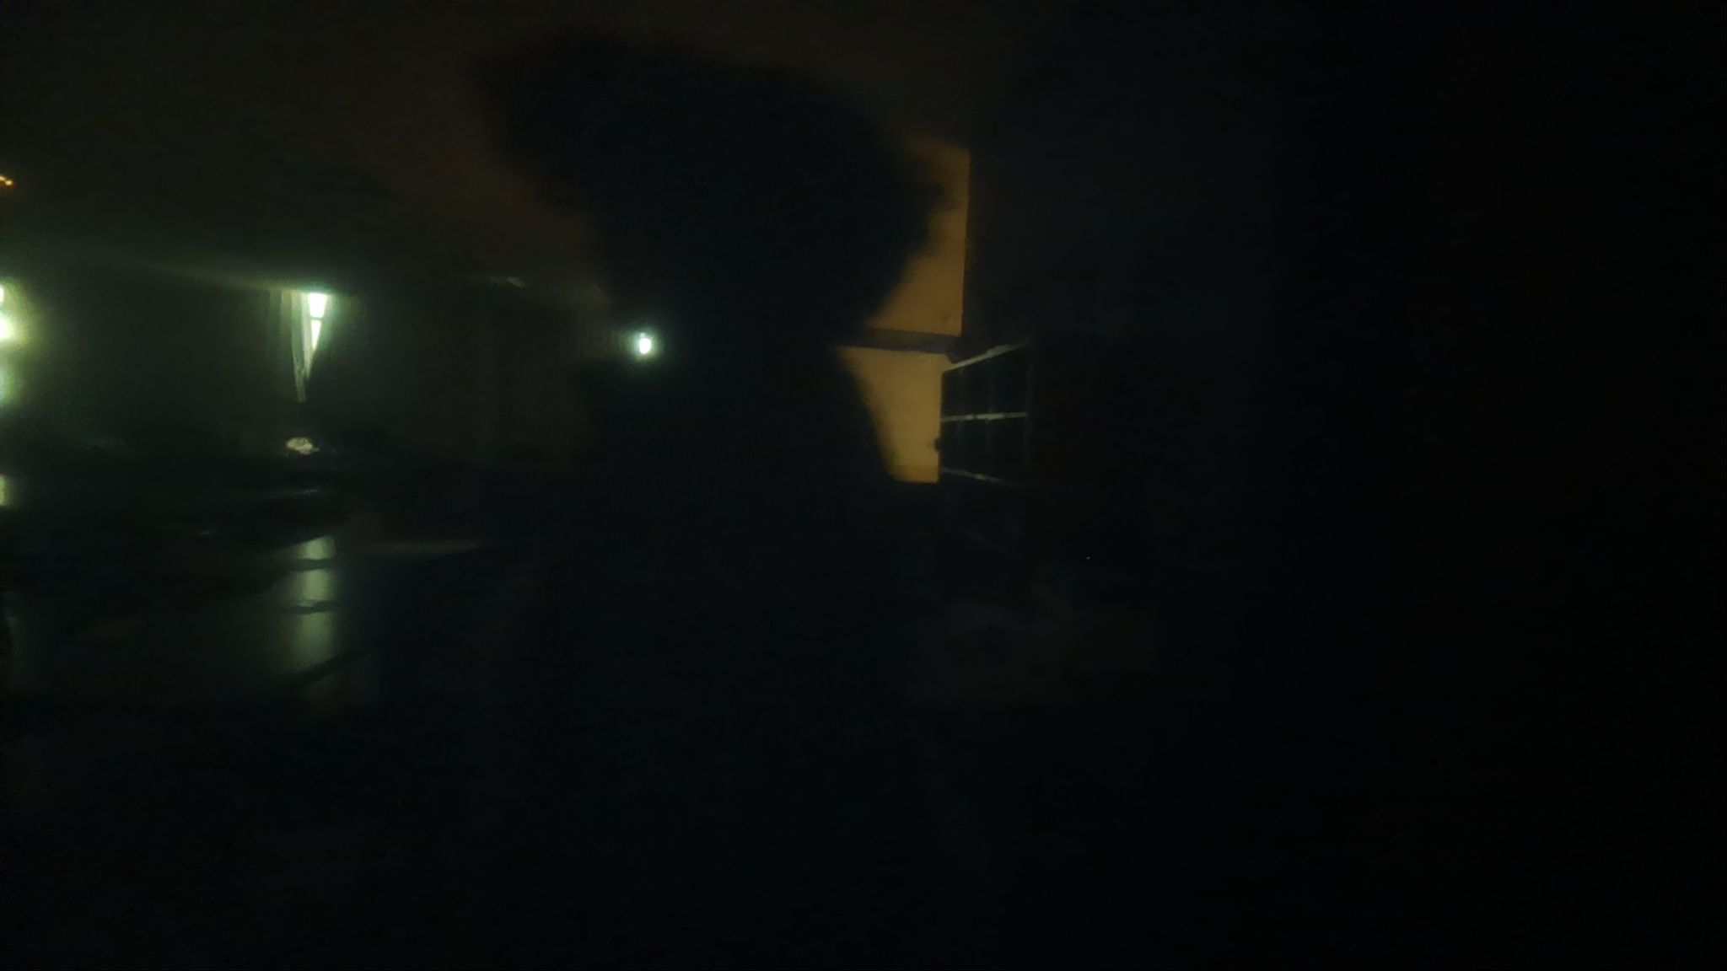
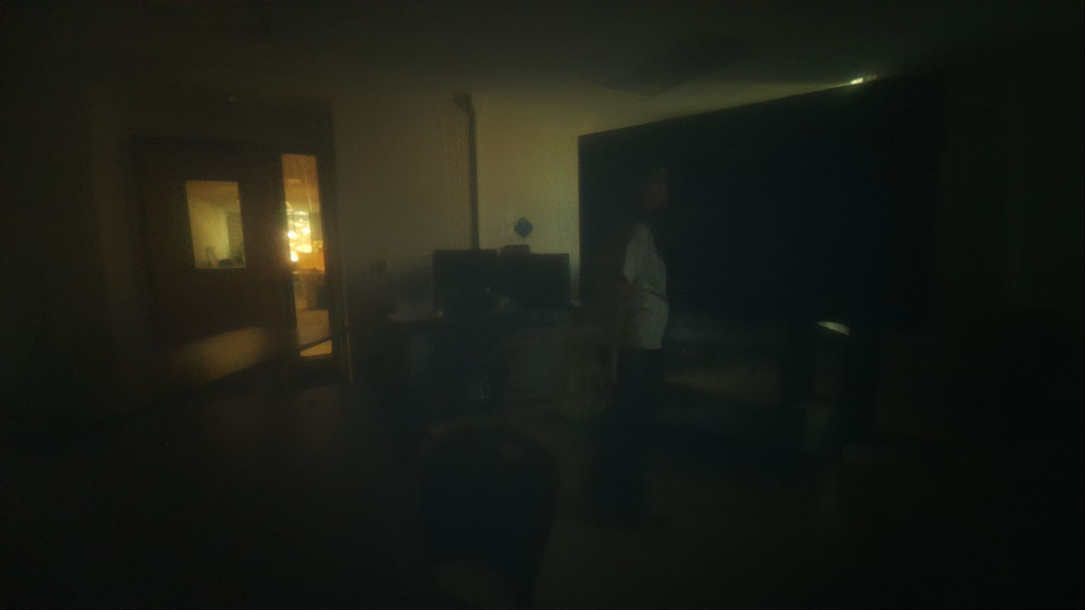
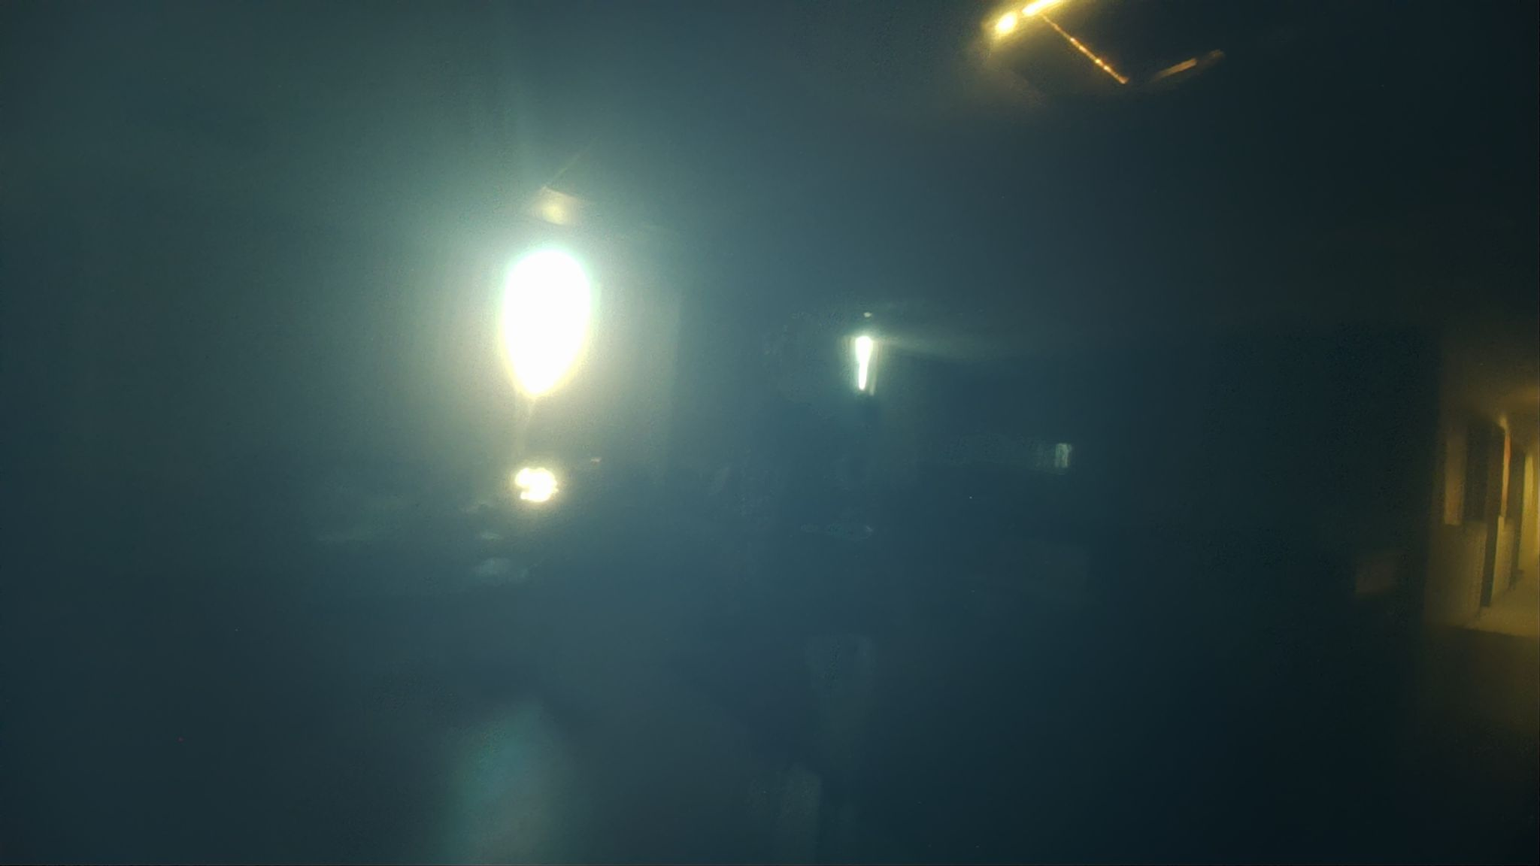
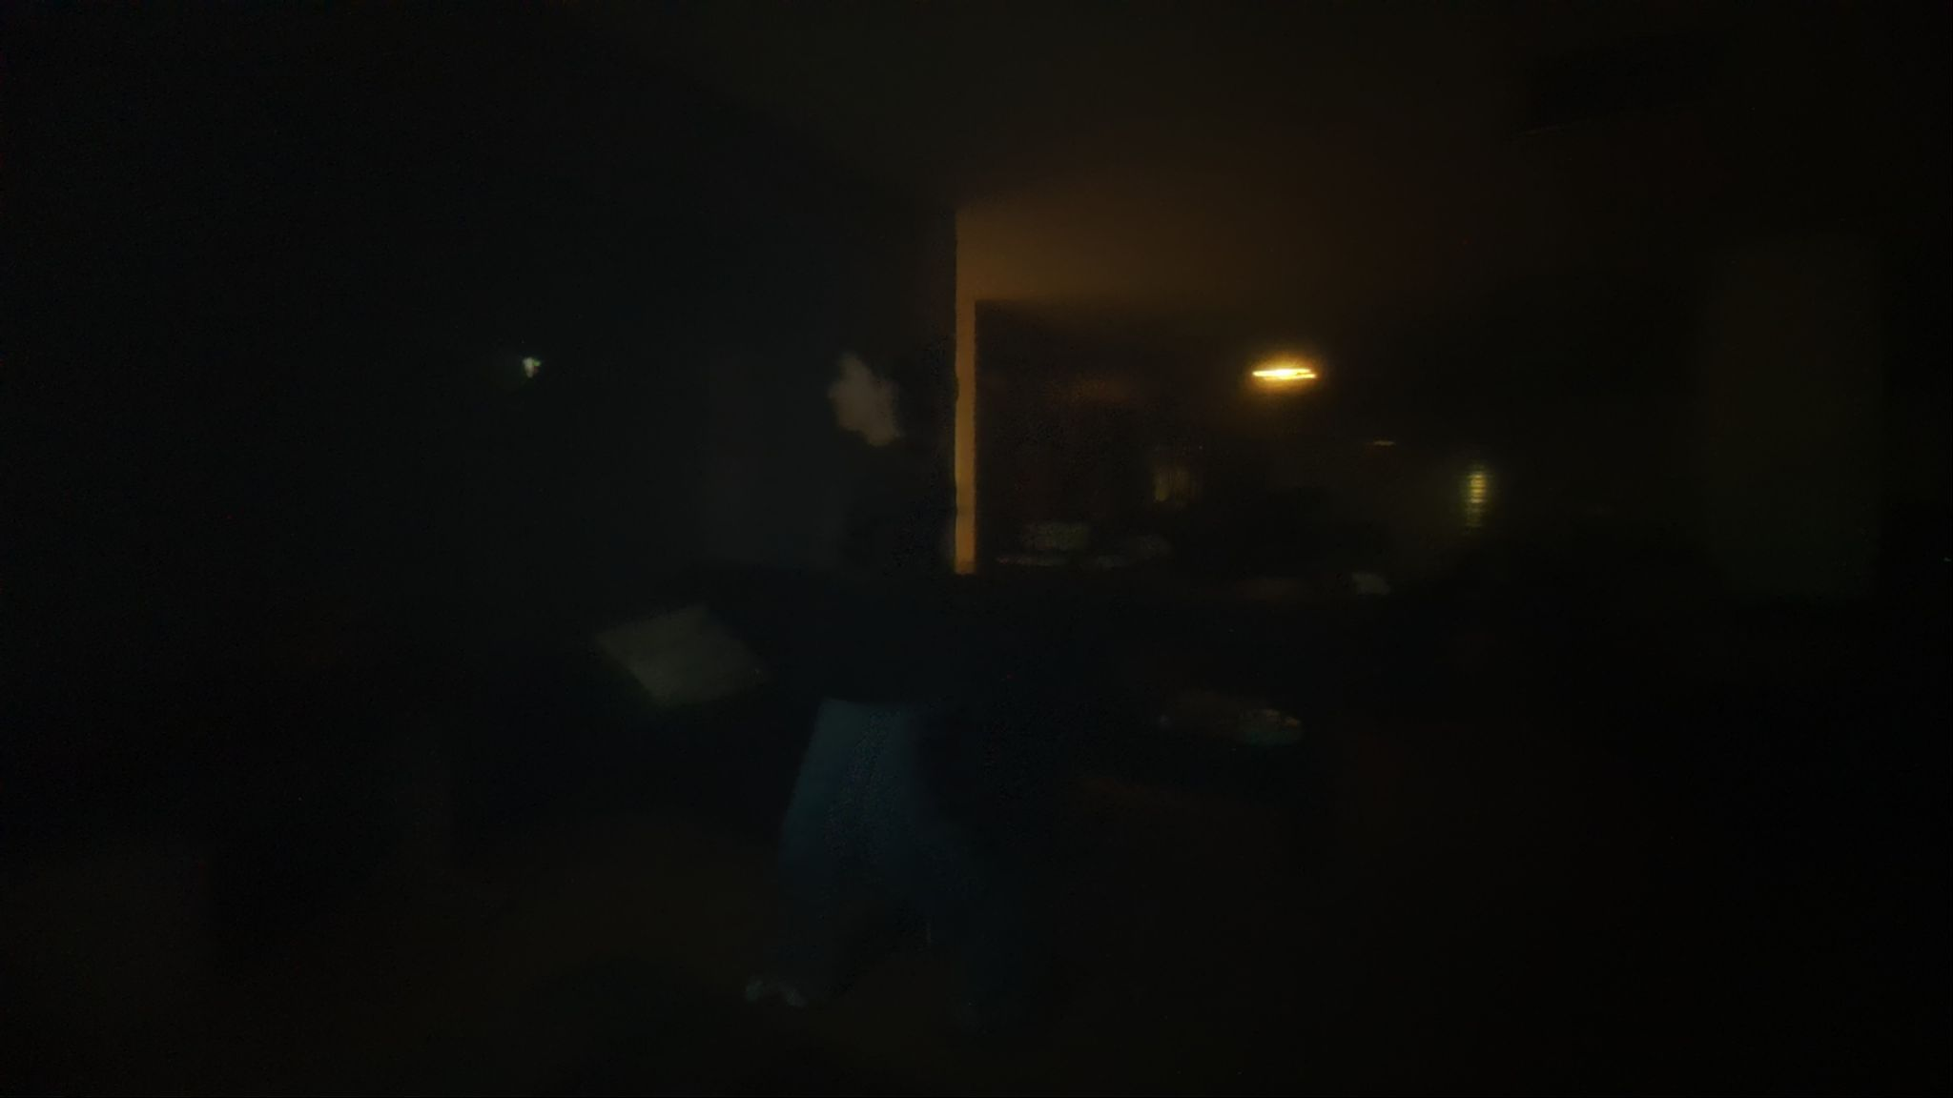
What’s New: Over 1100 Photos (total)

Slide 6
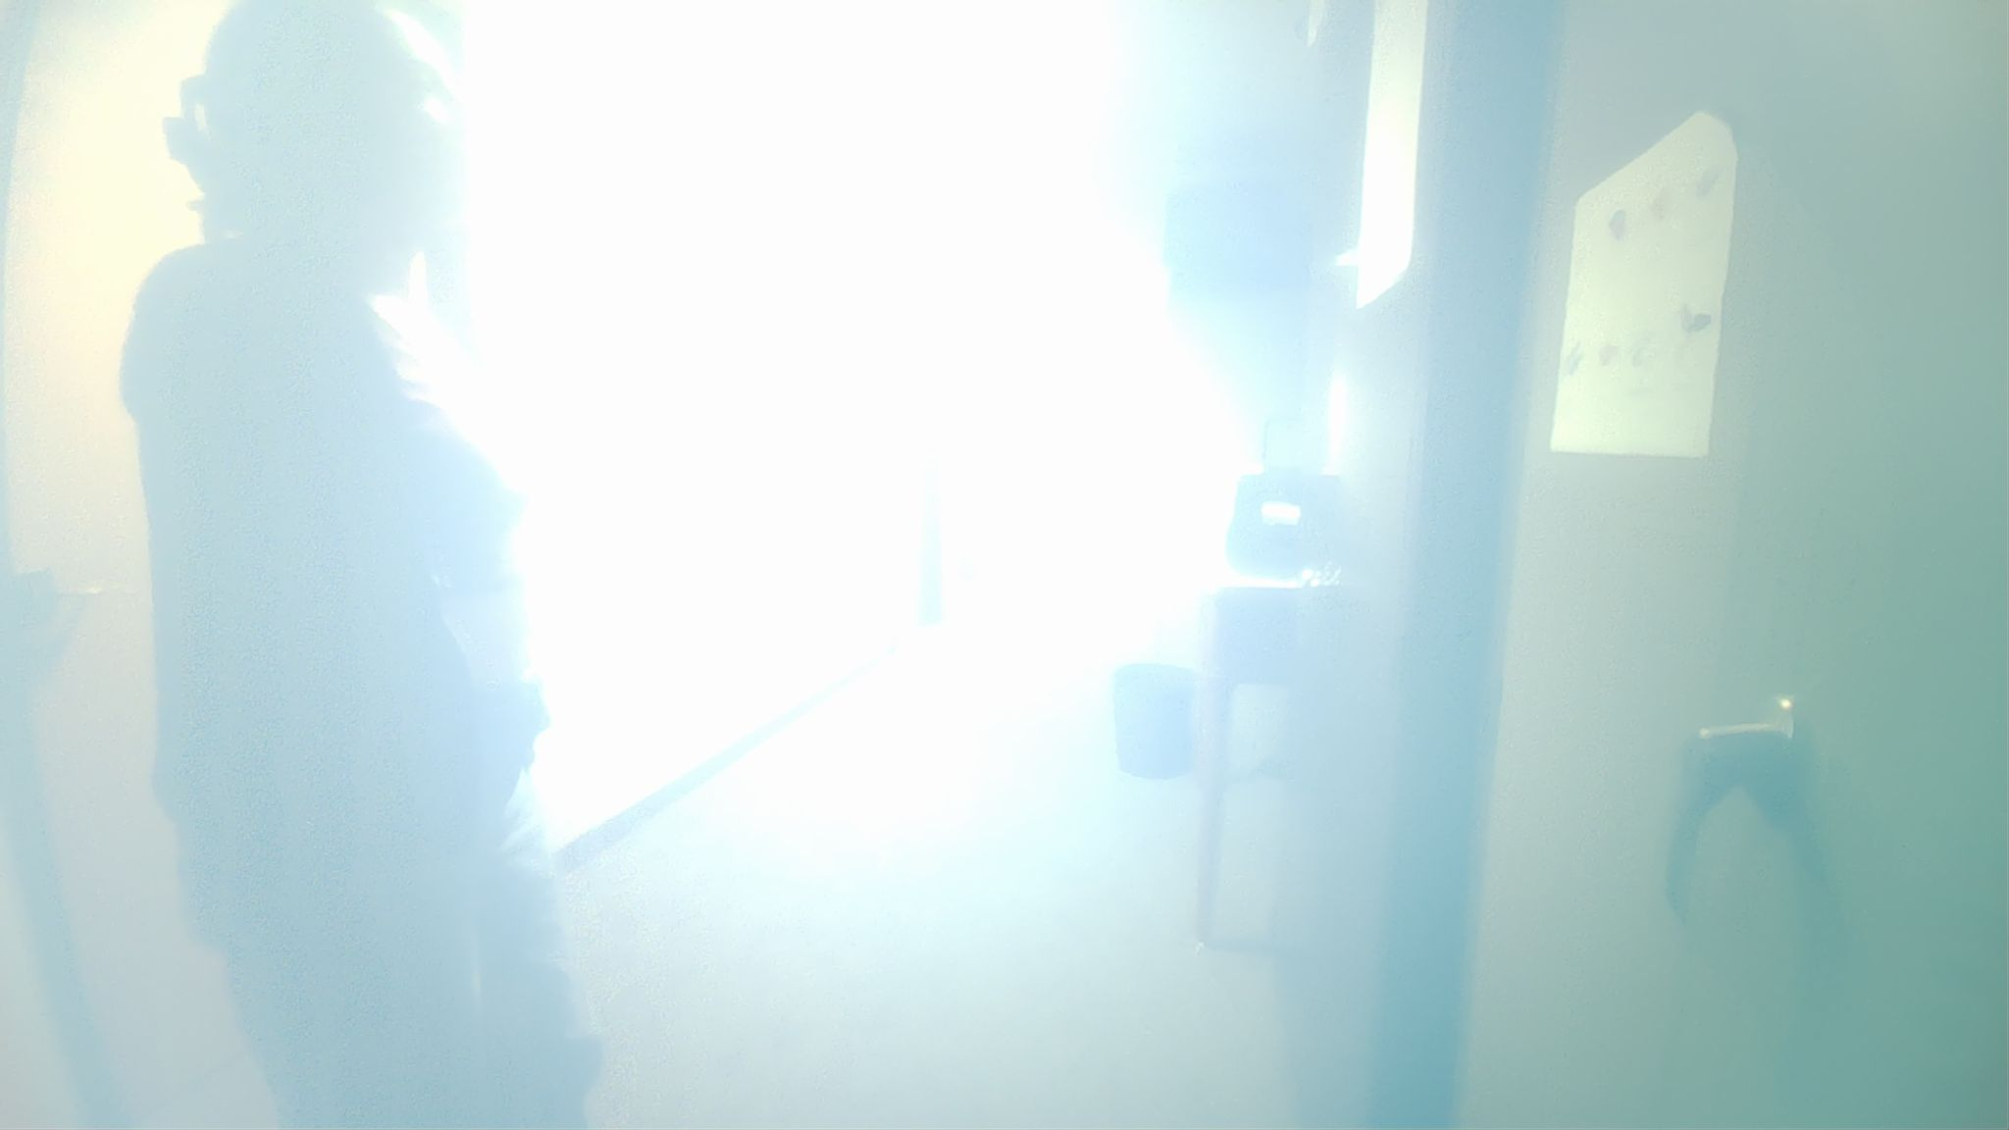
Diffusion Issue:
→

Slide 7
Demo Time:

Slide 8
Transfer Learning Results
Model | Precision | Recall | mAP50 | mAP50-95
Original YOLOv8m | 0.777 | 0.579 | 0.680 | 0.372
‘Fine-tuned’ Plasticola YOLOv8m | 0.769 | 0.667 | 0.779 | 0.397
^Only Precision
performed a tad bit worse, but it’s not always the case!
It’s also worth mentioning that precision isn’t necessarily a priority in this project.
Fine-tuning improved mAP50 from 0.680 to 0.779 and mAP50-95 from 0.372 to 0.397 on the held-out Plasticola test set.

Slide 9




Qualitative Results
As shown, the fine-tuned model often detected more people in Plasticola-specific conditions: low light, plastic diffusion, glare, and partial visibility.
Main remaining weakness: difficult glare and haze can still reduce box accuracy, so future improvements should focus on more hard negative images and cleaner optics.
Overlap! →

Slide 10
Thank You! :)

