Slide 1
Network Intrusion Detection
with Machine Learning
John MacIntyre · Jacob Marshall
Mentors: Dr. Namsong Wu · Dr. Gurman Gill · CS 470

Slide 2
The Problem
2
Network attacks are growing in frequency and sophistication, but most ML-based IDS models prioritise accuracy over deployability.
What is an IDS?
The Gap in Published Research
An Intrusion Detection System monitors network traffic and classifies flows as normal or one of several attack types in real time.
Most IDS papers report high accuracy but never measure model size, latency, or memory footprint, the metrics that determine if a model can actually be deployed.
Why Size Matters
Our Goal
Real deployments run on embedded monitors, IoT gateways, and vehicle-level hardware. A 67 MB Random Forest is not feasible on a device with 1 GB RAM and strict latency requirements.
Can feature reduction produce a model under 1 MB that retains high detection accuracy? We benchmark three compact models against two published reference studies.

Slide 3
Research Question & Objectives
3
Research Question: Which intrusion detection model provides the best balance between detection performance and computational efficiency for practical deployment?
1. Compare ML models for IDS performance
2. Measure computational efficiency
Decision Tree, XGBoost, LightGBM trained on the same features and evaluated identically
Model size (KB), inference latency (ms), throughput (samples/sec), memory footprint
3. Apply feature reduction
4. Benchmark against published work
Reduce 79 raw features to a compact set using statistical and model-based ranking
Compare our results to two reference notebooks using the same CICIDS2017 dataset

Slide 4
Three-Phase Pipeline
4
Dataset: CICIDS2017, 2.83M labelled network flows, 79 features, 15 attack classes
01
Data Cleaning
02
Feature Engineering
03
Model Training
▸ Remove inf / NaN / duplicates
▸ Group 15 labels → 7 classes
▸ Decision Tree (depth sweep)
▸ Drop zero-variance & identical columns
→
▸ Correlation filter (r > 0.95)
→
▸ XGBoost (Optuna 50 trials, GPU)
▸ Memory downcast (44% reduction)
▸ Kruskal-Wallis + RF importance
▸ LightGBM (Optuna 15 trials)
▸ Result: 2,499,641 clean rows, 66 cols
▸ Result: 10 final features selected
▸ Benchmark: size, latency, F1, throughput

Slide 5
Data Cleaning
5
01
Infinite values → median imputation
02
Negative flow duration removed
Flow Bytes/s and Packets/s contained 4,376 infinite values. Replaced with column median, recovering rows that dropna() would discard.
115 rows had negative Flow Duration (physically impossible). Removed as instrumentation errors.
03
Zero-variance & identical columns dropped
04
Duplicates removed + memory downcast
8 constant columns dropped (e.g. Bwd PSH Flags). 5 byte-for-byte duplicate columns removed using Series.equals(). Found SYN Flag Count = Fwd PSH Flags
308,373 duplicate rows removed. float64→float32 downcast achieved 44% memory reduction (1,400→780 MB). Post-downcast dedup removed 22,614 precision-collision rows.
Final: 2,499,641 rows · 780 MB (−44%)

Slide 6
How We Selected 10 Features
6
79 raw features
Original CICIDS2017 columns
Why two methods?
Kruskal-Wallis
Statistical test, how much does each feature's distribution differ across attack classes?
RF Importance
How often does each feature appear in tree splits? Features used near the root score highest.
Combined score
Normalise both 0–1 and average. Select top 10 where both agree.
▼
48 features
Removed 31 correlated pairs (r > 0.95)
▼
10 features selected
Combined Kruskal-Wallis + RF importance ranking

Slide 7
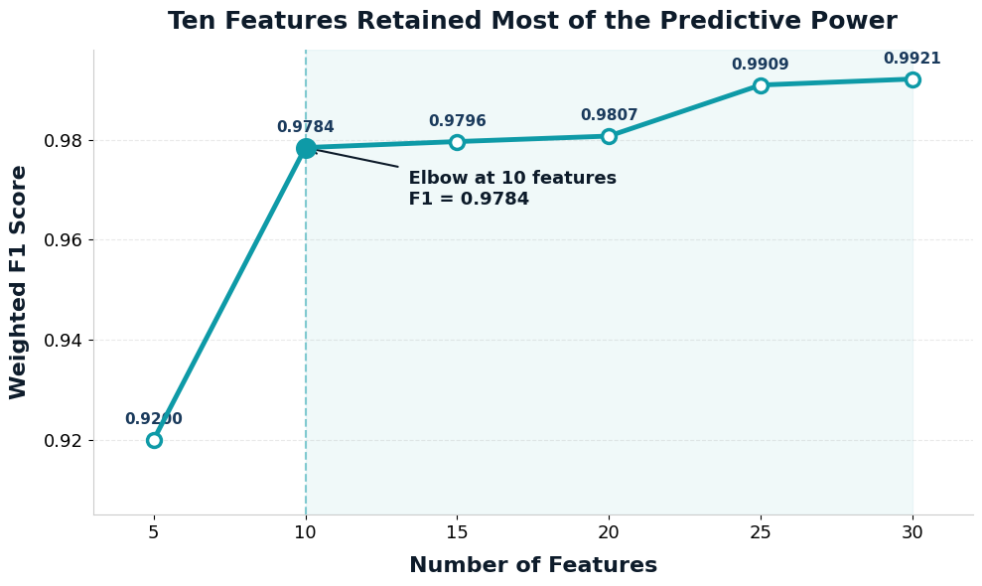
10 Features Retained Most of the Predictive Power
7
5 → 10 features
+0.058 F1
10 → 30 features
+0.014 F1
Model size at 10
27 KB

Slide 8
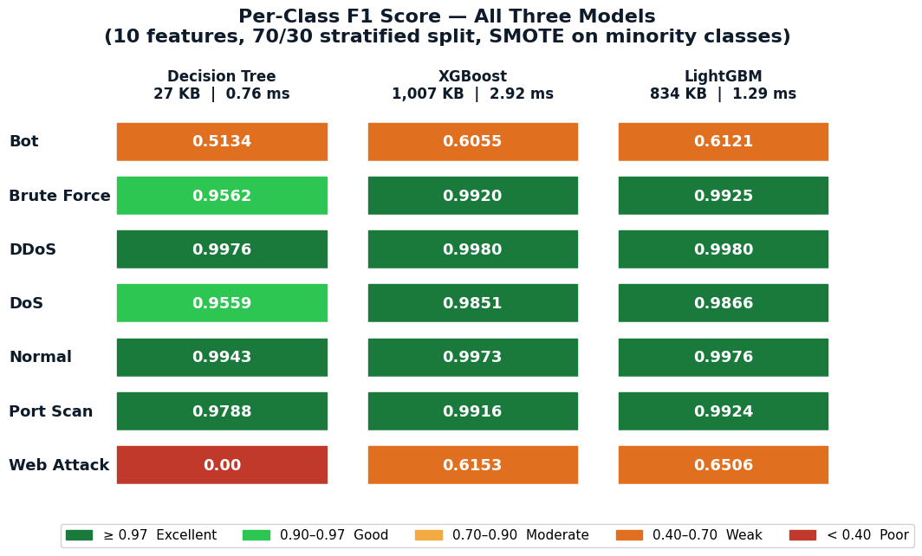
Per-Class F1 — All Three Models
8
Key takeaways
✓ DDoS, Normal, Port Scanning, Brute Force — all models 0.95+ F1
↑ XGBoost and LightGBM significantly improve Bot and Web Attack over DT
! Bot (0.51–0.61) and Web Attack (0.00–0.65) are the hardest classes, a feature space problem, not a model failure

Slide 9
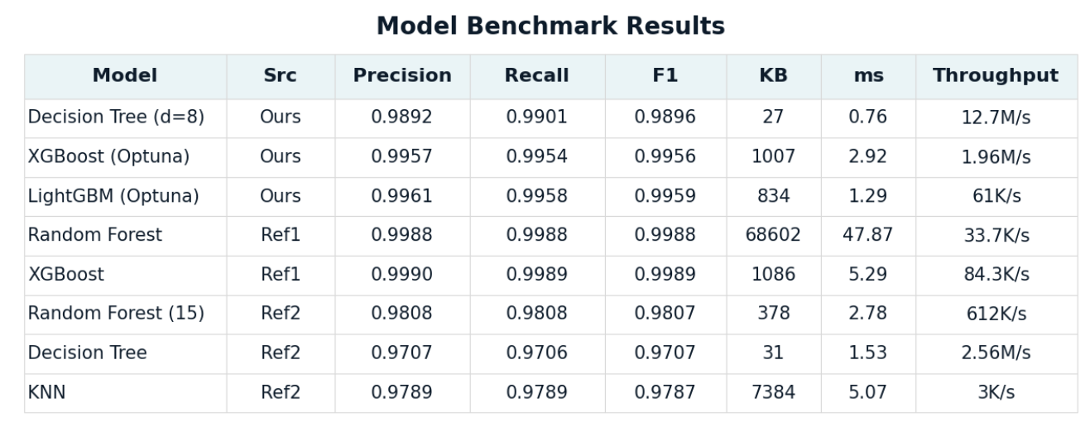
Full Benchmark — All Models
9
▸ DT is 2,440× smaller than Ref1 RF
▸ Our XGB is 8% smaller than Ref1 XGB with 23× higher throughput
▸ KNN (Ref1) terminated after 60+ min — infeasible at scale

Slide 10
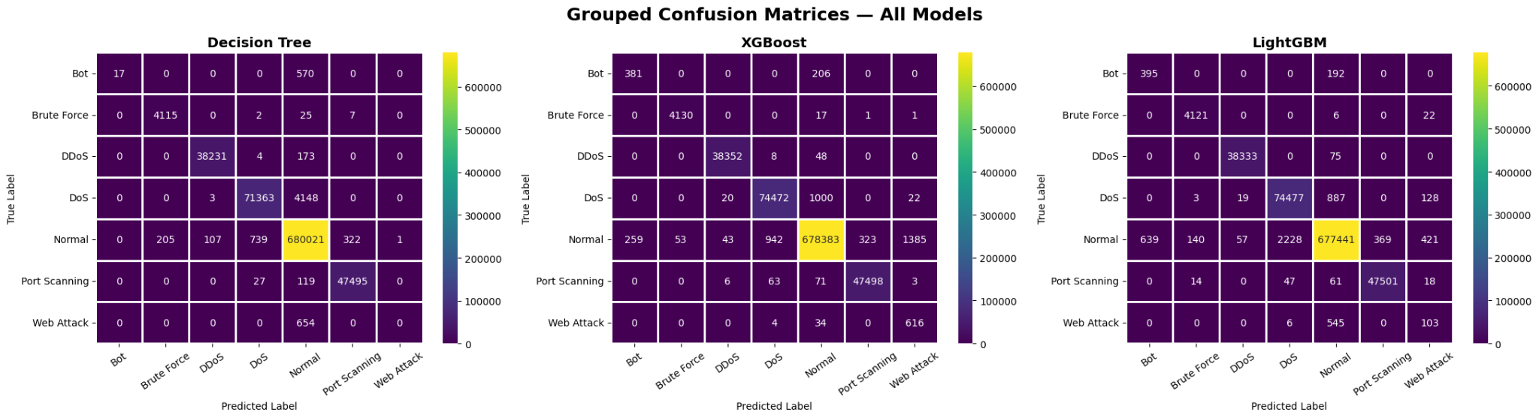
Confusion Matrices — All Three Models
10
Read the diagonal: bright values = correct predictions. Off-diagonal = misclassifications. Bot row shows most missed predictions (low recall) across all three models.

Slide 11
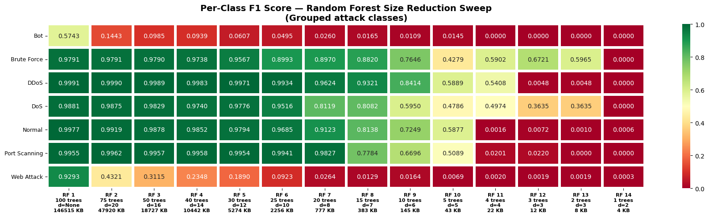
Random Forest - accuracy/size
11

Slide 12
Random Forest benchmarks
index | Model | Trees | Max Depth | Accuracy | Precision | Recall | F1 | KB | ms/sample | Throughput/s
0 | RF 1 (100 trees, d=) | 100 | None | 0.9959 | 0.9962 | 0.9959 | 0.996 | 146515 | 0.003887 | 257277
1 | RF 2 (75 trees, d=20) | 75 | 20 | 0.9868 | 0.9961 | 0.9868 | 0.991 | 47920 | 0.002823 | 354205
2 | RF 3 (50 trees, d=16) | 50 | 16 | 0.9801 | 0.9952 | 0.9801 | 0.9871 | 18727 | 0.001974 | 506675
3 | RF 4 (40 trees, d=14) | 40 | 14 | 0.9761 | 0.9934 | 0.9761 | 0.9841 | 10442 | 0.001532 | 652809
4 | RF 5 (30 trees, d=12) | 30 | 12 | 0.9669 | 0.9938 | 0.9669 | 0.9795 | 5274 | 0.001256 | 796103
5 | RF 6 (25 trees, d=10) | 25 | 10 | 0.9488 | 0.9899 | 0.9488 | 0.968 | 2256 | 0.001067 | 937317
6 | RF 7 (20 trees, d=8) | 20 | 8 | 0.8592 | 0.9723 | 0.8592 | 0.9088 | 777 | 0.00092 | 1087383
7 | RF 8 (15 trees, d=7) | 15 | 7 | 0.7356 | 0.9561 | 0.7356 | 0.8195 | 383 | 0.00079 | 1265062
8 | RF 9 (10 trees, d=6) | 10 | 6 | 0.6299 | 0.9544 | 0.6299 | 0.7374 | 145 | 0.000669 | 1494308
9 | RF 10 (5 trees, d=5) | 5 | 5 | 0.476 | 0.9076 | 0.476 | 0.5873 | 43 | 0.000459 | 2176306
10 | RF 11 (4 trees, d=4) | 4 | 4 | 0.0878 | 0.9546 | 0.0878 | 0.0918 | 22 | 0.000442 | 2263908
11 | RF 12 (3 trees, d=3) | 3 | 3 | 0.0628 | 0.9444 | 0.0628 | 0.0688 | 12 | 0.000403 | 2478757
12 | RF 13 (2 trees, d=3) | 2 | 3 | 0.0562 | 0.9054 | 0.0562 | 0.0604 | 8 | 0.000364 | 2747201
13 | RF 14 (1 trees, d=2) | 1 | 2 | 0.0002 | 0.799 | 0.0002 | 0.0005 | 4 | 0.000308 | 3242647

Slide 13
An Unexpected Finding
12
Adding more features to the Decision Tree made it smaller
Feature Count
Model Size
F1 Weighted
Why?
10 features
27.4 KB
0.9896
More discriminative features let the tree reach pure leaf nodes earlier, fewer total splits needed = smaller file size.
15 features
25.2 KB
0.9903
20 features
23.4 KB
0.9911
30 features
22.9 KB
0.9931
The throughput tradeoff: 10 feat = 12,679K/s → 30 feat = 5,810K/s. Still 3× faster than XGBoost at 1,956K/s.

Slide 14
Key Findings
13
27 KB is viable
Gradient boosting matches references at fraction of the size
A Decision Tree at depth=8 with 10 features achieves 98.96% weighted F1, 0.76 ms latency, and 12.6M samples/sec throughput, under 30 KB on disk.
LightGBM (834 KB) and XGBoost (1,007 KB) match Ref1's accuracy while being up to 80× smaller than their Random Forest (67 MB).
More features = smaller DT
Bot and Web Attack remain hard
Adding targeted features reduced model size (27→22 KB) because the tree solves minority classes earlier and terminates branches sooner.
F1 of 0.51–0.65 across all models. Timing-based features cannot fully separate these classes, backward packet and TCP handshake features are needed.

