Slide 1
CS479 Wine Project
Hal Norman, Pablo Barriga,
Angel Centeno, Raul Gallardo Trejo

Slide 2
Overarching Goals for the Project
Keep track of the “Customer Journey” as they go through the store and select/examine certain wines in select isles
Keep track of which customers had employee interactions
Tell customer and employees apart from one another

Slide 3
Currently accomplished
Found a reliable CNN to detect people in the background
Built the fundamentals needed to make a heat map for customer activity in different isles of wine.
Detect percentage of time spent in each region of the store
Have the foundations for our Customer/Employee Classifier, however accuracy still has room for improvement.

Slide 4
Demonstrable Product
Bounding boxes for tracking people
Heatmap of customer activity for the isles
4 Classes of Customer Interaction
Customer Employee Classification
Improved accuracy to 84.8%
While the accuracy increase is small the proper classification of customers has increased noticeably

Slide 5
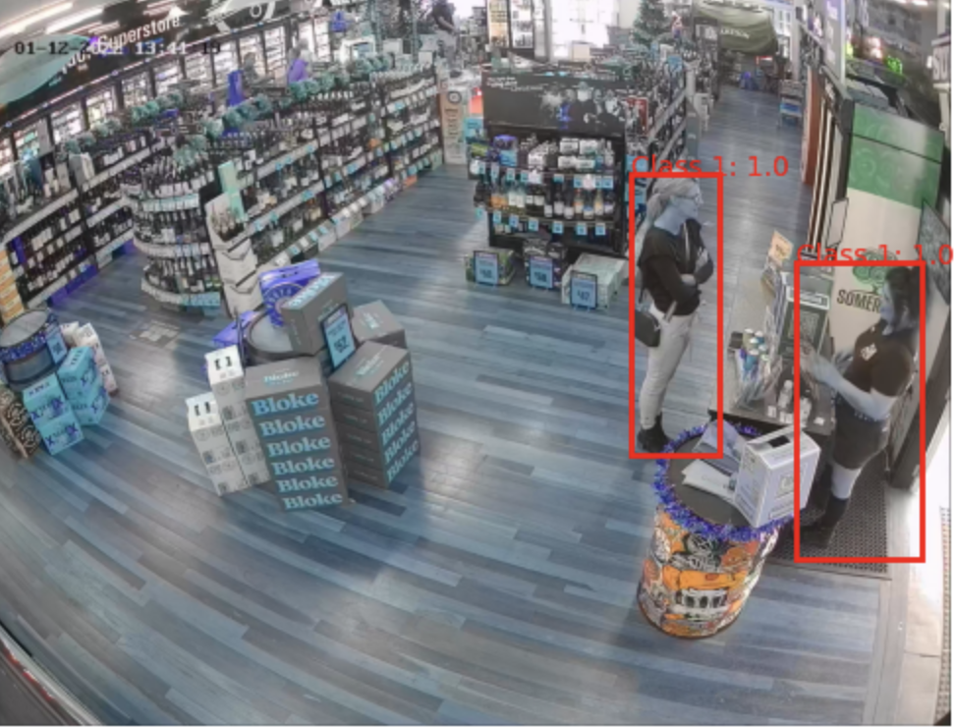
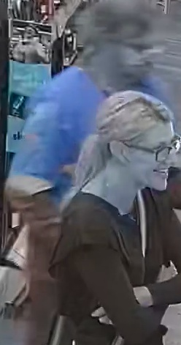
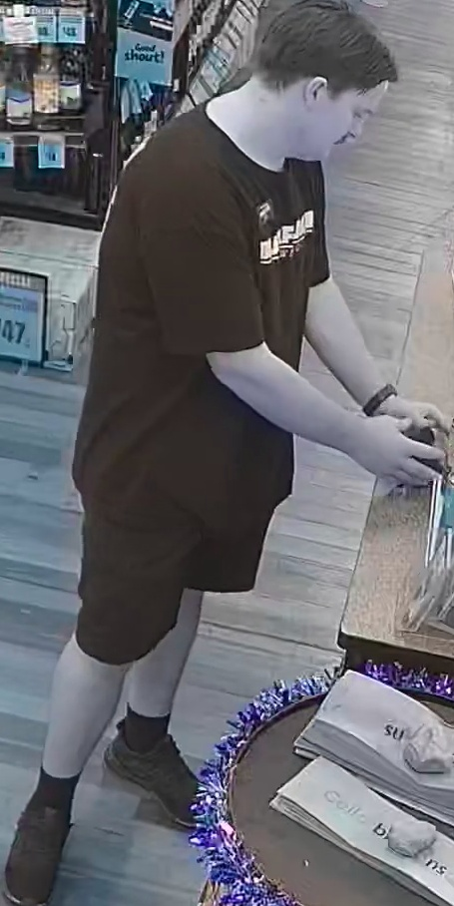
Data preparation/Bounding Box

Slide 6
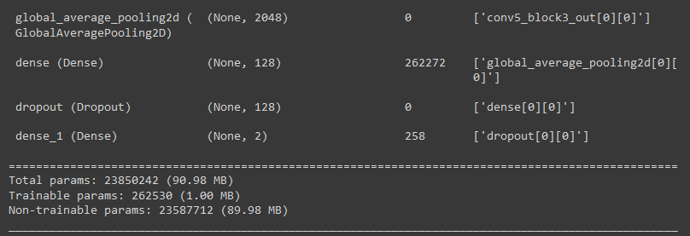
Customer Employee Classification
CNN made with Transfer Learning Based off Resnet
600+ image dataset labeled and organized
2 Labels
Customer
Employee
Currently has reached up to 84.8% Accuracy on validation set
Has a tendency to identify customers better than employees

Slide 7
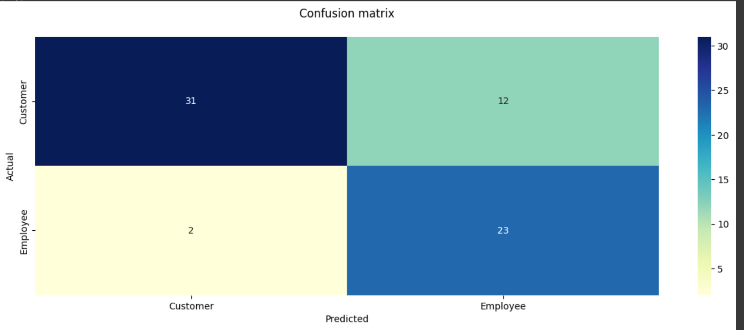
Previous Customer Employee Classifier

Slide 8
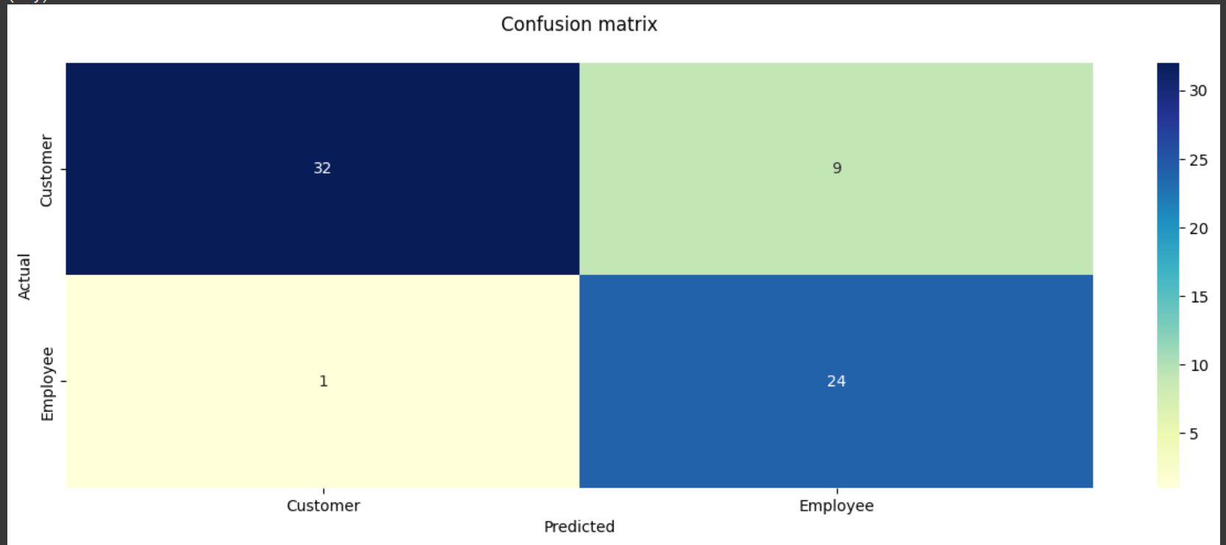
New Customer Employee Classifier

Slide 9
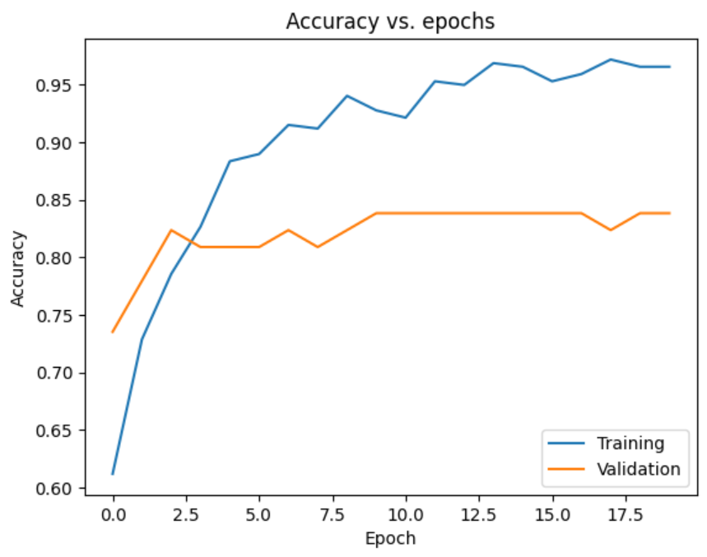
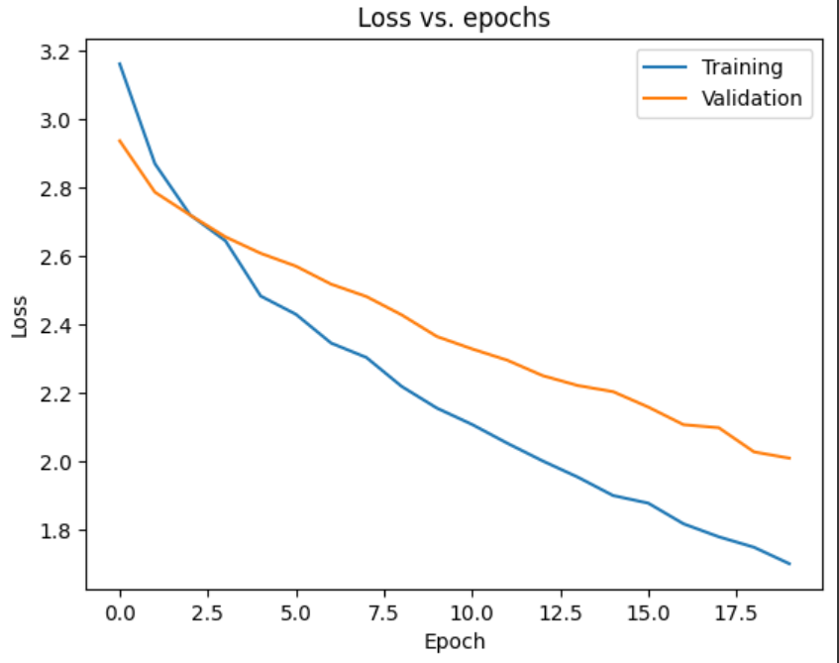
Customer Employee Classifier

Slide 10
Customer Employee Classifier

Slide 11
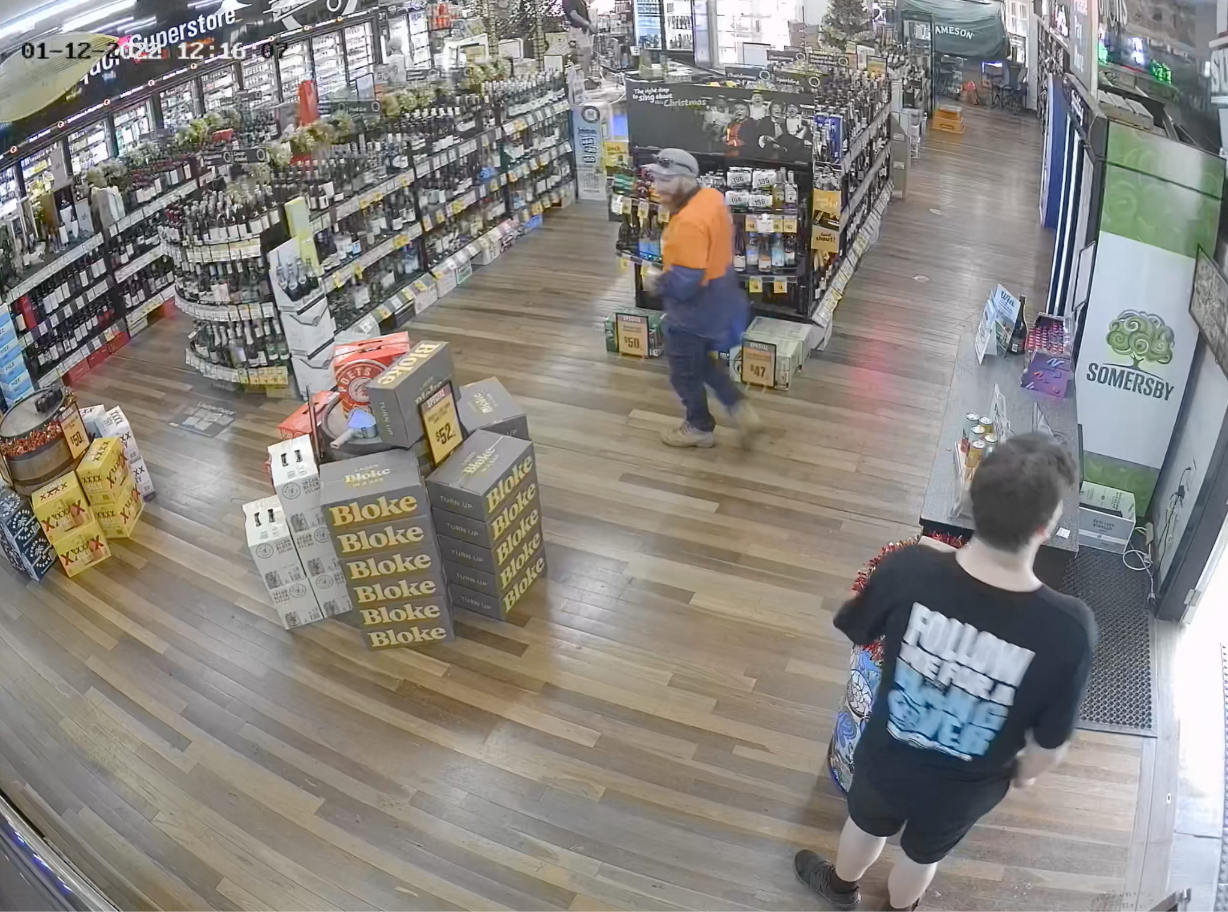
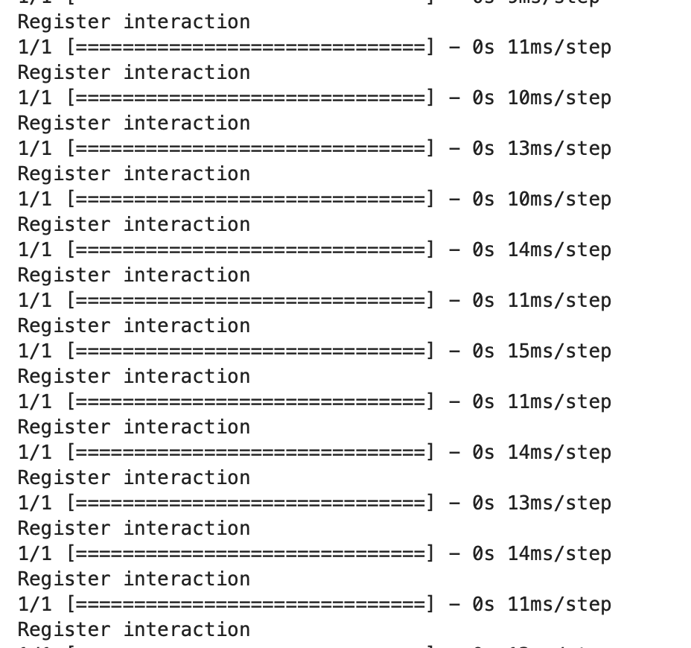
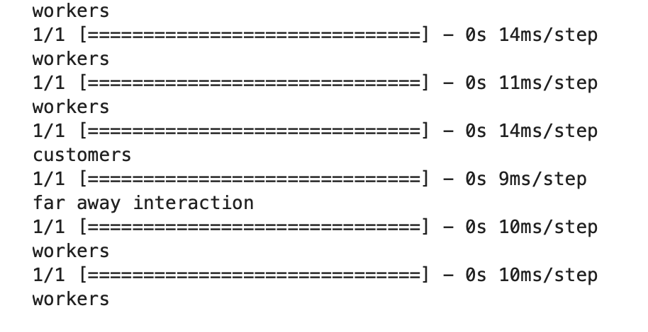
Customer Employee Scene classification
Looking at each 20 frames and classifying what's going on.

Slide 12
Finale output of scene classification
Displays what is the makeup of the video currently been seen

Slide 13
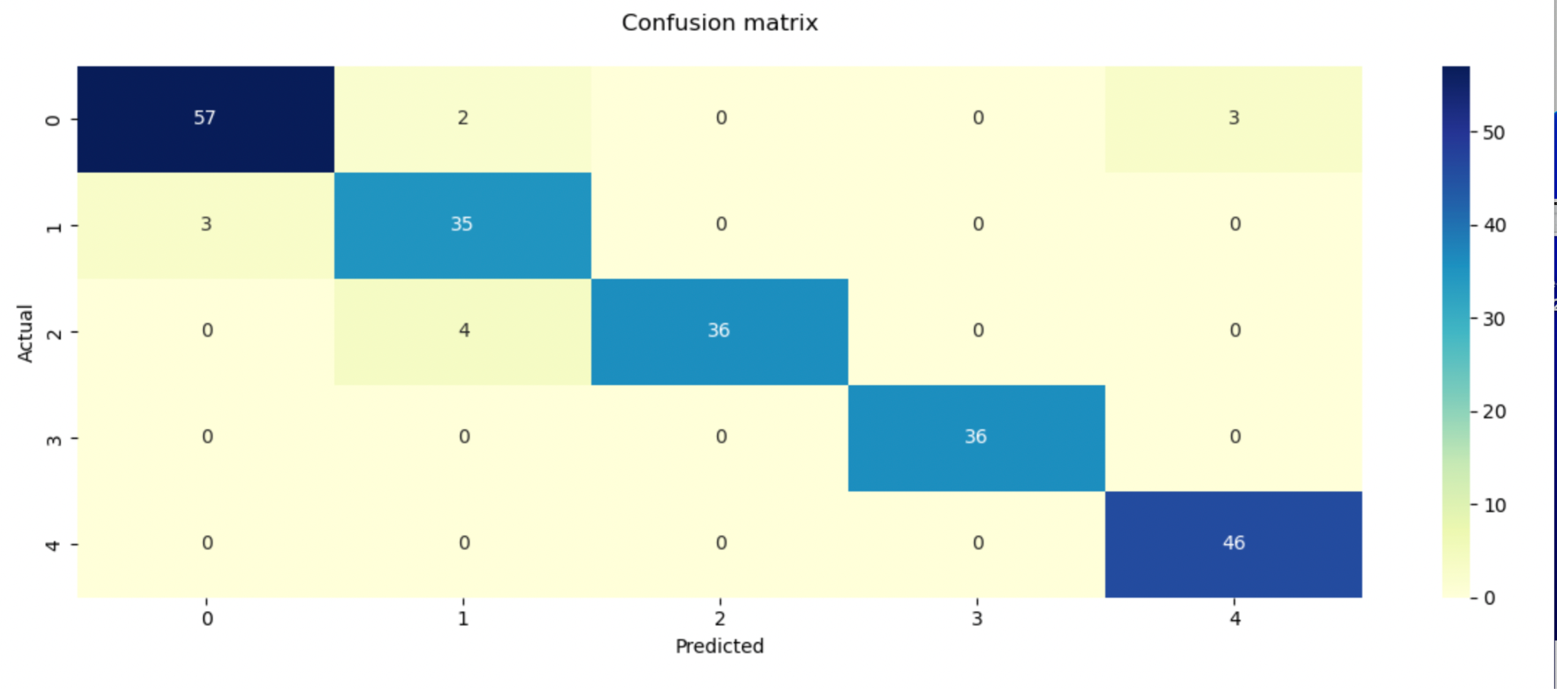
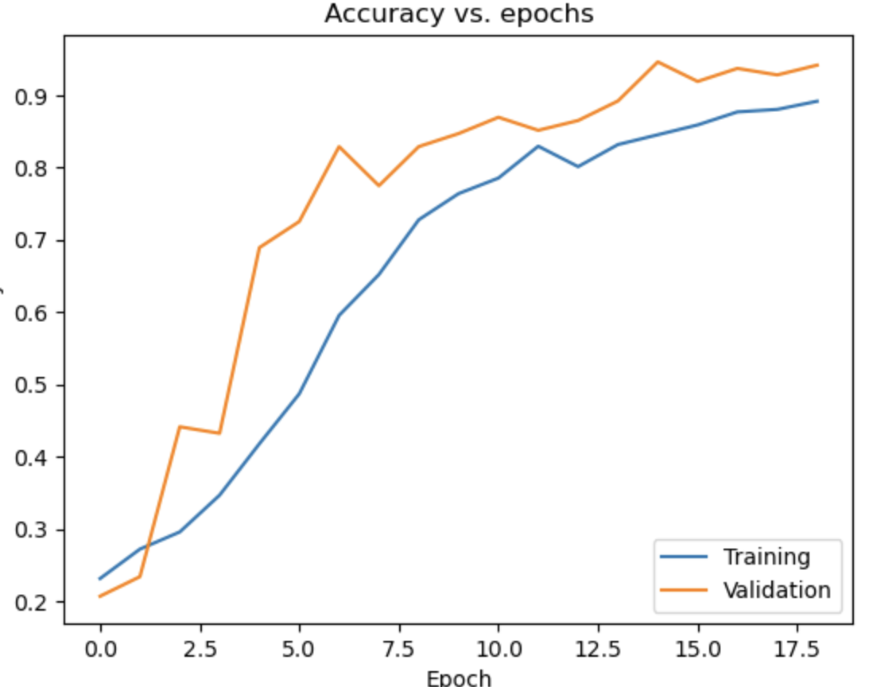
Confusion matrix and accuracy vs epochs for scene classification

Slide 14
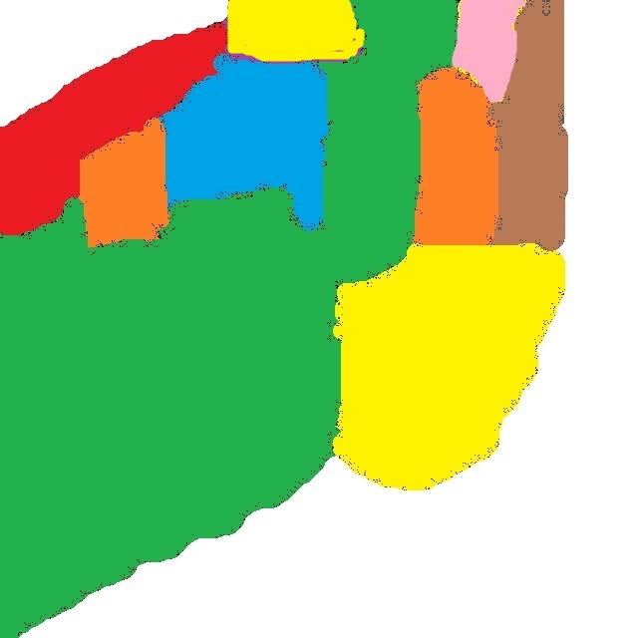
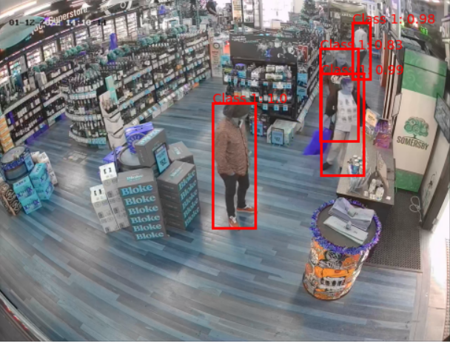
Region Map
Green - Promo (116)10.9%
Red - Red Wine (209)19.6%
Pink - Discount (152)14.3%
Orange - Sparkling (316)29.7%
Skyblue - White Wine (8)0.7%
Brown - Liquor (30)2.8%
Yellow - Register (232)21.8%

Slide 15
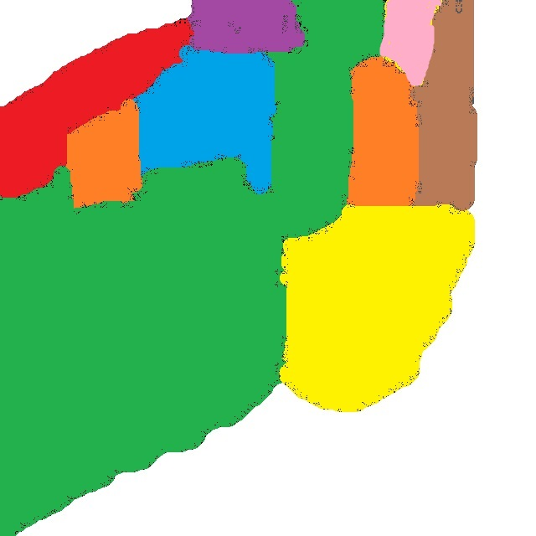
Region Map
Green - Promo (116)10.9%
Red - Red Wine (209)19.6%
Pink - Discount (152)14.3%
Orange - Sparkling (316)29.7%
Skyblue - White Wine (8)0.7%
Brown - Liquor (30)2.8%
Yellow - Register (232)21.8%

Slide 16
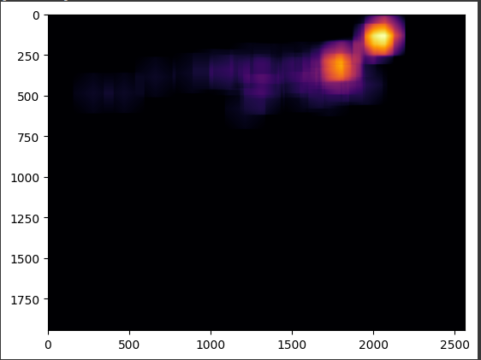
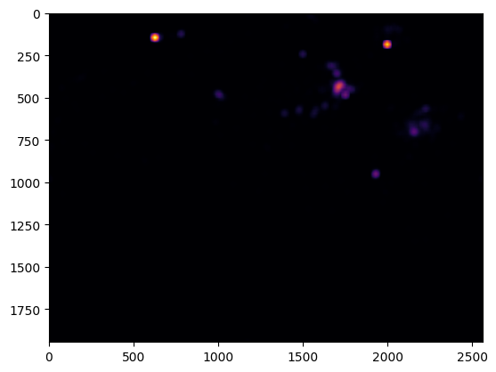
Heat Map

Slide 17
Work in progress
Improve Accuracy for Customer Employee Classifier
Improving the heatmap for customer activity
Tracking customer and employee interactions

Slide 18
Future Goals
Customer Employee Classification of 90% accuracy or higher
Less Data Biases
More equally represented groups of people
Improve speed of BBox extractor
Fully connecting all of the aspects of the project together better

Slide 19
Stretch Goals - What we accomplished
Fully combining all the aspects of the project together
The Person Tracking - Neural Network
Customer Employee Identification
Heat Map of Customer Activity - N.N.
Customer Employee Interaction - N.N.

Slide 20
Stretch Goals - What was difficult

Slide 21
Stretch Goals - What we couldn't accomplish
Continuously Tracking Customers with unique identifiers
Tracking each customers travel route through the store and their isle they spent the most time in
Did not reach past 90% accuracy
Instead focused on improving the detection of customers so they can be properly tracked for our heatmap.

Slide 22
For the groups after us
Exploring the Yolo V8 model for speed
Has the potential to allow for the implementation of real time tracking
Trying out different CNN models to improve the accuracy or speed of what was done.
Increasing the amount of labeled data for training and validation for whichever model they decide to use
Will improve accuracy of Customer Employee Classification

Slide 23
Thank you

Slide 24
Resources used
Pytorch Documentation - For the bounding boxes model
Tensorflow Documentation - for the Customer Employee Classification & For
Customer Employee Interaction Models
Stack Overflow - for troubleshooting
Aseprite - For creating the region map

