Slide 1
Grain Boundary Detection
Joel
Luis
Xander
Ben

Slide 2
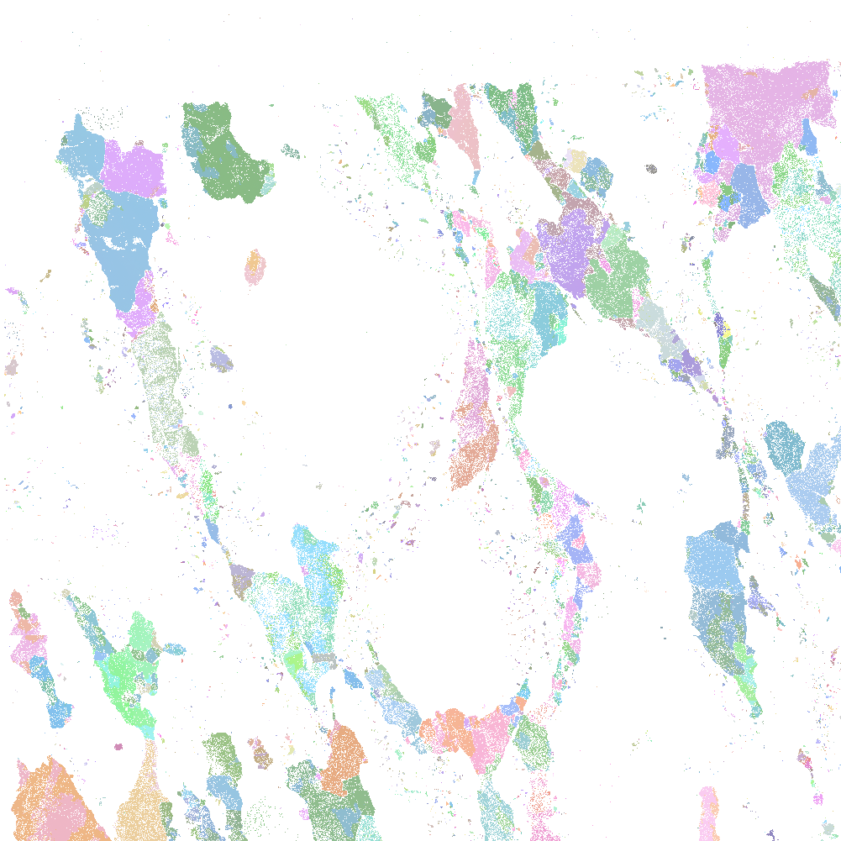
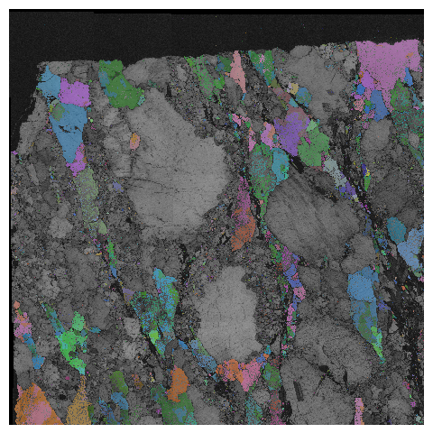
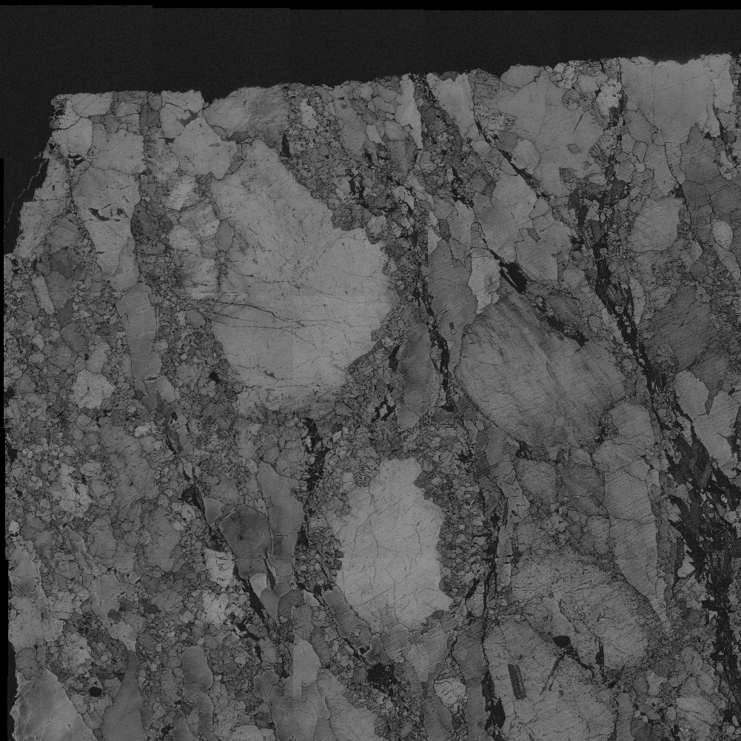
Xander
Goal:
- detect quartz grain within the given images.
- Develop a method to tie the datasets derived from SEMs (Scanning electron microscopes) EDS and EBSD, together.
Data:
- EDS: Electron dispersive spectroscopy to create chemical compositions of our rock samples
- EBSD: Electron BackScatter Diffraction which finds the crystallographic structure, orientation, and phase of the sample (Band Contrast)
The inability for AZtecOne to utilize both these datasets concurrently, creates difficulties in filling in regions of interest such as quartz, delineated from a high concentration of certain chemicals (SI) and not going over the lines delineated by the band contrast.

Slide 3
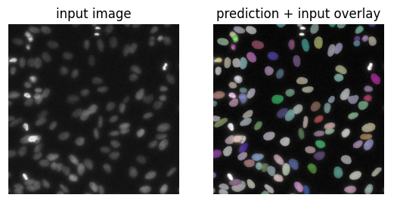
Xander
What is Stardist?
Stardist is a specialized U-Net designed to detect ellipsoid star convex shapes in cellular biology. The model works by accepting training images and annotations of those training images with the desired regions the model is learning to detect. stardist functions by determining the center point of a region to be detected and casts n number of rays out from that point to capture the desired region. Of note stardist is expecting a star convex shape which is why it was chosen for this geology project. As the grains we would like to detect are also star convex.

Slide 4
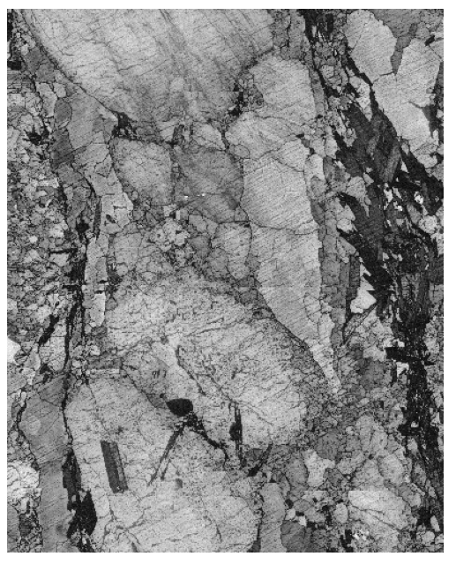
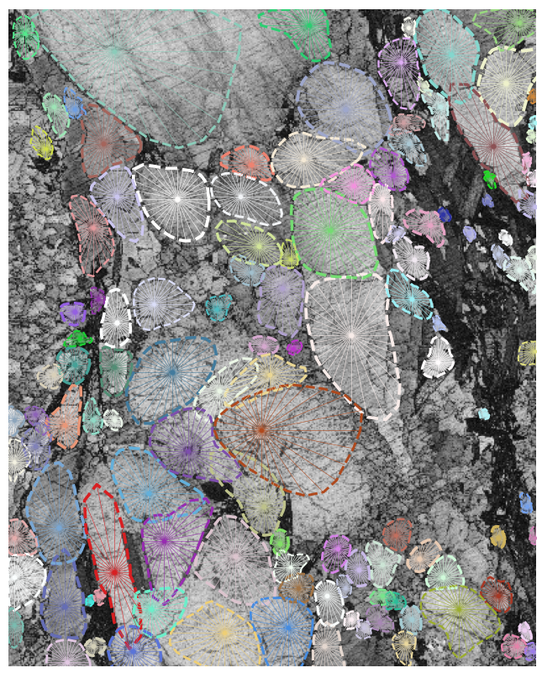
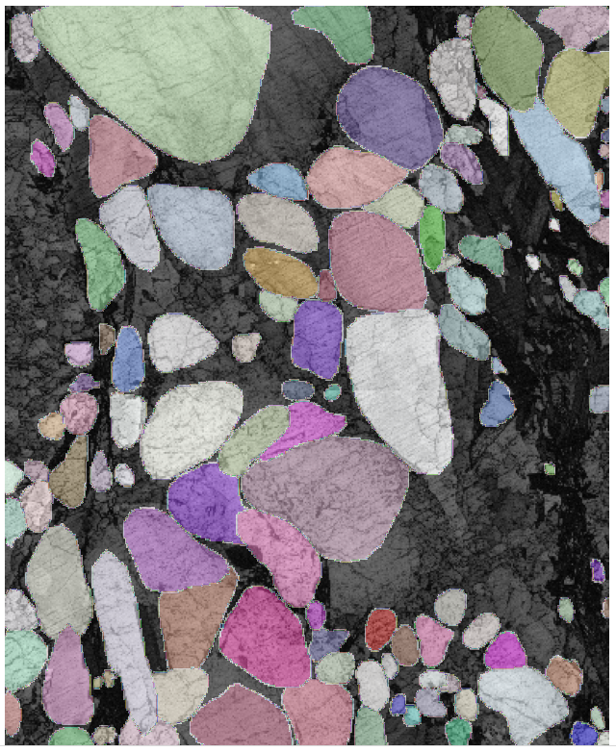
Xander
Starting with a pre-trained model.
stardist comes with pre trained models. Of the 2D models we tested, the most effective in detecting our grains was '2D_versatile_fluo' which was able to detect regions with decent enough accuracy, but with a significant problem. The regions it was detecting where rounded in shape and did not fit the grain edges that have to be preserved.

Slide 5
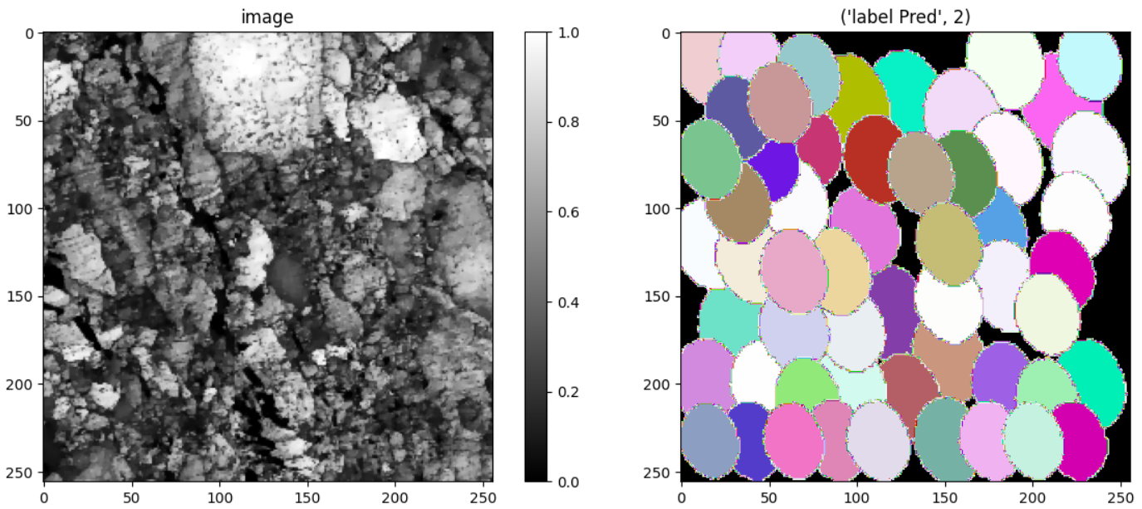
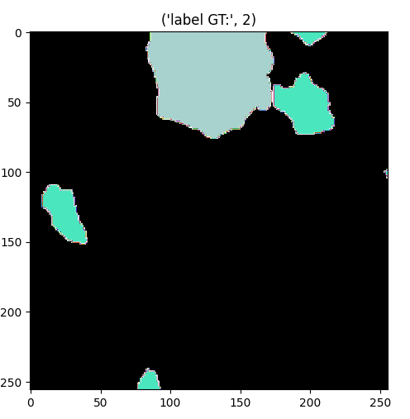
Xander
Shortcomings of Stardist
Without high number of epochs stardist utterly fails to detect the correct grains within the image. With the same settings but only 20 epochs the model defaults to random blobs of varying size based on the grid view. This could be due to how heavily stardist is designed for biology data with rounder ellipsoid shapes. Meaning the long train time is required to teach the model how to recognize rough and only shaped grains within our data.

Slide 6
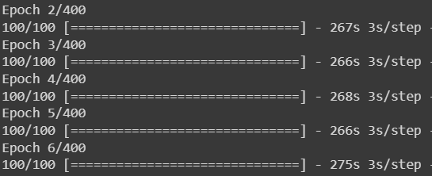
XANDER
Improvements to the model Training
Due to the high computational cost and time taken to train a stardust model for 400 epochs, a decent gpu is necessary for a reasonable and efficient training and testing of the model. With the use of docker and my own gpu, i hooked our model to my gpu which drastically increased epoch train time. On average the train time per each epoch was 9 to 10 seconds with my gpu and 268.4 seconds not using gpu or cpu. Resulting in a speed up of 29x. Which reduces the train time from 29.7 hours to a reasonable 1.11 hours.
With GPU
Without CPU or GPU

Slide 7
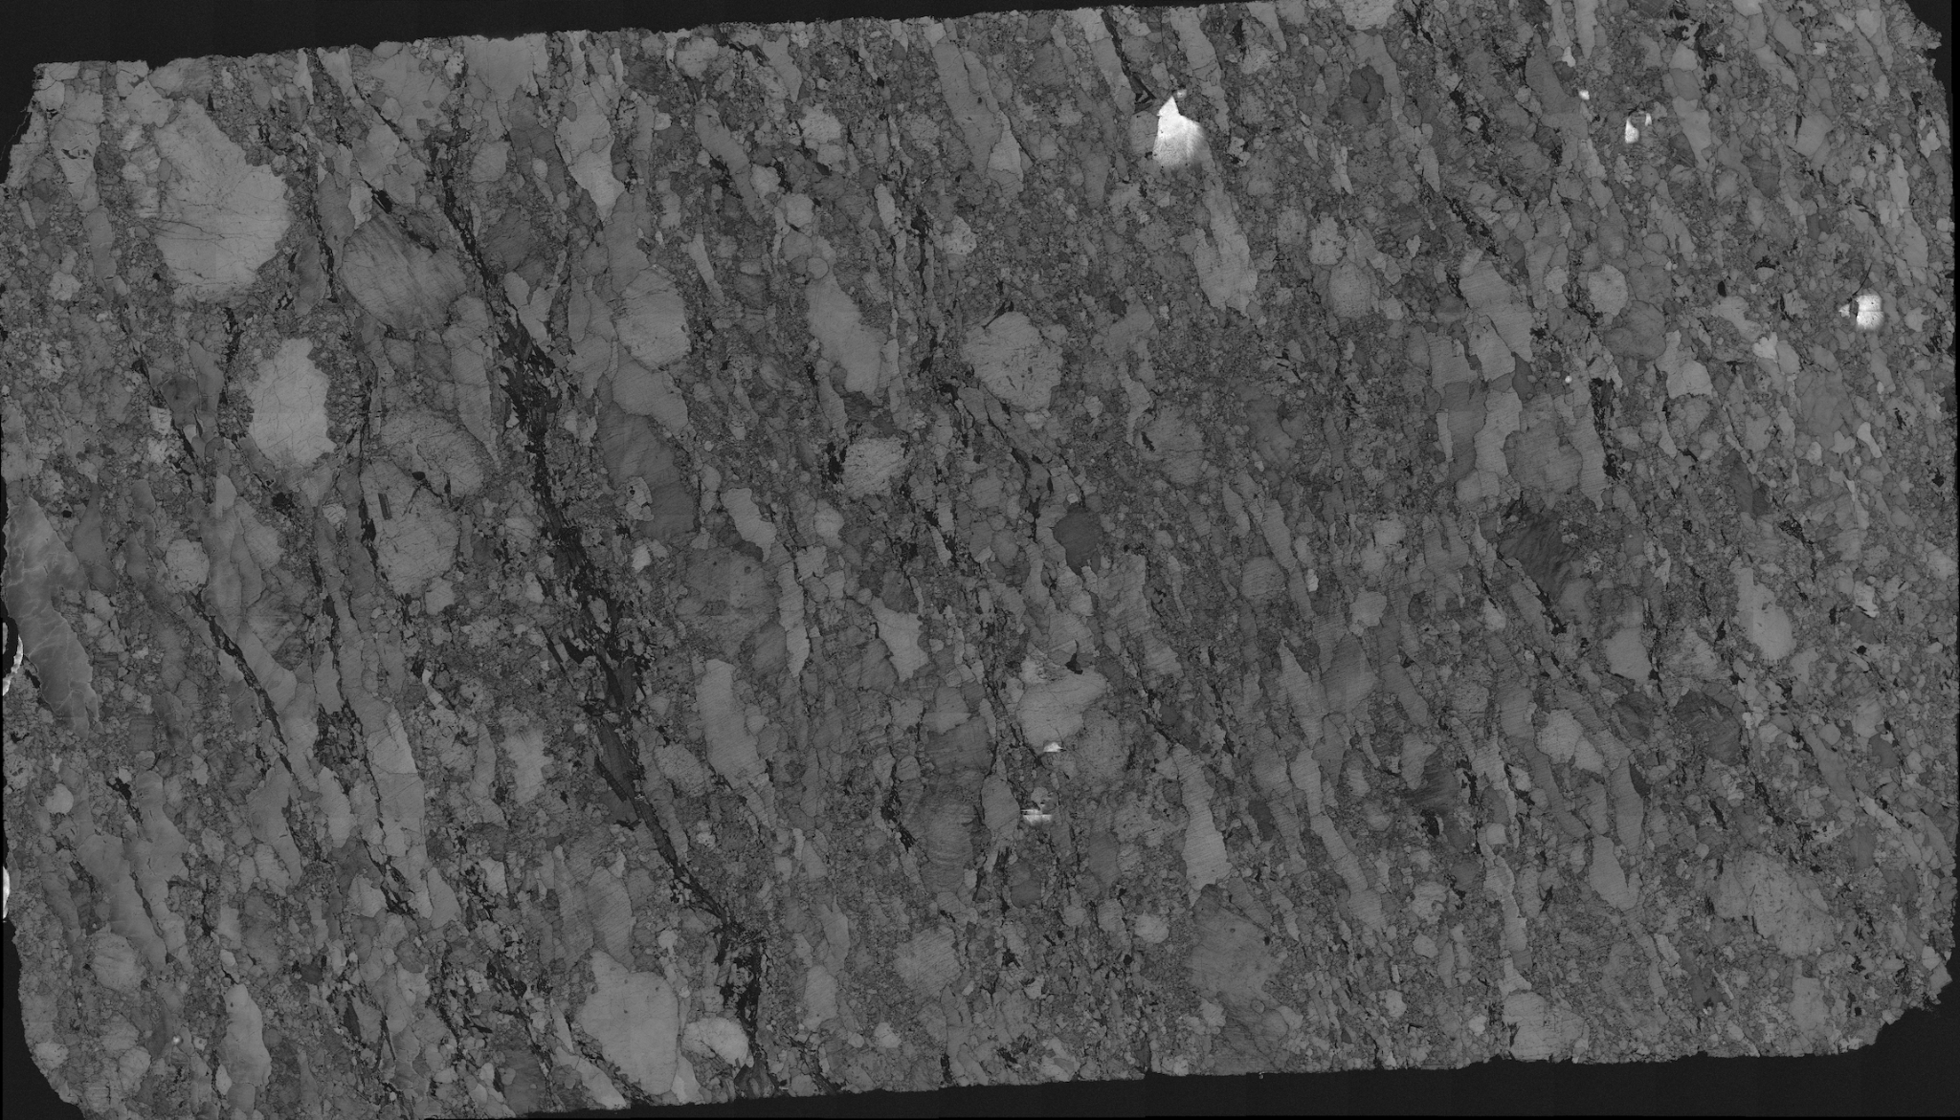
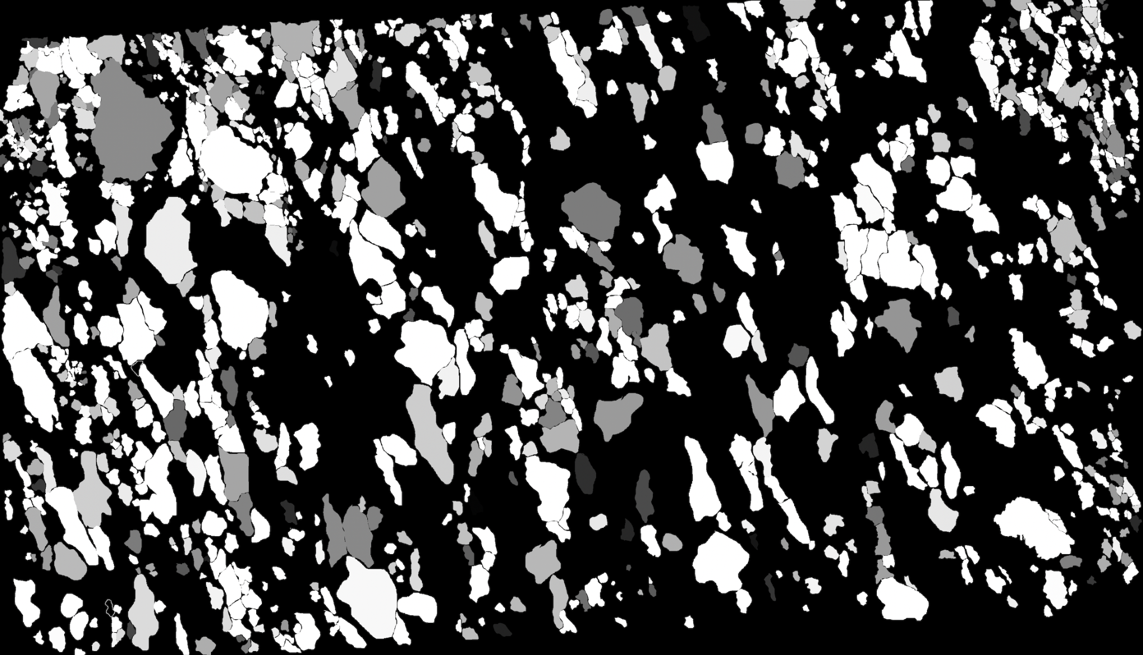
Ben
Creating Annotation Via QuPath
- To enhance the capability of our Stardist model through transfer learning, we annotated a Band contrast image to allow for training with masks characteristic of our dataset.
Original Band Contrast Image
Corresponding Mask

Slide 8
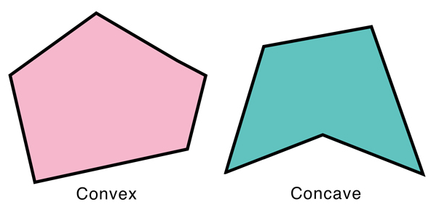
Ben
Stardist Data Prerequisites:
ROI’s must be pass convexity test to be able to be segmented properly by StarDist.
Convex shapes have all interior angles >180 degrees

Slide 9
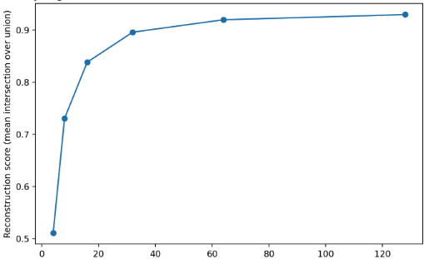
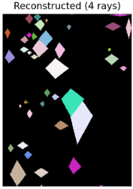
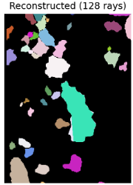
Ben
By configuring Stardist to cast more number of rays out from the centroid, more defined regions are created, however this is more computationally intensive.
- Band Contrast ROI Convexity Test for annotated Regions Of Interest
Accuracy of ground truth reconstruction should be >.8
Number of rays for star-convex polygon

Slide 10
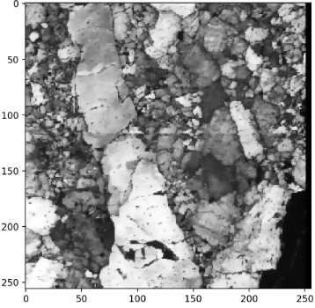
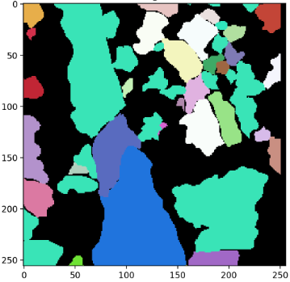
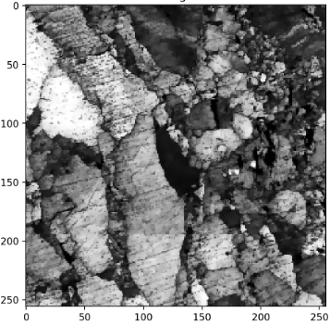
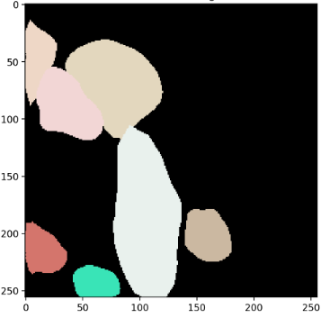
Ben
Initial Training Efforts with Stardist
- Training with Stardist began with our manually annotated images via QuPath. (90 256 x 256)
- Despite fine-tuning the pretrained model's configurations and training on these annotated images for the last 3 layers of the model, the results were not up to expectations. This led to exploring alternative methods for creating more training data to enhance model performance.
Original BC Image
Ground Truth Label
Original BC Image
Model Prediction

Slide 11
Ben
Stardist Architecture used

Slide 12
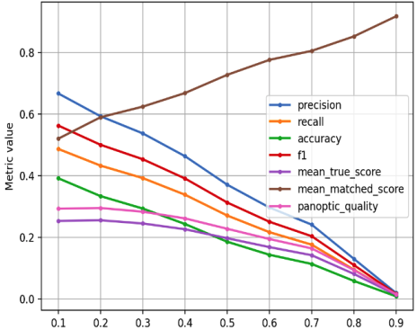
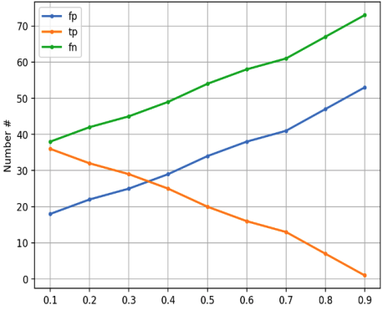
Ben
- Results: To evaluate the actual detection/segmentation performance on the validation data we considered objects in the ground truth to be correctly matched if there were predicted objects with overlap (here intersection over union (IoU)) beyond a chosen IoU threshold 𝜏
- The value of 𝜏 can be between 0 (even slightly overlapping objects count as correctly predicted) and 1 (only pixel-perfectly overlapping objects count).
IoU threshold 𝜏
IoU threshold 𝜏

Slide 13
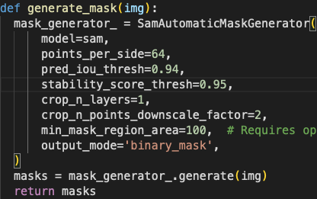
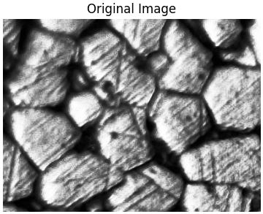
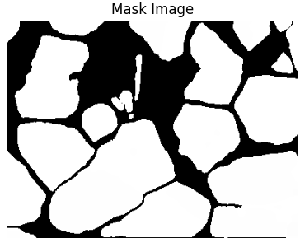
Ben
Utilizing the Segment Anything Model (SAM) by Meta to generate masks for all objects in an Kaggle Dataset.
points_per_side: Used for number of points to be sampled along one side of the image (**2)
pred_iou_thresh: Used as a filtering threshold for model’s predicted mask quality.
stability_score_thresh: Used as a filtering threshold that using the stability of the mask under changes to cut off the model’s mask predictions.

Slide 14
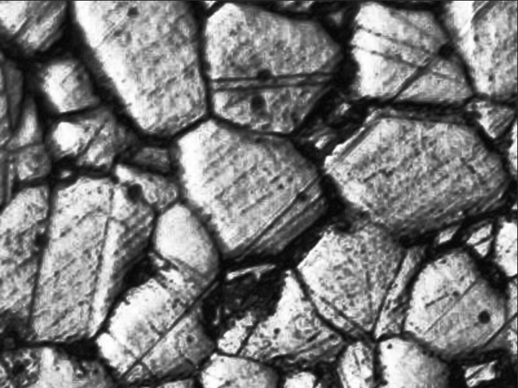
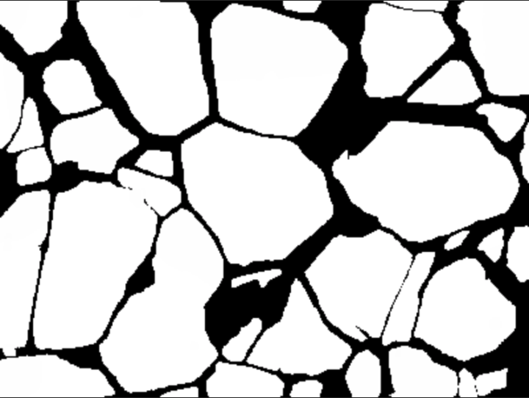
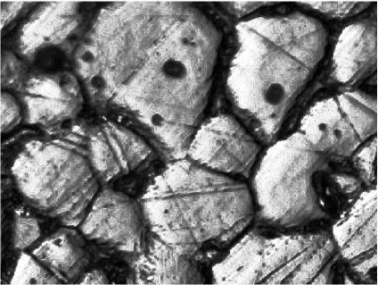
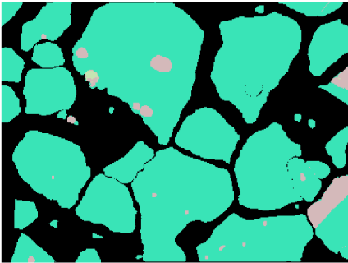
Ben
Adopting SAM for Image Annotation:
- Open-source model SAM (Segmentation Anything Model) by Meta used to quickly generate annotated masks.
- A Kaggle dataset of Stainless Steel 316L Grains resembling our band contrast images was used as input to the model and helped create 230 new annotated images. This approach initially seemed promising for training purposes.
- Stardist interpreted the SAM annotations differently creating unwanted artifacts
Original Kaggle Image
SAM Mask
Original Kaggle Image
Stardist Mask

Slide 15
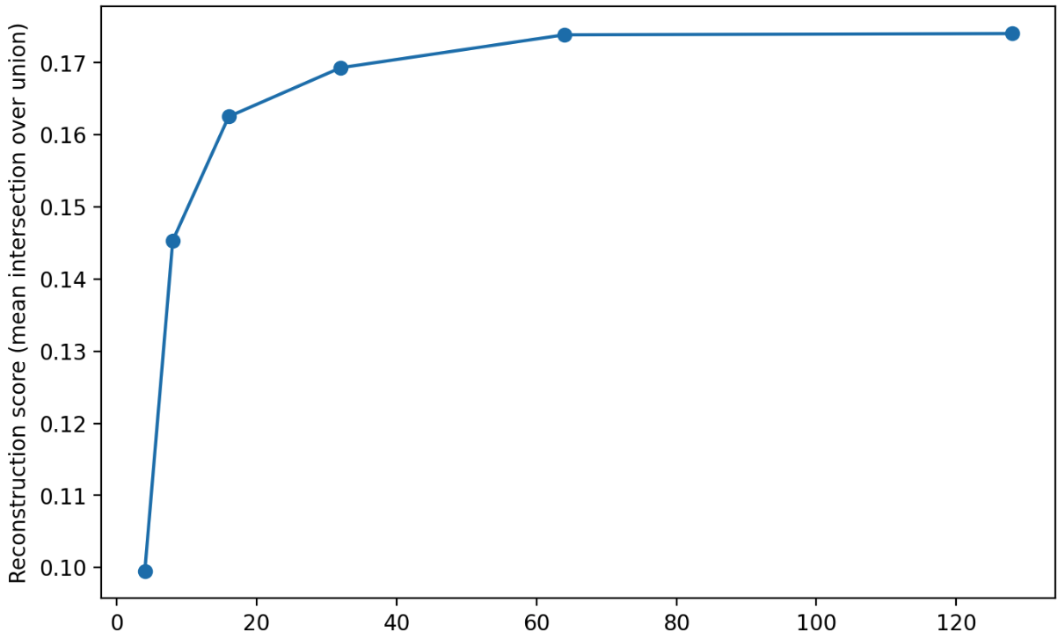
Ben
Encountering Convexity Challenges:
- Masks generated through SAM, while visually reliable, failed the convexity test, indicating non-convex shapes.
Accuracy of ground truth reconstruction should be >.8
- Stemming from Stardist's interpretation of SAM-generated masks, necessitated additional preprocessing.
- Time constraints however, limited our ability to utilize these images for training and further model development.
Number of rays for star-convex polygon

Slide 16
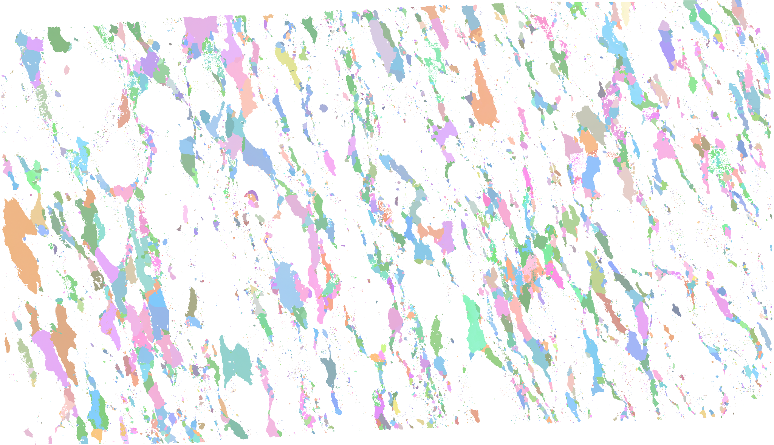
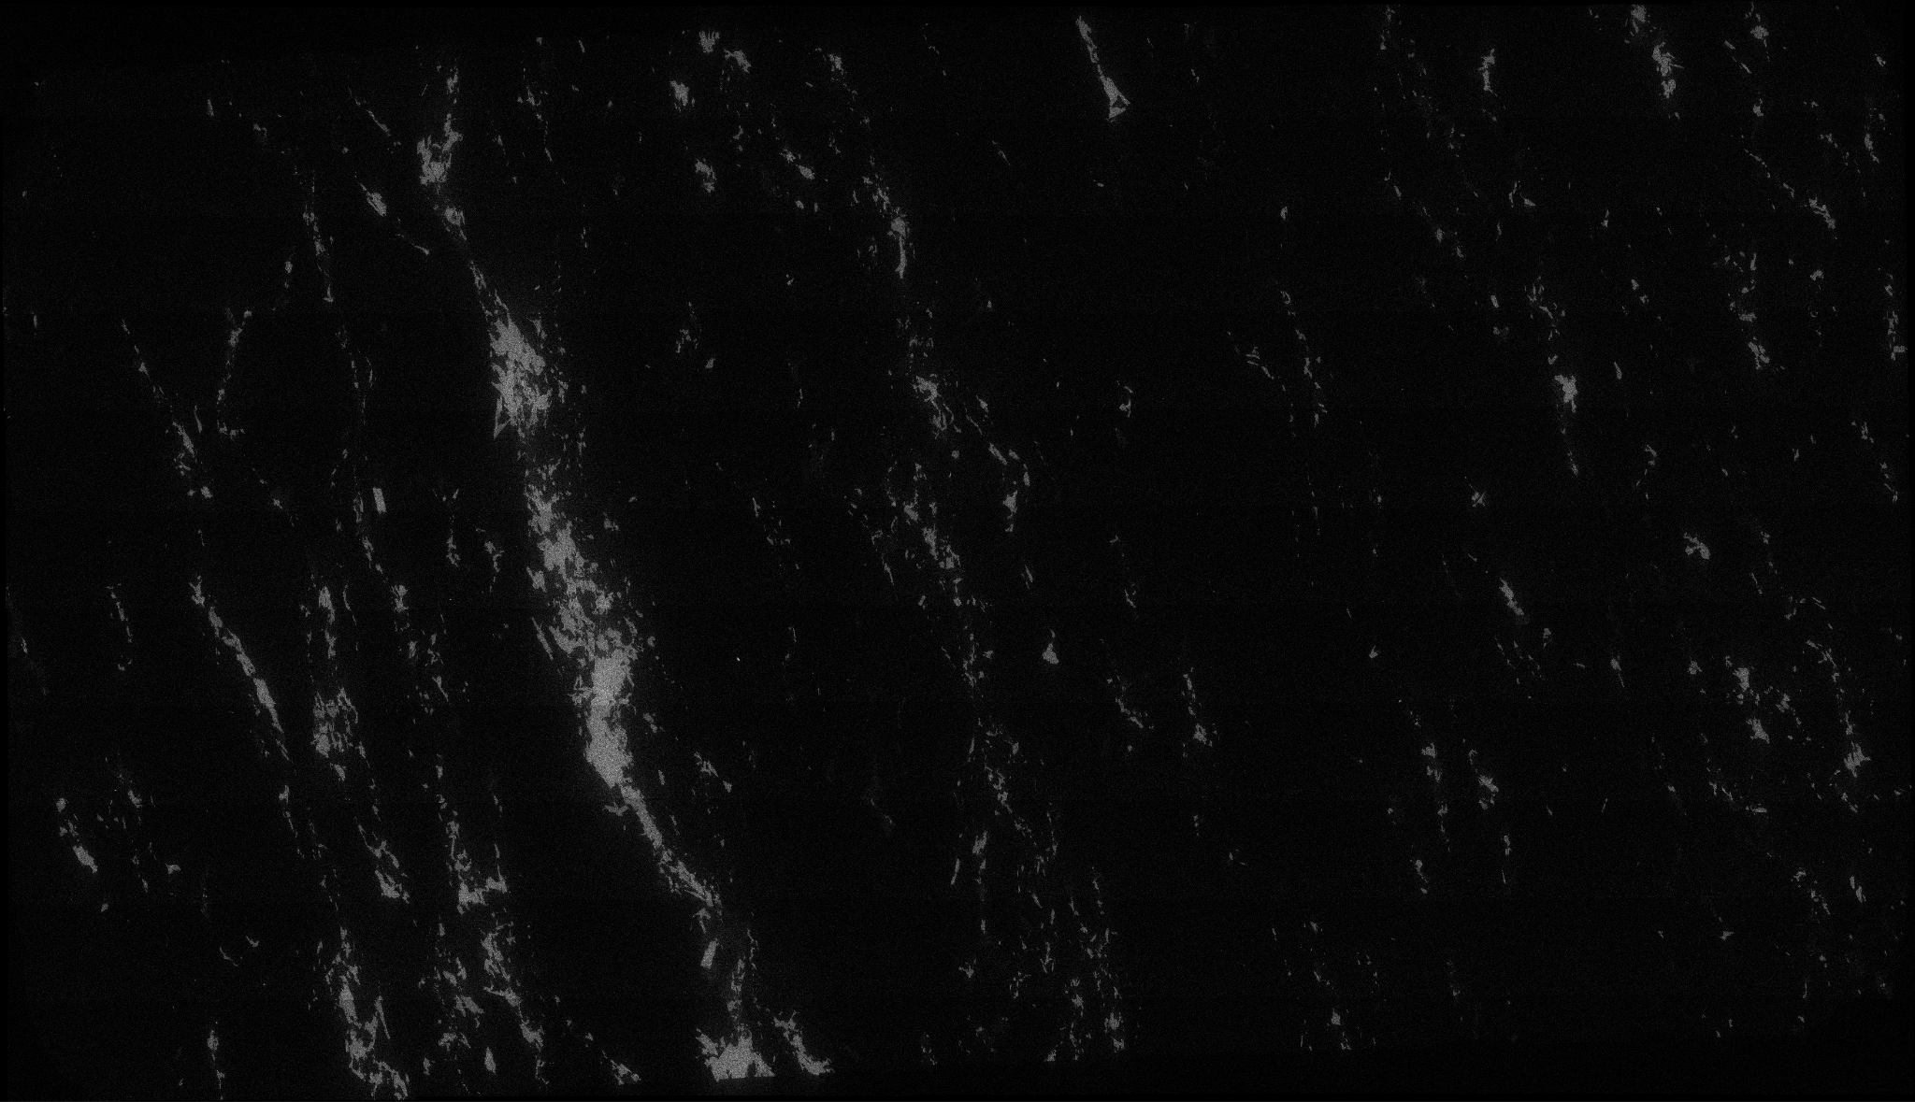
(Luis) USING THE CSV FILE
-From the csv File we can now create Euler angle images and heat maps of the different chemicals
Euler Phase’s
Iron(FE)
Silicon(SI)

Slide 17
EULER IMAGES
STEPS TO CLEAN UP THE IMAGE:
First step quantize the image
Max_neighbor function that uses a 3x3 sliding window, the center pixel is then turned to the maximum color that occurs in the window.
Then we can reduce even further by erasing labels with a certain area.First you have to do this to a labeled version of the image then used that mask as a way to erase labels.

Slide 18
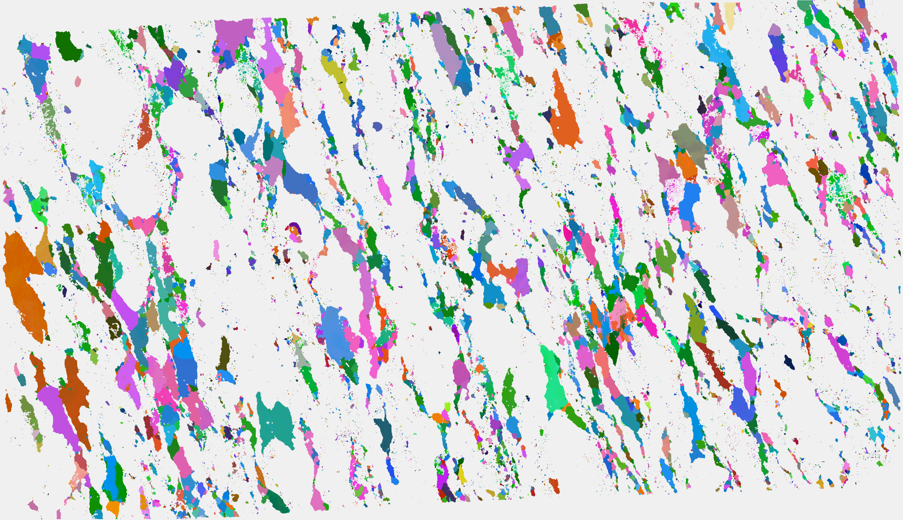
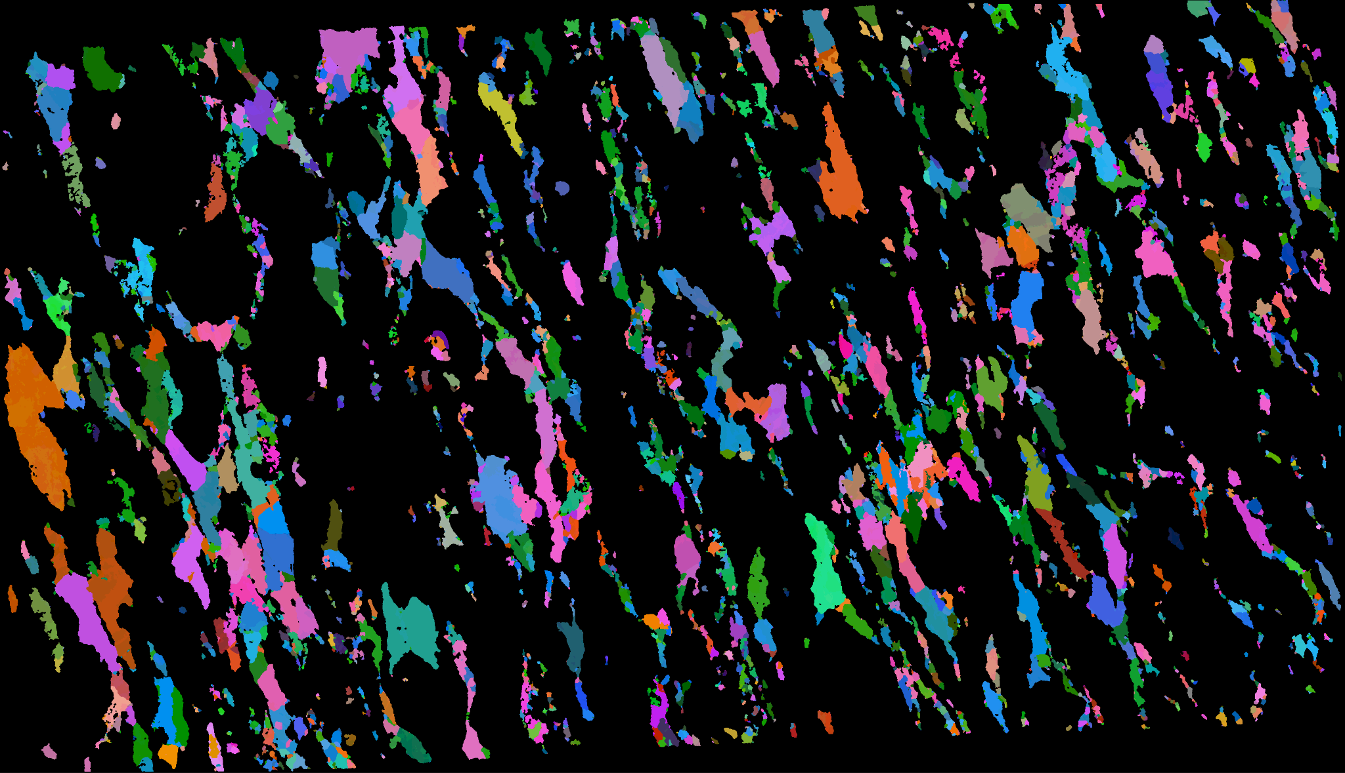
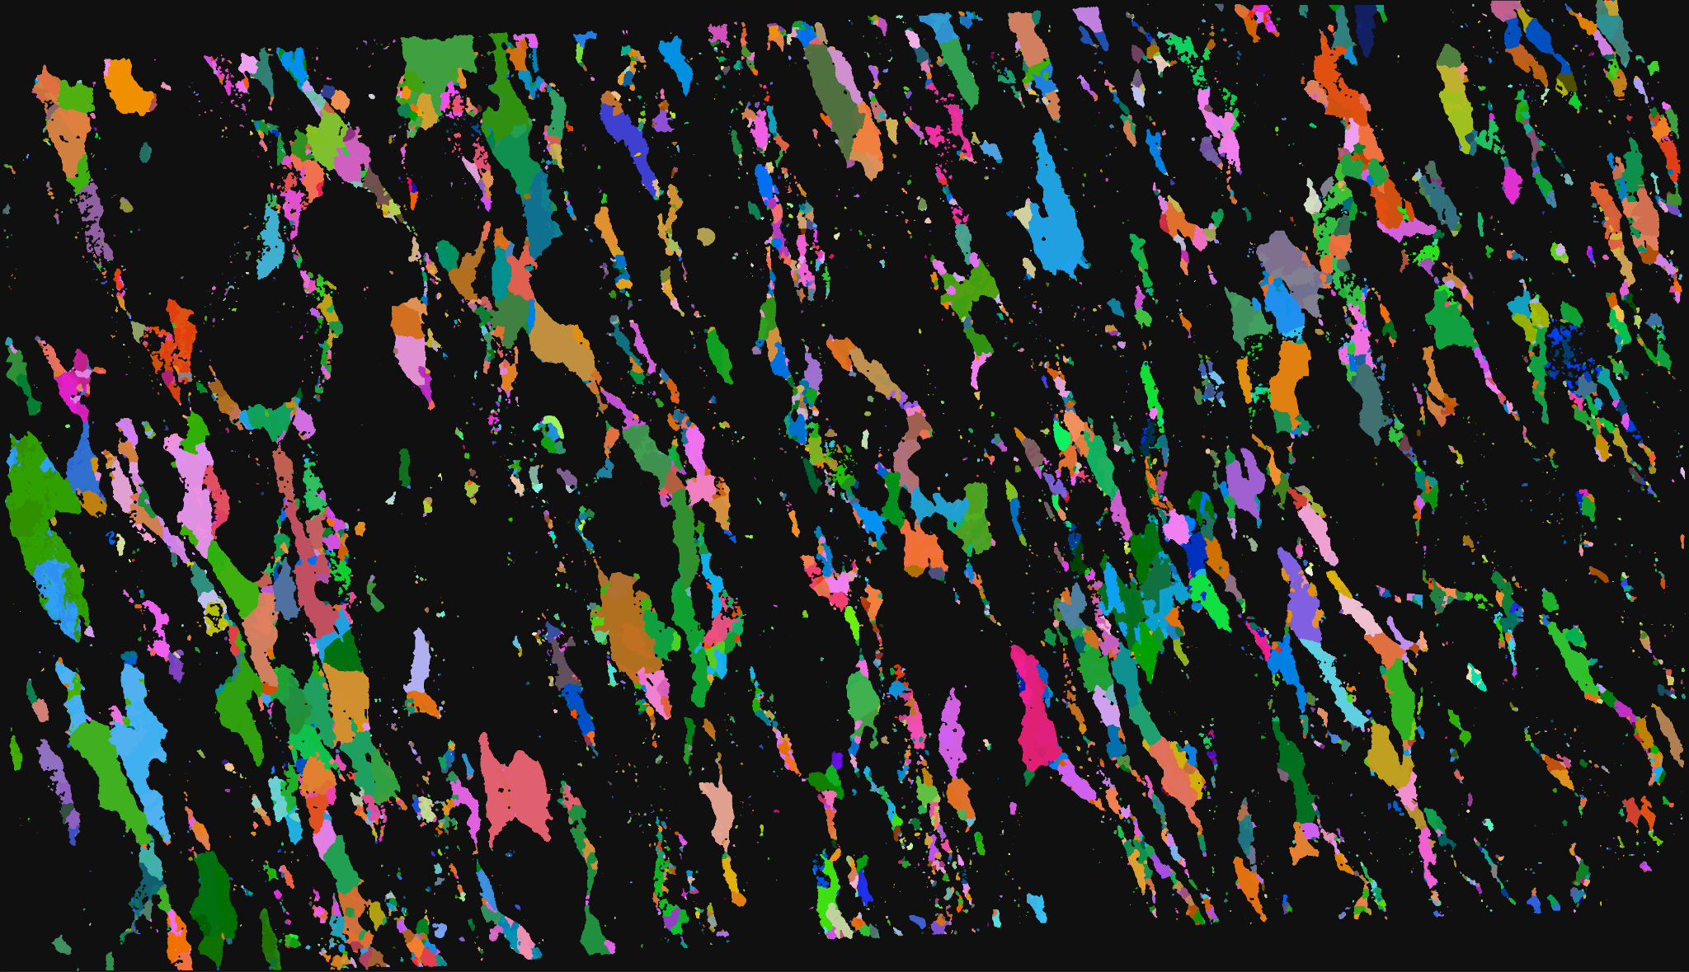
original
Quantized
Reduced
Max filter

Slide 19
CHEMICAL IMAGES
Same exact process can be applied to the chemical images just no need for quantization
Instead we threshold and get rid of pixels under a certain value
STEPS TO CLEAN UP THE IMAGE:
Use a threshold to reduce image, any pixel below that threshold will be set to 0. Higher will be set to 1 creating a binary image.
Max_neighbor function that uses a 3x3 sliding window, the center pixel is then turned to the max pixel value that occurs in the window.
Then we can reduce even further by erasing labels with a certain area.First you have to do this to a labeled version of the image then used that mask as a way to erase labels.

Slide 20
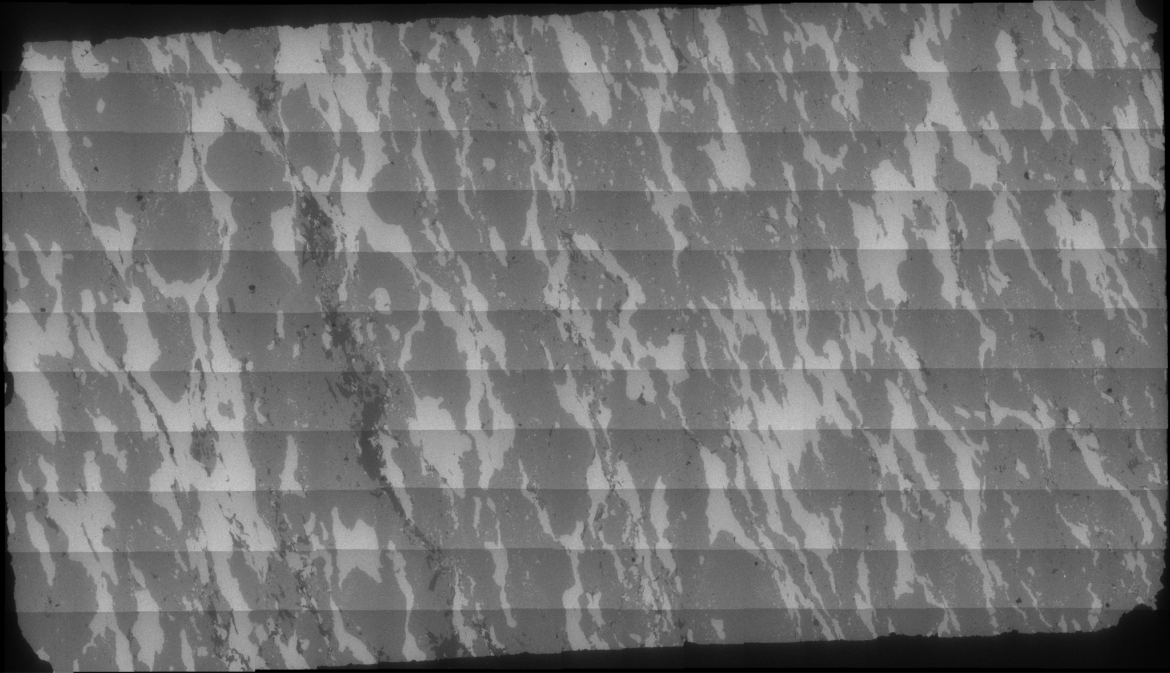
Original SI image
Reduced and turned to image

Slide 21
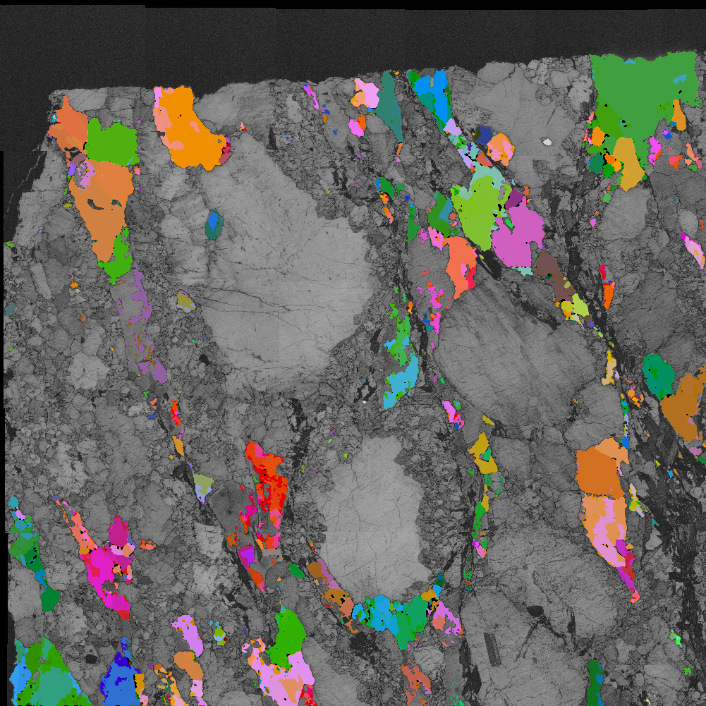
Overlaying the SI image with the band contrast we can see the segmentation is almost perfect and matched the euler pretty well
SI overlayed
Euler overlayed

Slide 22
By changing chemical images to binary and using XOR a mask of only SI can be created
SI before XOR:
Final SI mask:

Slide 23
Then use a binary version of EULER image and use AND to create a mask that is of only regions with only SI and euler angles

Slide 24
JOEL
Grain Boundary Segmentation
Techniques covered:
Watershed Segmentation
SLIC Segmentation
Felzenszwalb Segmentation
Utilizing Chemistry To Create Overlays

Slide 25
Watershed
The first approach used Watershed segmentation in an attempt to isolate the boundaries of the grains.
Utilizes elevation map derived using Difference of Gaussians filter and a threshold mask to find boundaries
Morphological operations performed before labeling the regions created from the mask (binary_fill_holes)
Overlay the labeled mask onto the original image

Slide 26
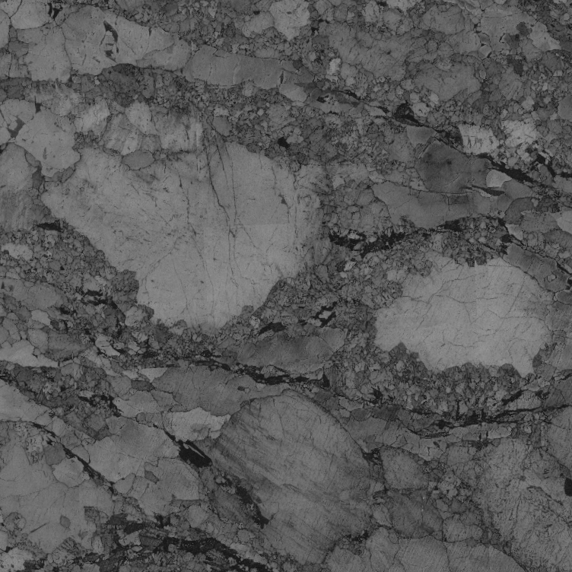
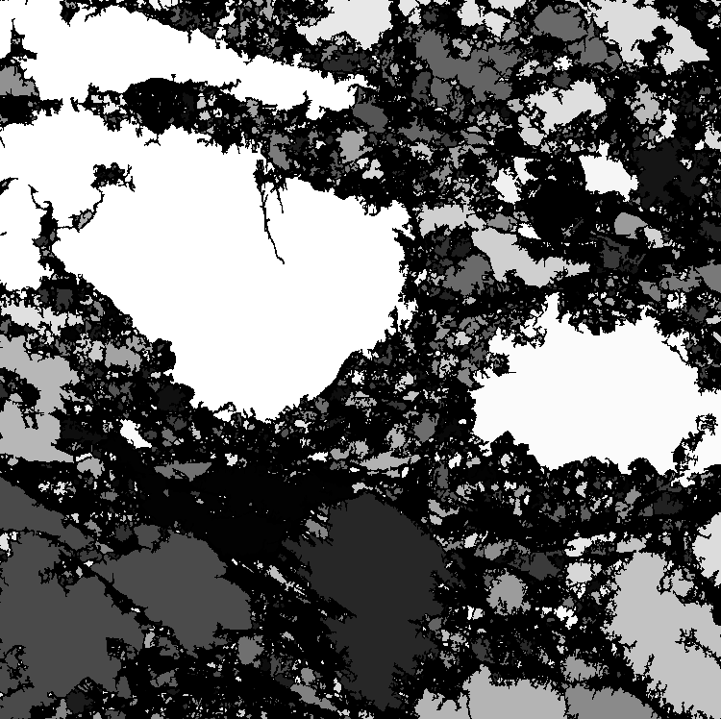
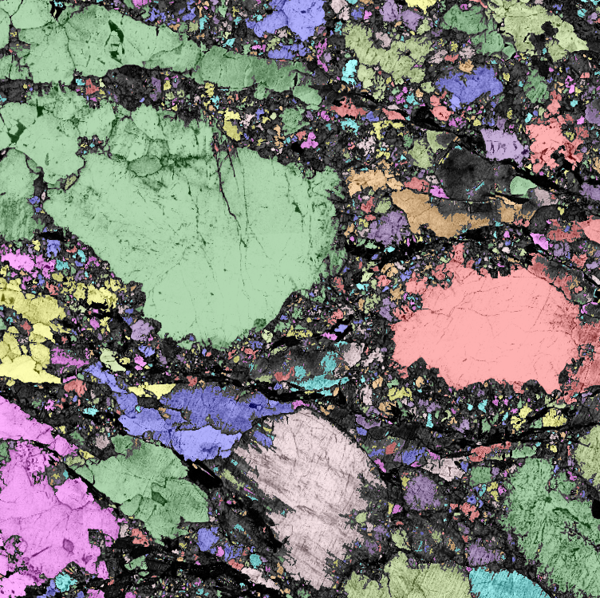
Watershed
Continued…
Original
Mask
Labeled

Slide 27
SLIC
SLIC (superpixel) segmentation showed promising results with great boundary detection, even when they did not really exist.
Histogram equalization provided the best boundary contrast
Create a threshold mask and use morphological operations performed before segmenting: remove_small_objects, remove_small_holes, opening
Create two segmentations: one with and without the mask (slic, m_slic)
Mark the boundaries using the equalized image and slic and overlay the boundary contours using m_slic

Slide 28
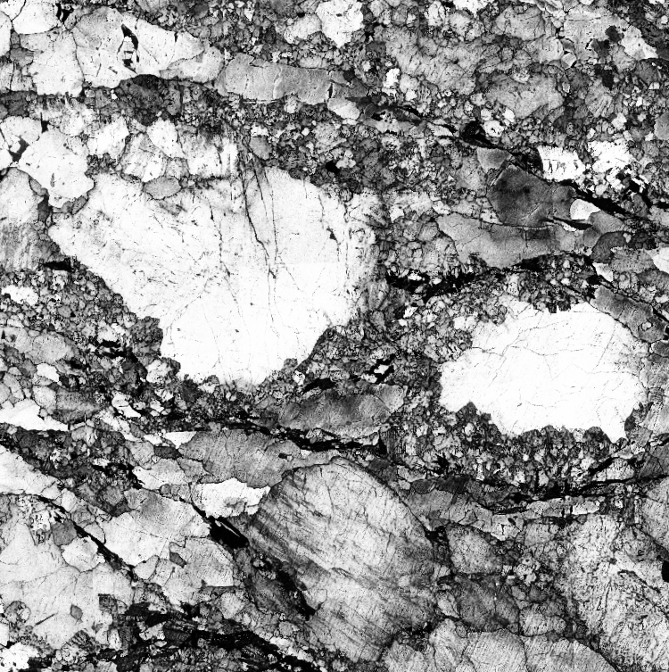
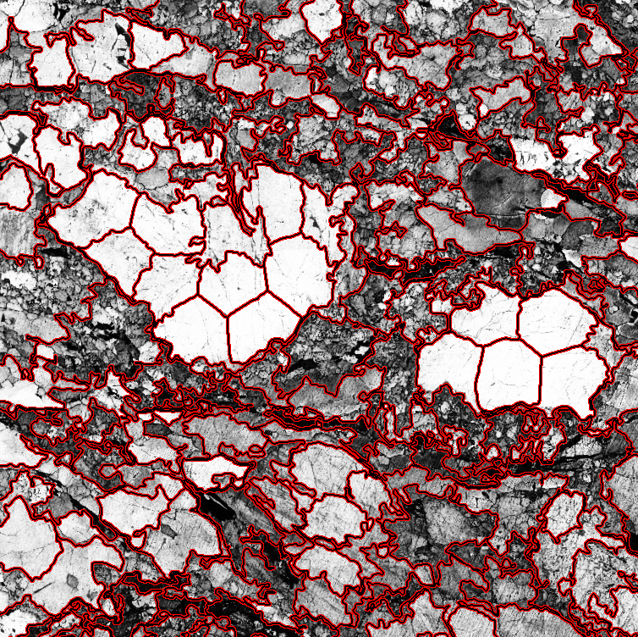
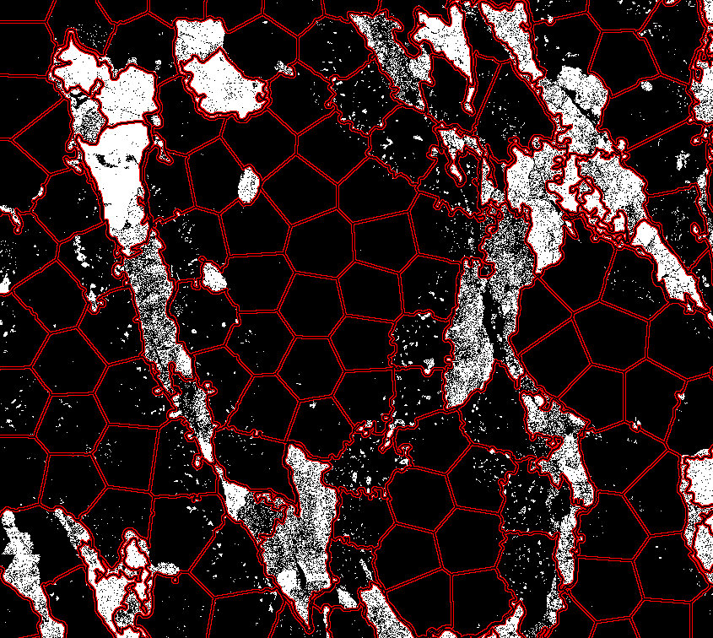
SLIC
Continued…
Equalized
Contours
Artifacts

Slide 29
Felzenszwalb
Felzenszwalb segmentation showed the best results over all other methods tested with minimal artifacting.
Convert RGB image to grayscale
Equalize the histogram
Call the segmentation function to obtain the mask
Mark the boundaries of the equalized image using the mask
Overlay the segmented labels

Slide 30
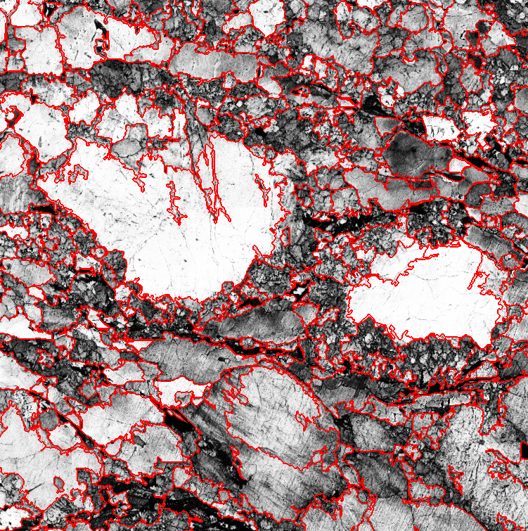
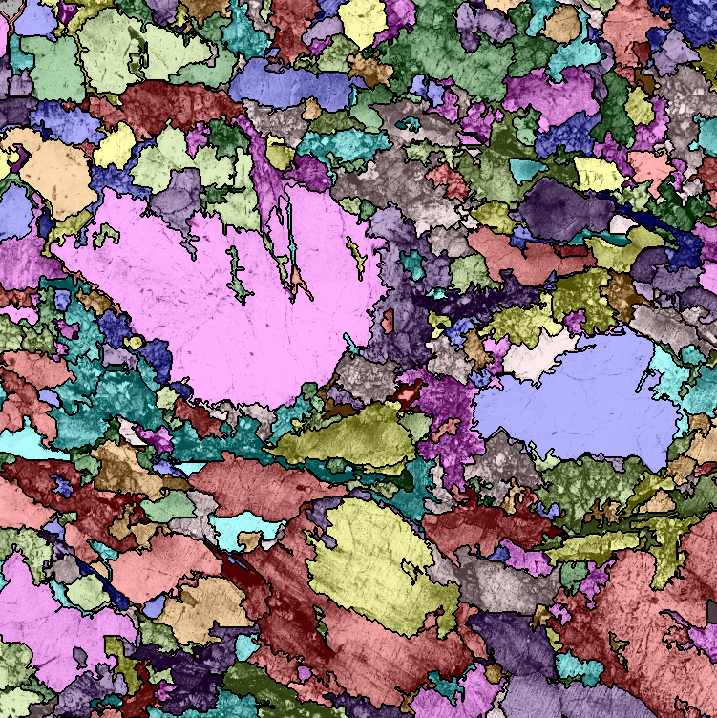
Felzenszwalb
Continued…
Equalized
Boundaries
Marked and Labeled

Slide 31
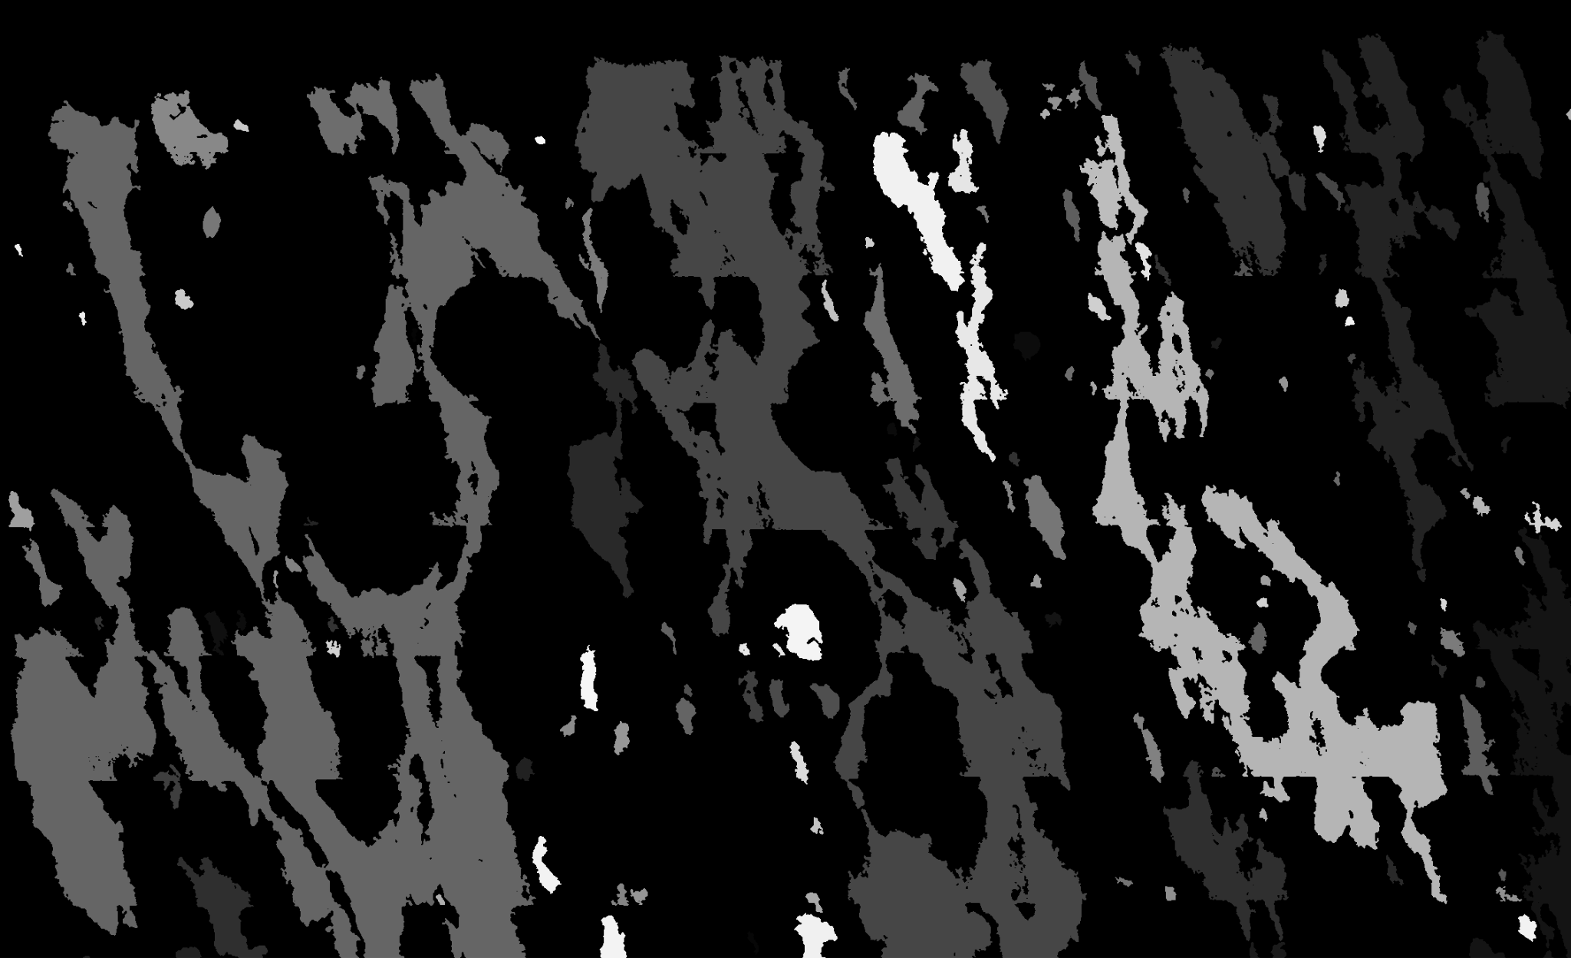
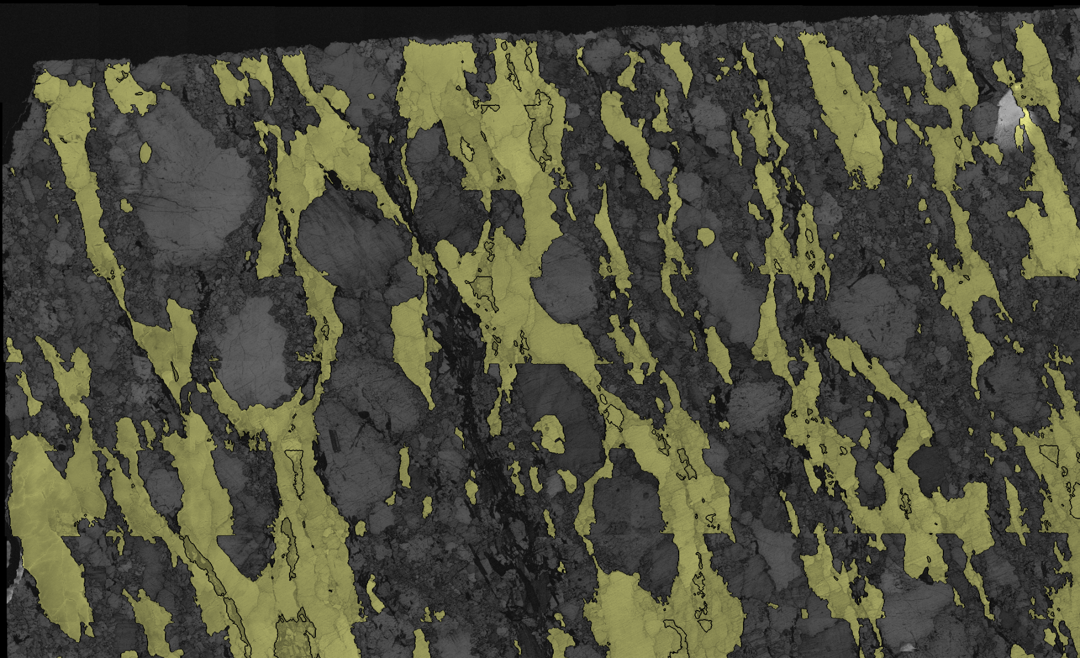
Using The Chemistry Images
By utilizing the labels and boundary images produced by using Felzenszwalb segmentation create clear boundaries of the only the target chemistry. This is performed using the segment_boundaries() function.
Silica Mask
Silica overlay

Slide 32
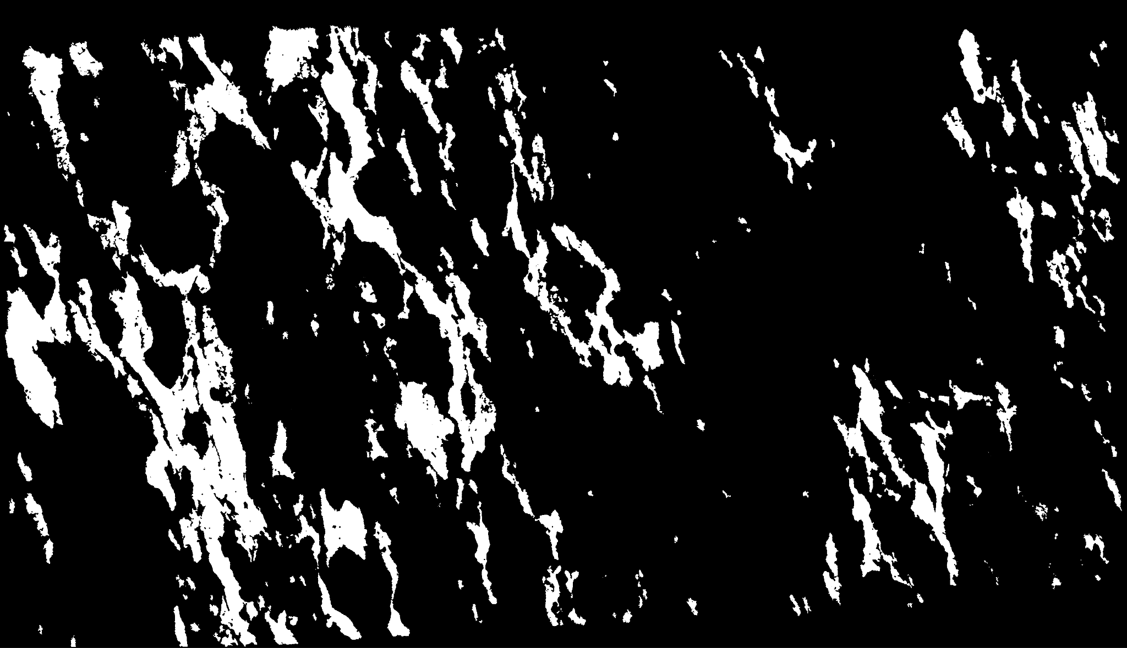
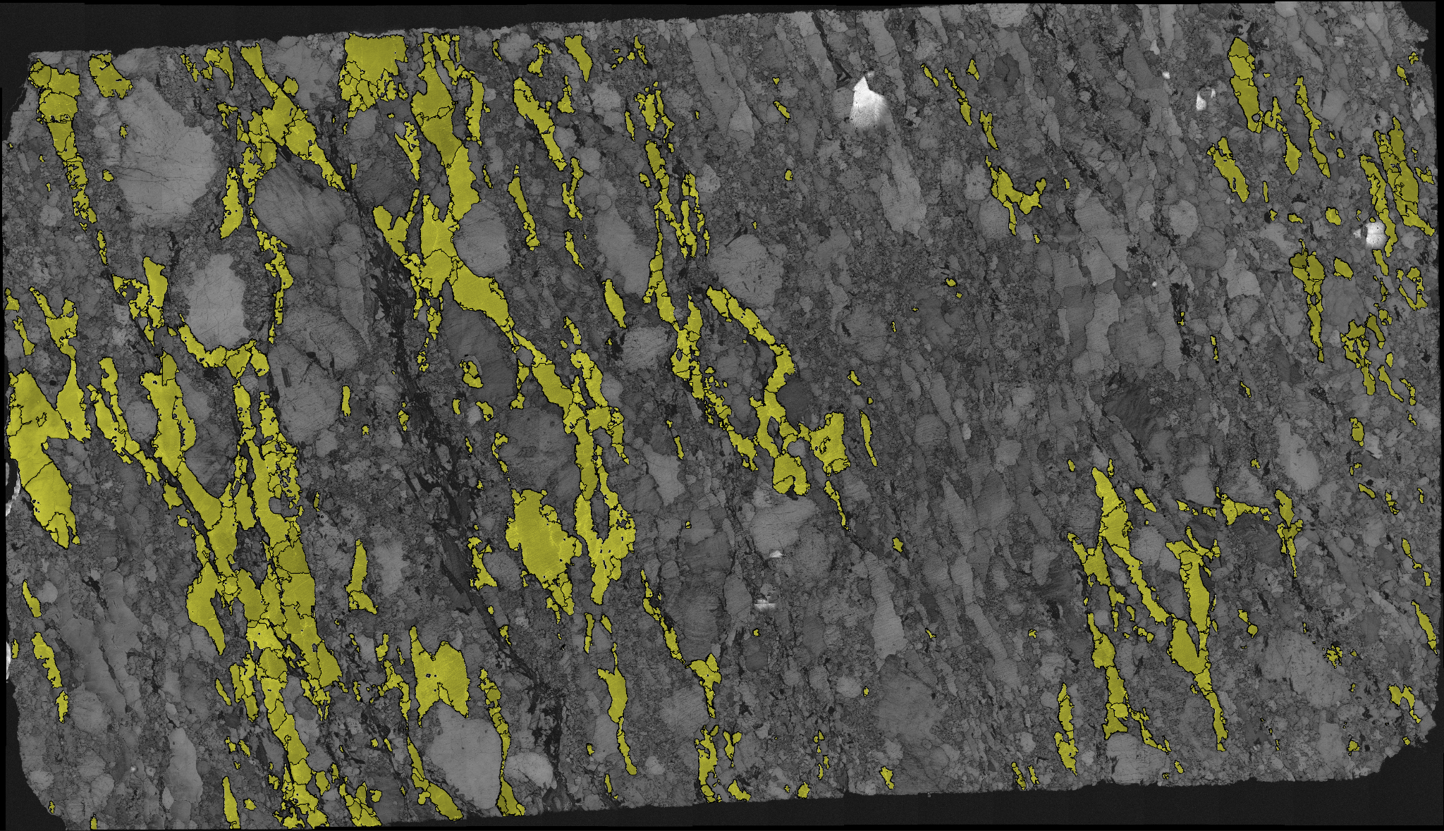
Using The Chemistry Images
Continued…
This technique is further refined with the function segment_and_overlay_chemistry(), which uses the band contrast and the mask of the Euler angles to isolate and define the boundaries of only target chemistry.
Euler Mask (SI)
Euler overlay (SI)

Slide 33
To The Future!
Improvements can certainly be made to this method of segmentation. For example:
If the batch mode of segment_boundaries() is useful, implementing multithreading will greatly improve processing time.
Combining all of the chemistry overlays into one. Might not be worth much, but it will look cool.
Stardist may need to be trained for many thousands epochs in order for it to finish training.

Slide 34
References
https://scikit-image.org/docs/
Stardist Github: https://github.com/maweigert/neubias_academy_stardist
Stardist Video: https://www.youtube.com/watch?v=Amn_eHRGX5M
Kaggle Dataset: https://www.kaggle.com/code/peterwarren/multiple-edge-detection-methods
QuPath: https://www.youtube.com/watch?v=9G6uaoC18WA
SAM:
https://www.youtube.com/watch?v=83tnWs_YBRQ
https://github.com/facebookresearch/segment-anything

Slide 35
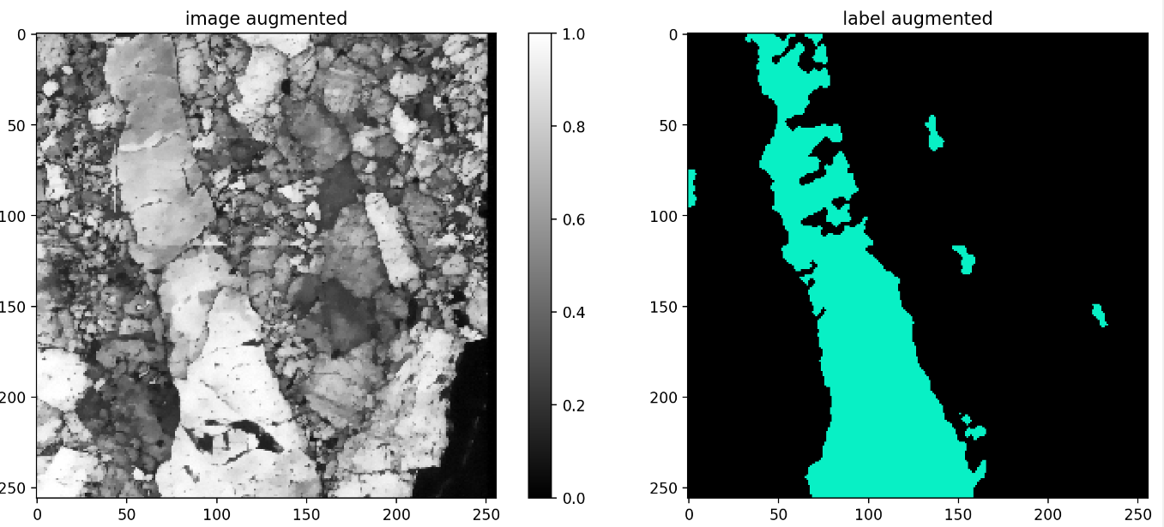
Additional data
Attempting to train stardust on the masked produced by louis’s algorithm provided these results. These results were likely less accuraturate due to not all the labels being bery star convex.

