Slide 1
ABGQI Classification
Sean, Zach, Chris

Slide 2
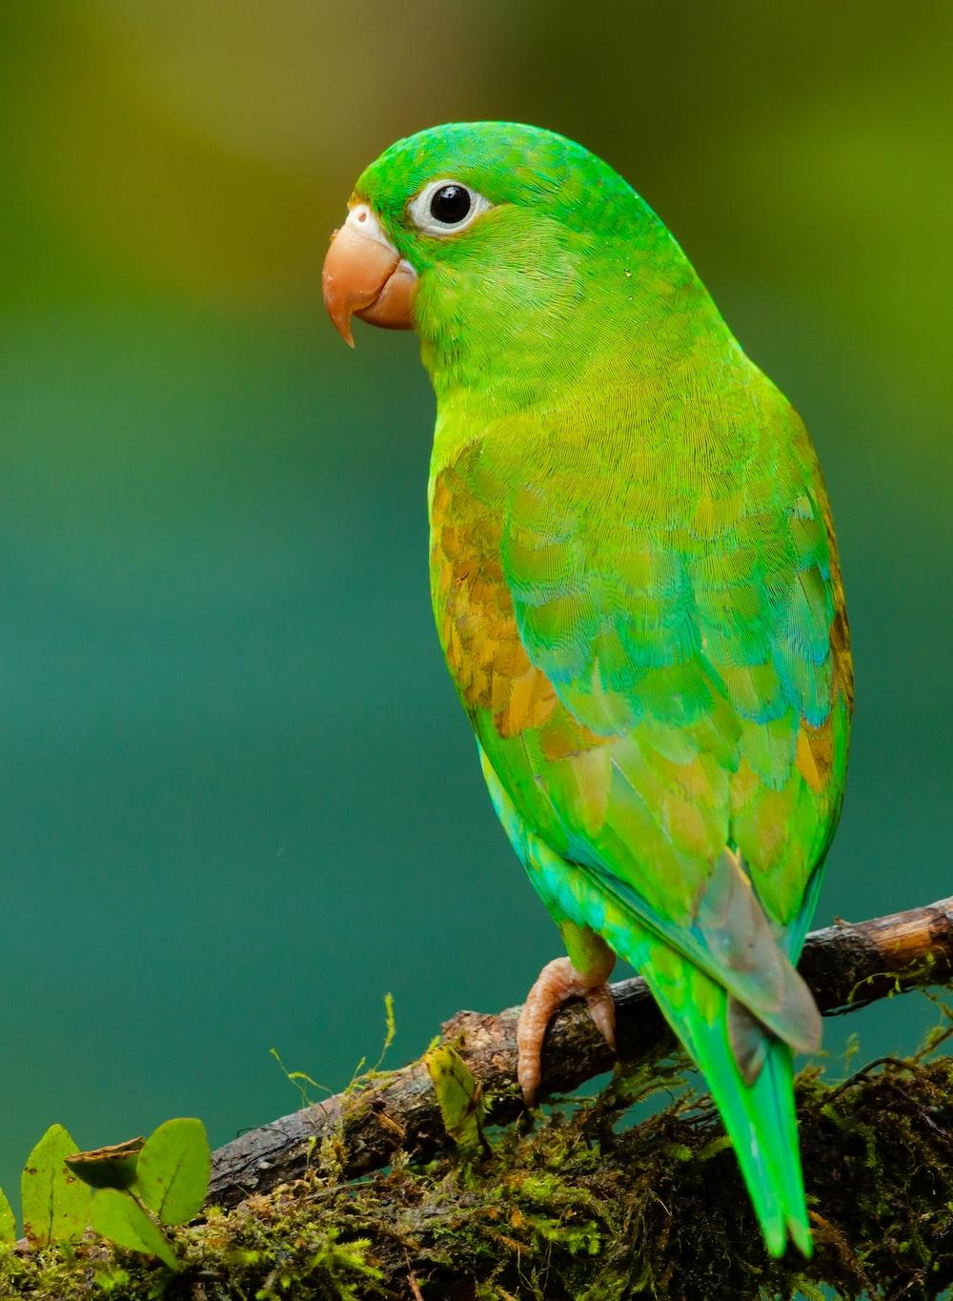
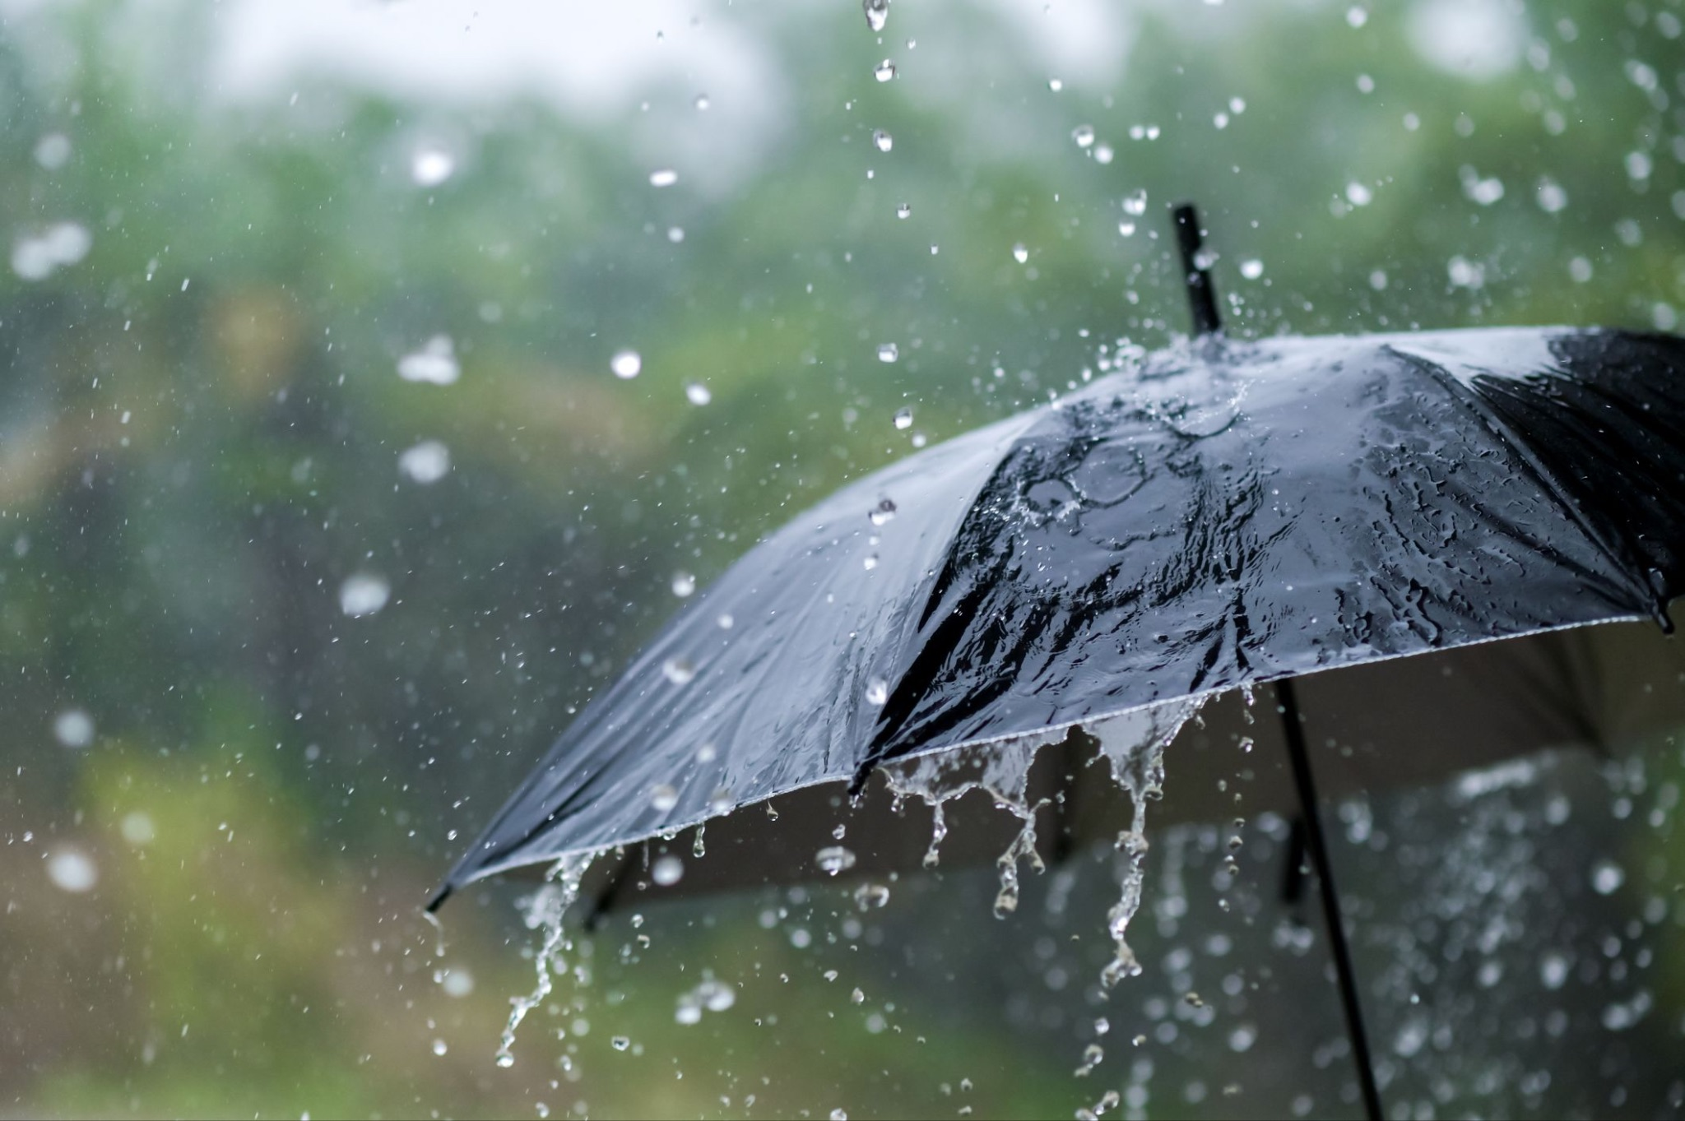
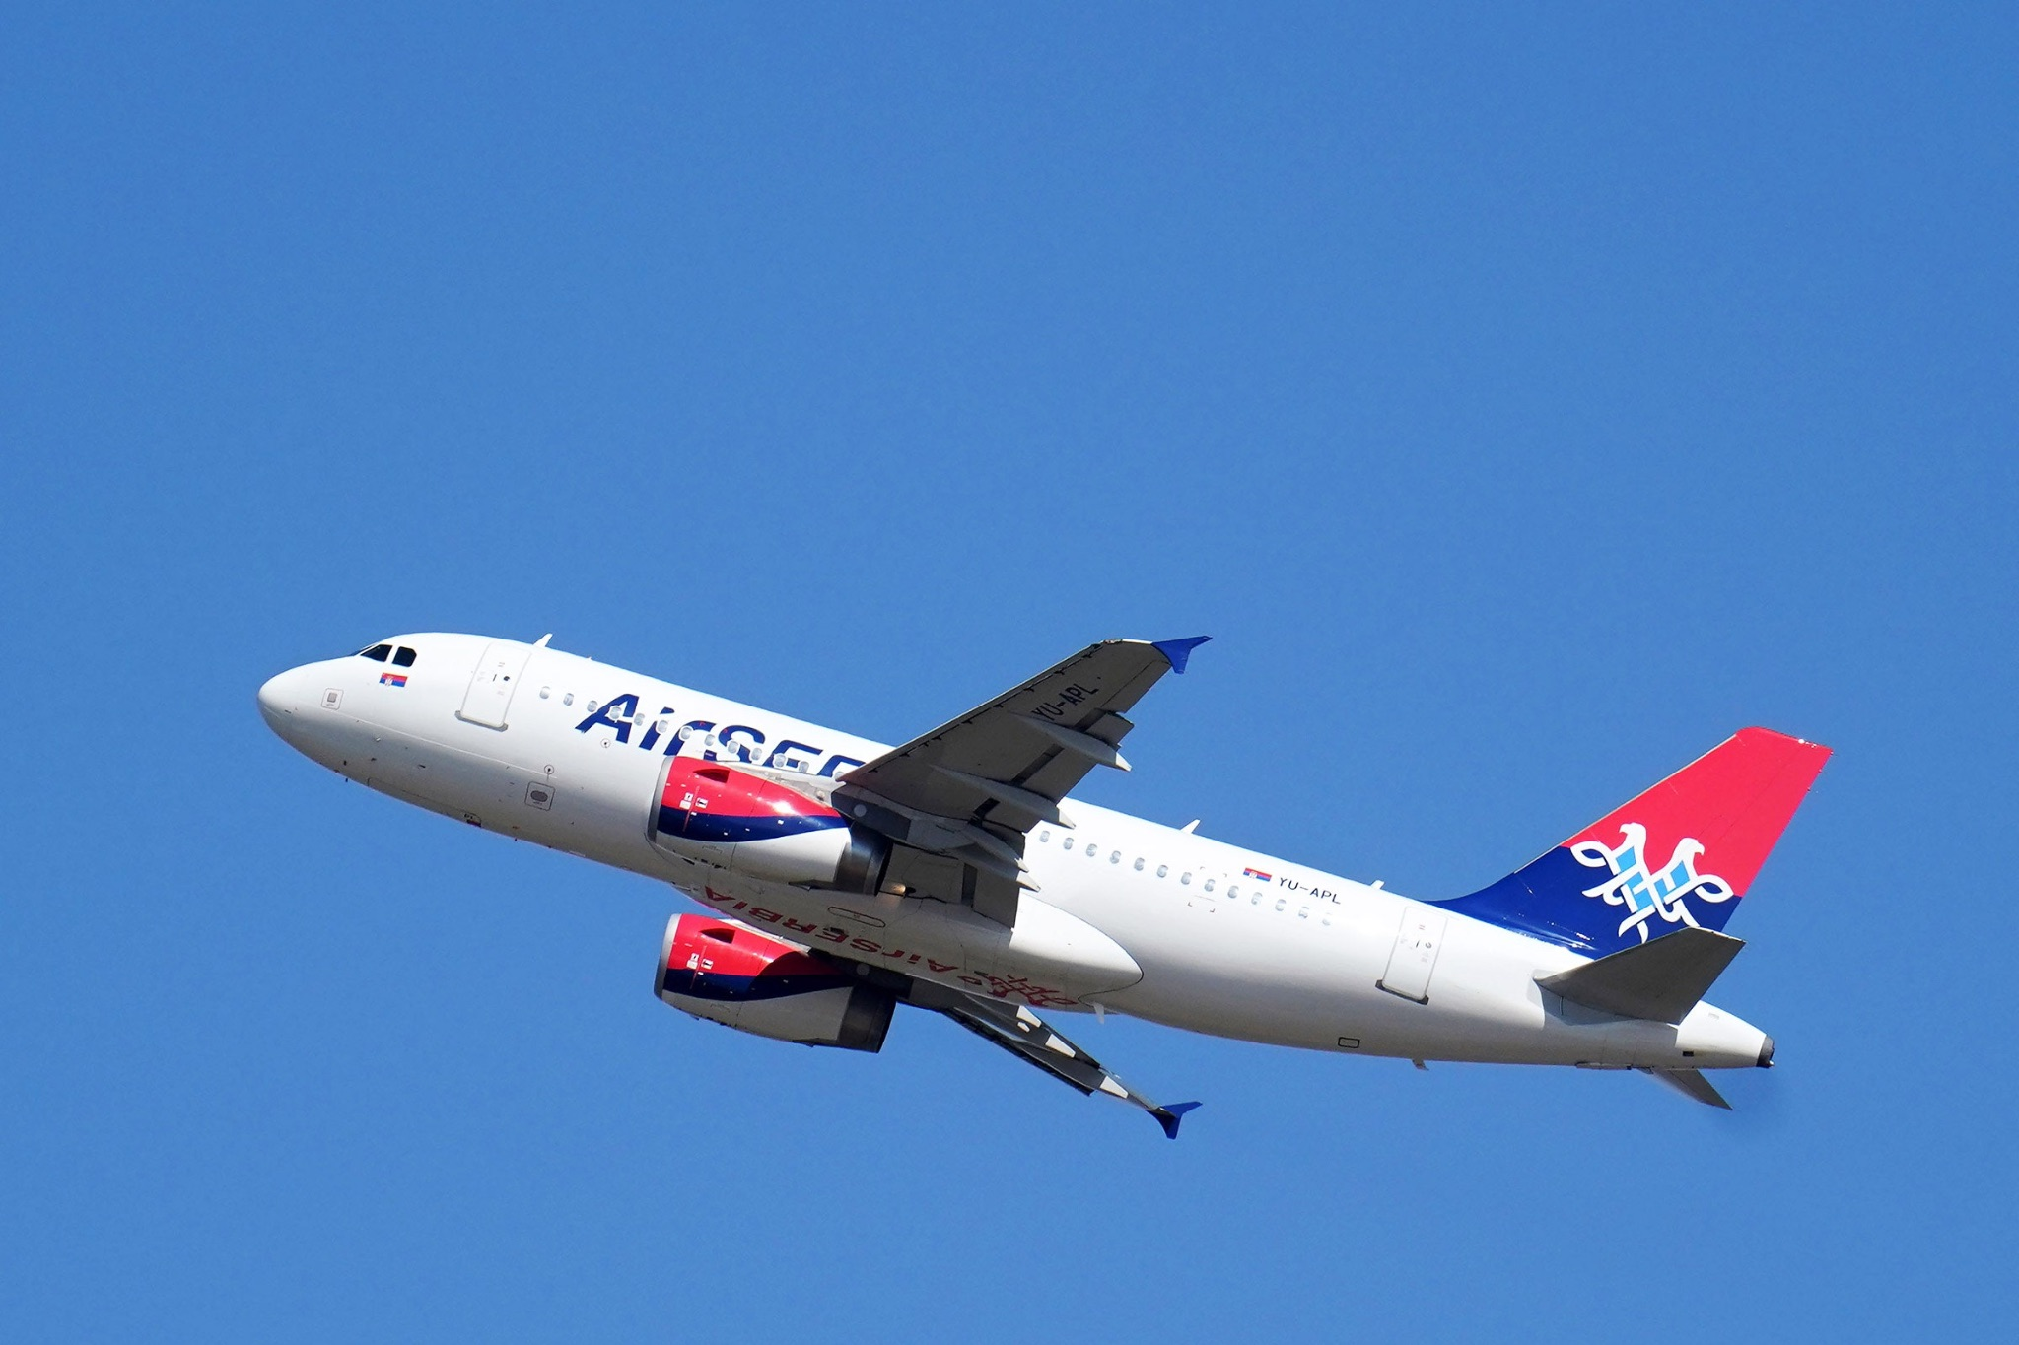
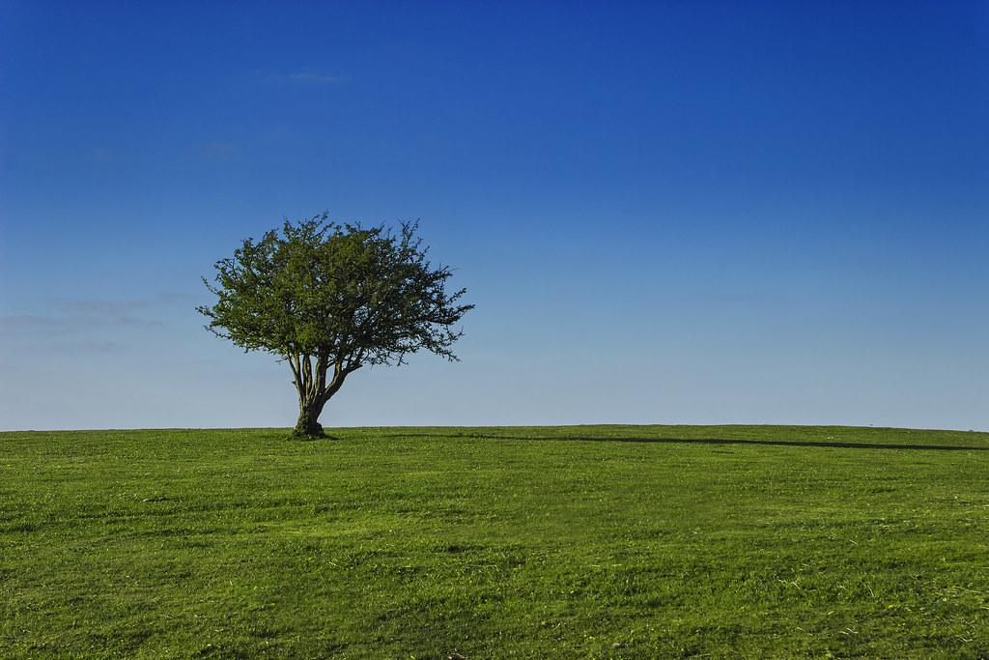
What is ABGQI
Biophony
Geophony
Anthropophony
Quiet
Birds, insects, mammals, amphibians
Wind, rain, water in streams
Cars, airplanes, human voices (man-made)
Absence of sound
Interference
Banging noises

Slide 3
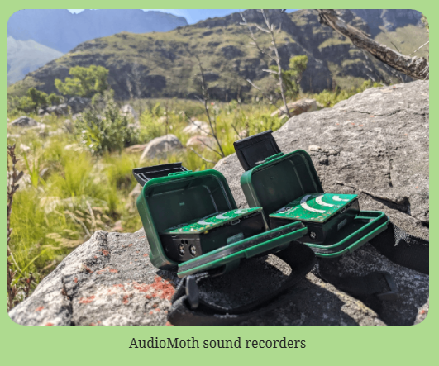
Our Problem
For this project we had to build a model to identify certain ABGQI noises in South Africa audio clips.
We had a model that was built on Sonoma County ABGQI noises which would be very different from those in South Africa.
Recorder used in South Africa

Slide 4
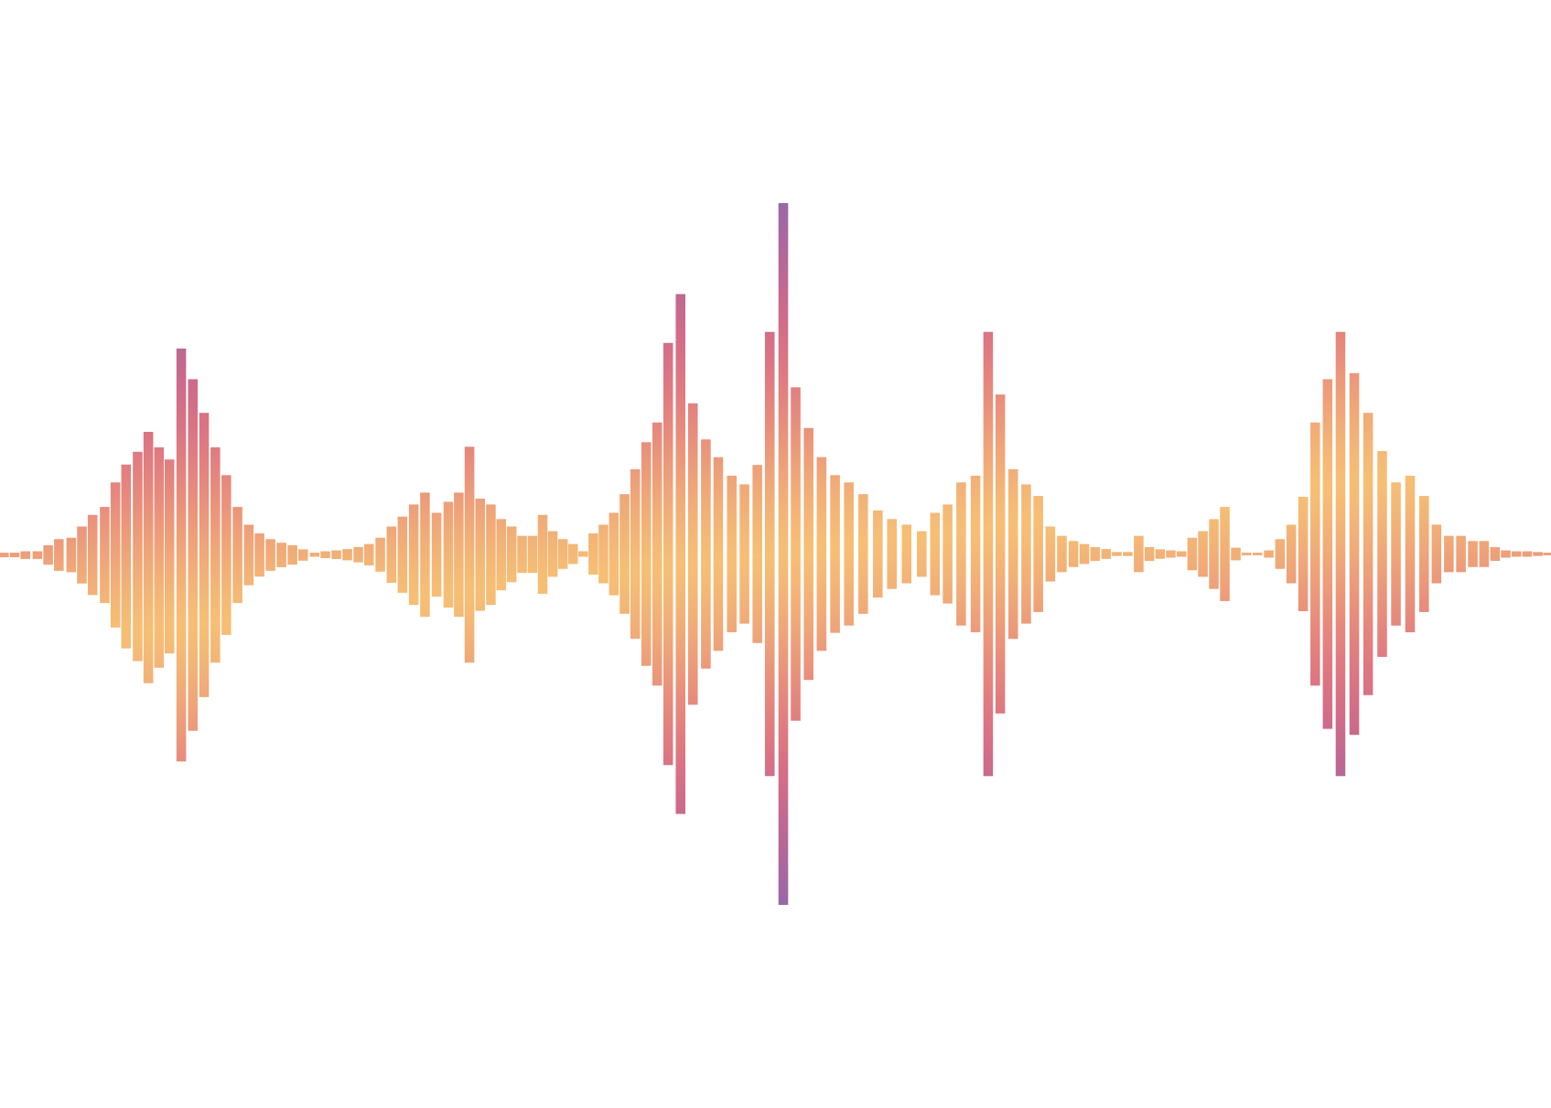
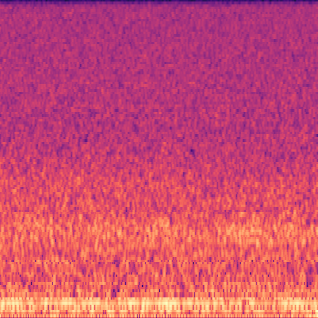
Steps to the CNN
A short example of both biophony and geophony—
—which is interpreted as an audio wave
CNN
SVM
— is converted to a mel-spectrogram:

Slide 5
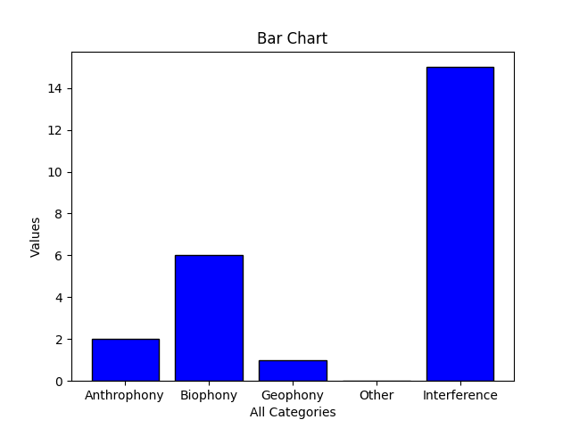
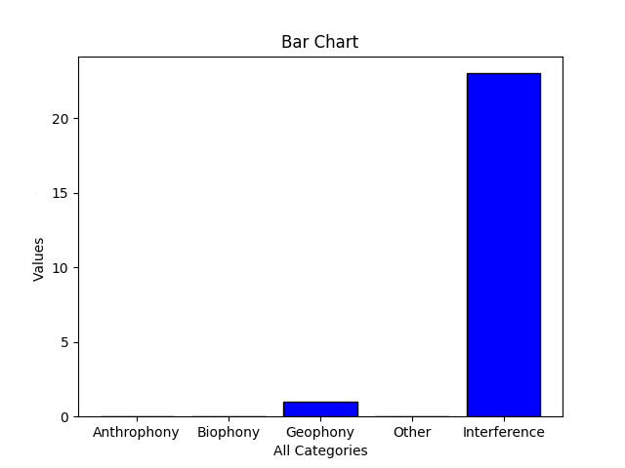
Histograms
We also generated a Histogram for each of the Audio clips with thresholds in place to determine whether or not an instance of a noise should be recorded or not.
These histograms allowed us to understand what is happening the most throughout an audio clip.

Slide 6
Confusion Matrices (1 of 3)
Generated 1 minute spectrograms of the labeled wav files and compared the results we obtained from Colin’s model with the labeled data
Colin’s CNN had five classes in the final layer: Anthropophony, Biophony, Geophony, Quiet, and Interference
We omitted Quiet since the labeled data didn’t take Quiet into account
Used thresholds from Colin’s paper for each class, and if model predicted a class was above it’s given threshold, we would count it as an occurrence
Each spectrogram could be classified as multiple classes of A, B, G, or I
Created confusion matrices for A, B, G, and I

Slide 7
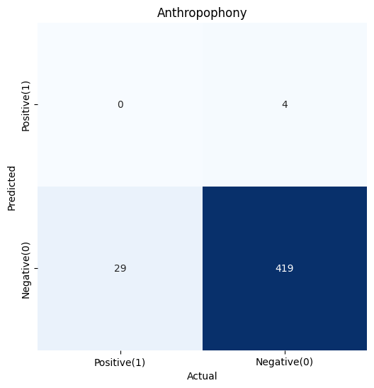
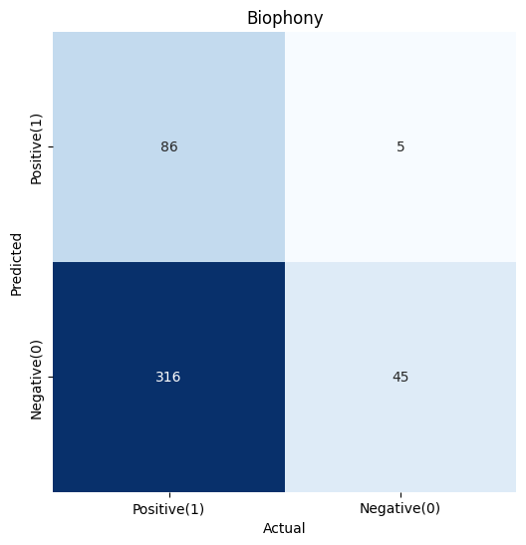
Confusion Matrices (2 of 3)
Precision: 0.0 Precision: 0.94505
Recall: 0.0 Recall: 0.21393
Accuracy: 0.92699 Accuracy: 0.28982

Slide 8
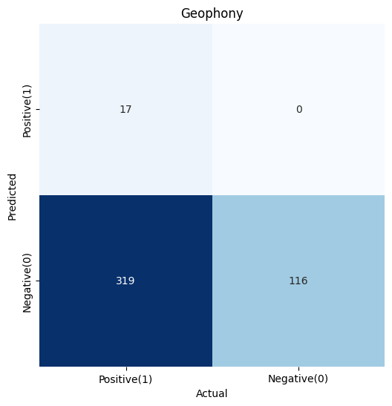
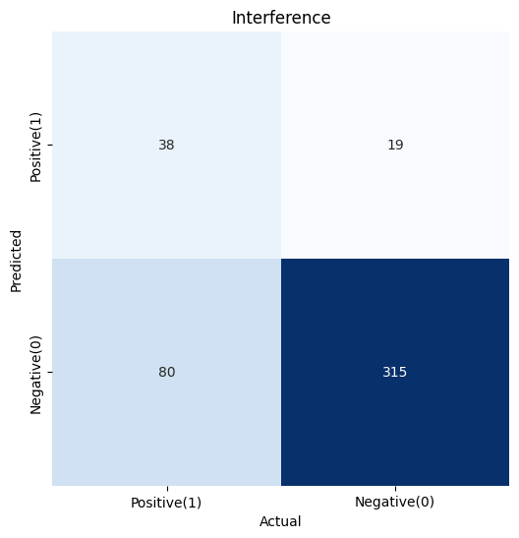
Confusion Matrices (3 of 3)
Precision: 1.0 Precision: 0.66666
Recall: 0.05059 Recall: 0.32203
Accuracy: 0.29424 Accuracy: 0.78097

Slide 9
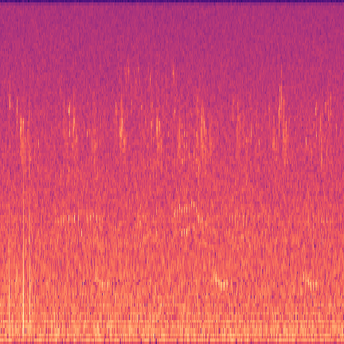
Our SVM (Support Vector Machine)
For this part of the project we decided to create a SVM, which allowed us to use it as a feature extraction tool.
Our SVM is built on top of Colin’s pre-existing model that he used to classify ABGQI sounds.
We were able to use the SVM to classify the labeled Dataset of sound clips from South Africa
To do this we need to convert the audio clips into spectrograms.
Example spectrogram

Slide 10
Conclusion
This project is an aid to the BioSoundSCape team–located in the Cape Region of South Africa–to measure animal diversity over large areas using a combination of acoustics and advanced remote sensing technology.
Throughout this project, we have covered some fundamentals such as:
An understanding of the required data
Getting a better understanding the data itself
The application of an SVM to a smaller dataset
Looking at layers of a CNN and deciding which to remove

